Slide 1
Census Data API
KaNin Reese
Center for Enterprise Dissemination
U.S. Census Bureau
September 19, 2019
Notes:
Today’s presentation is focused on the Census Data API and how you can use it to get the data that you need.

Slide 2
Outline
API Basics
Building an API Request
API Demo
Resources for Learning More
Other Options to Download Data in Bulk
Real World Examples
Notes:
We are going to cover…

Slide 3
Application Programming Interfaces
Free, publically accessible, open source services:
Census Data API
Raw statistical data from programs and surveys across the Bureau.
Geocoder
Translates addresses and other location formats into latitude/longitude parameters.
TigerWeb Services
Census area boundaries and shapes for mapping referenced by FIPS codes.
Notes:
Based on technological advances and customer pushes to make data more easily accessible, the Census Bureau is leveraging these underlying services for open source data -- for data scientists to use and also for developers to make their own applications.
And the future of dissemination at the Census Bureau is based on using these services to fuel our own applications, including what you heard about earlier today with data.census.gov.
Applications built on Census data typically take advantage of three underlying services: Census Data API, TigerWeb REST Services and the Geocoder REST Services:

Slide 4
Census Data API
Census Data API
Data service that allows software developers and other users to access public data in a standardized way.
Uses:
Supports mobile and web applications (internal and external)
Drives interactive data visualizations
Connects to statistical analysis software like SAS and R
Advantages:
Access only the variables and geographies needed
Immediate access to updates
No need to host data on another server
Notes:
Of these services, the one I want to focus on today is the Census Data API. For today’s presentation you will hear me refer to the Census Data API simply as the API.
So what is it? The Census Data API is a data service that allows software developers and other data users to publically access our data in a standardized way using a series of commands. It is an extremely efficient way to request data directly from Census servers. And the standardization across multiple data sets allows you to access data in the same way regardless of the survey or the data.
Uses and Advantages -

Slide 5
Census Programs in the API
Demographic Programs
American Community Survey
Decennial Census
Health Insurance Statistics (from Current Population Survey, Survey of Income Program Participation, American Community Survey, Small Area Health Insurance Estimates)
International Database
Population Estimates and Projections
Poverty stats (from Current Population Survey, Small Area Income & Poverty Estimates)
Economic (Business) Programs
Annual Survey of Entrepreneurs and Annual Survey of Manufacturers
Business Dynamics Statistics
County Business Patterns and Nonemployer Statistics
Economic Census and Economic Indicators
International Trade
Quarterly Workforce Indicators
Survey of Business Owners
Other Programs
The Planning Database
Notes:
Currently the Census Data API has 370 data sets available for public use.
And from these datasets, we are able to access a wide variety of data, including American Community Survey, Population Estimates, and Migration Flows.

Slide 6
Available Geographic Areas
Nation
Metropolitan and Micropolitan Areas
American Indian/
Alaska Native Areas/
Hawaiian Home Lands
Zip Code Tabulation Areas
Urban Areas
Regions
States
Congressional Districts
School Districts
Places
Counties
Public Use Microdata Areas (PUMAs)
Alaska Native Regional Areas
State Legislative Districts
Census Tracts
6
Block Groups
Blocks
Notes:
The API is available in all ascribed geographic areas. I say ascribed because not every survey or program is available at every summary level but it is available for whatever summary level released with Decennial Census being the only program that releases our smallest geographic level which is block level.

Slide 7
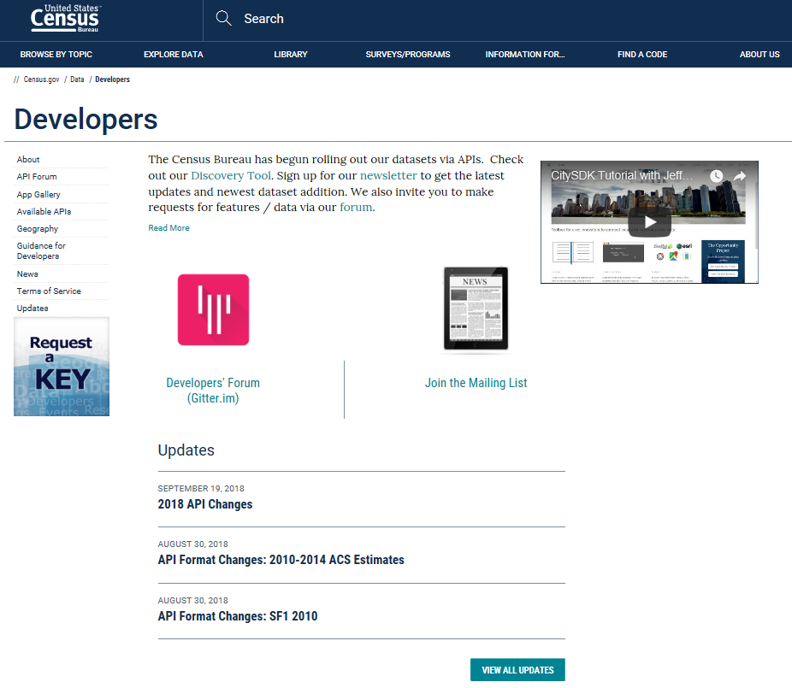
Developers Page
Accessing our API
Request a Key
For more than 500 queries per day
No throttling/limitations
Browse the Discovery Tool
List of available datasets/endpoints (370 as of 9/12/2019)
Descriptions, etc.
Review the Updates Periodically
Join the Mailing List
Check your Spam folder for alerts
Share your Experiences
Developer s Forum
Developers Home Page
https://www.census.gov/developers/
Notes:
So How to use our Data API – First you begin at our developers page.
-Access a key that allows you to access our data when you make more than 500 queries per day.
Check out the discovery tool:
Gives you a list of available datasets, descriptions, variables available. All you need to determine what data you need.
Also information about joining the mailing lists and the online developers forums (all ways we can stay connected to inform the user about changing, upcoming improvements and also for the user to share experiences, get help, etc.)

Slide 8
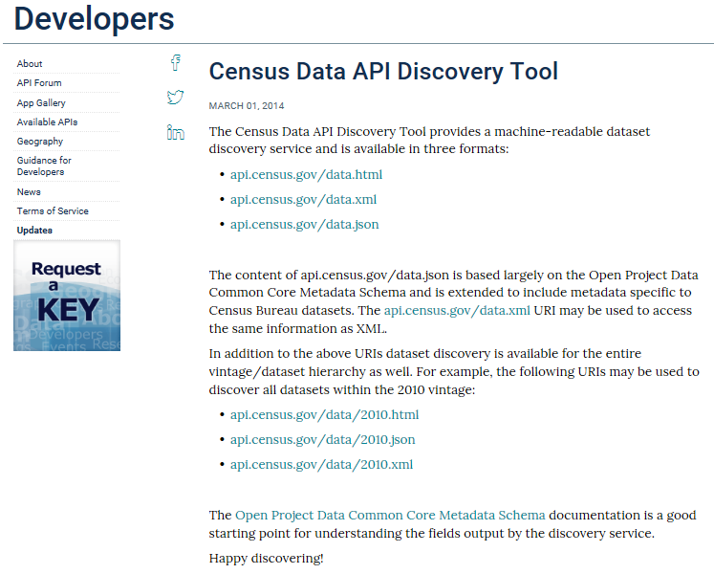
Discovery Tool
Information Provided
Dataset Description
Variables Included, Changes, Variable Formats, and Notes
Annotation Variables and Values
Cross-Tab Variables
Supported Geographies
Example Calls
Base URL for building queries from the dataset
Links to Program Technical Documentation
Notes:
The Developers Page gives guidance and direction on the dataset you’re looking for; however, the Discovery Tool provides, in one place, access to the complete list of datasets with immediate, direct access.
I want to take a moment to give you a short tour of the Discovery page. Follow along with me at api.census.gov/data.html. Firefox, Edge, and Chrome are the recommended browsers.
DEMO OF DISCOVERY TOOL
I want to take a moment to go over some of the basics of the Discovery Tool.
The datasets are sorted by year and then by dataset name. The dataset may be a single name or may be a name with a structure that is 2 or 3 levels deep (for example: acs/acs5/profile).
Once you determine the dataset you want to work with, the tool helps you with providing the geographies available, variables, examples,
There are also links to technical documentation here. These Developer Documentation links take you to Developers Page, and from there you click Available APIs and select the survey/program you are working with.
There are different ways to view the datasets on the Discovery Tool, which is important for drilling down to the dataset you want to work with.
https://api.census.gov/data.html – shows all datasets
https://api.census.gov/data/2018.html - shows all datasets for 2018
https://api.census.gov/data/2018/acs.html - shows all 2018 acs data sets
https://api.census.gov/data/2018/acs/acs5.html - shows all 2018 acs 5-year data sets

Slide 9
Outline
API Basics
Building an API Request
API Demo
Resources for Learning More
Other Options to Download Data in Bulk
Real World Examples
Notes:
Let’s now look at how to build an API request or a query.

Slide 10
How to Start Your Data Request
api.census.gov/data/2018/pep/charagegroups?get=POP,GEONAME,DATE_DESC&DATE_CODE=11&RACE=10&for=county:*&in=state:04
1
Requests always begin with: https://api.census.gov/data
Notes:
Using the guidance from the Discovery Tool, you can put together a request for data, which is creating a URL (or a call to the data). Let’s say you were looking for the data on the population for all counties in Arizona for the race, "Native Hawaiian and Other Pacific Islander alone or in combination"
You first start with https://api.census.gov/data. No matter what the dataset is, you start every request this way.

Slide 11
Add the Dataset Name
api.census.gov/data/2018/pep/charagegroups?get=POP,GEONAME,DATE_DESC&DATE_CODE=11&RACE=10&for=county:*&in=state:04
2
Find the dataset name at: https://api.census.gov/data/ 2018.html
Notes:
Add the year and the dataset . In this case we are using 2018 data from the Population Estimates Program – Demographic Characteristics Estimates by Age Group.
Again, please note that the year appears before the dataset name and that the dataset name may have 2 (pep/charagegroups) or 3 levels.

Slide 12
Start Your Variable Request
api.census.gov/data/2018/pep/charagegroups?get=POP,GEONAME,DATE_DESC&DATE_CODE=11&RACE=10&for=county:*&in=state:04
3
Always start your variable request with ?get=
Notes:
After defining the year and dataset, you always start your data requests/queries with ?get=

Slide 13
Add Your Variables
api.census.gov/data/2018/pep/charagegroups?get=POP,GEONAME,DATE_DESC&DATE_CODE=11&RACE=10&for=county:*&in=state:04
4
Find the variables you want here:
https://api.census.gov/data/ 2018/pep/charagegroups/ variables.html
Notes:
Go here for the variable names for this dataset: https://api.census.gov/data/2018/pep/charagegroups/variables.html
Separate the variable names with commas, and make sure the variable names are in ALL CAPS.

Slide 14
Add Your Geography
api.census.gov/data/2018/pep/charagegroups?get=POP,GEONAME,DATE_DESC&DATE_CODE=11&RACE=10&for=county:*&in=state:04
5
Find available geographies here:
https://api.census.gov/data/ 2018/pep/charagegroups/ geography.html
Notes:
And next is the geographic portion of the request. It always begins with &for.
Click https://....geography for the geographies available for this dataset.

Slide 15
Put it all Together
api.census.gov/data/2018/pep/charagegroups?get=POP,GEONAME,DATE_DESC&DATE_CODE=11&RACE=10&for=county:*&in=state:04
6
Returns data in json format

Slide 16
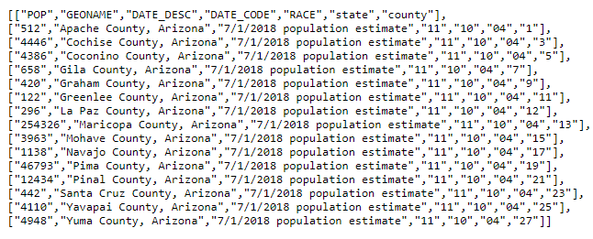
Output From the API
https://api.census.gov/data/2018/pep/charagegroups?get=POP,GEONAME,DATE_DESC&DATE_CODE=11&RACE=10&for=county:*&in=state:04
This URL returns data in JSON format that looks like this:
Notes:
From this request, the output is in a JSON format which stands for javascript object notation.
And using statistical software like SAS or R you can edit the commands to grab larger sets or data, to manipulate the data to display in a table format or as a chart or graph or in an interactive map.
And I mentioned earlier that our new dissemination platform, data.census.gov, that we are currently developing uses our own underlying services like the API and TigerWeb.

Slide 17
Outline
API Basics
Building an API Request
API Demo
Resources for Learning More
Other Options to Download Data in Bulk
Real World Examples
Notes:
Now I want to walk you through some examples.

Slide 18
Demo
For all counties in Arizona, what percent of people/households:
Have a disability
Do not have a vehicle at home

Slide 19
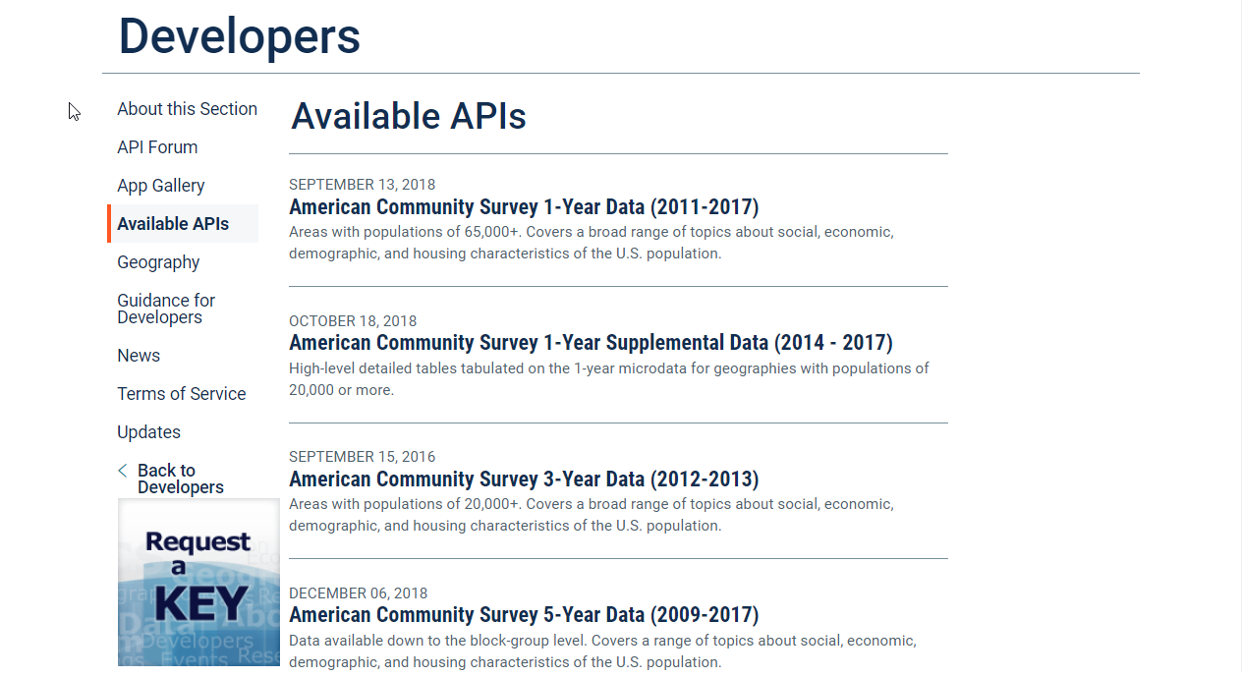
Disability and Vehicle Availability for all Arizona Counties
Select Your Dataset On The Developers Page
census.gov/data/developers/data-sets.html

Slide 20
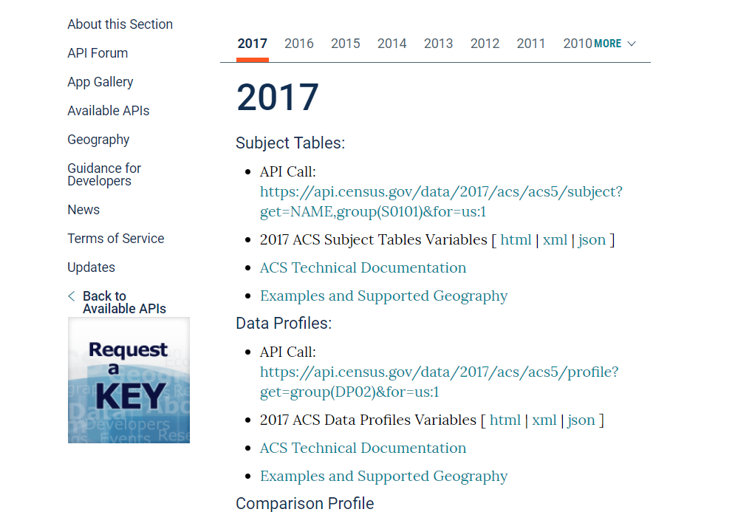
Choose Type of Table - Select “Examples and Supported Geography” under Data Profiles
census.gov/data/developers/data-sets/acs-5year.html

Slide 21
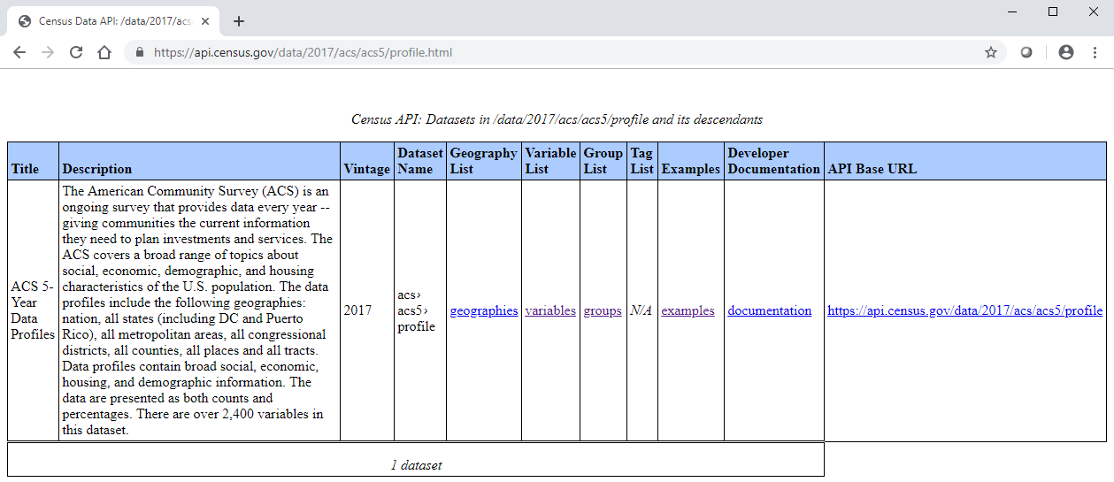
Select “examples”
https://api.census.gov/data/2017/acs/acs5/profile.html

Slide 22
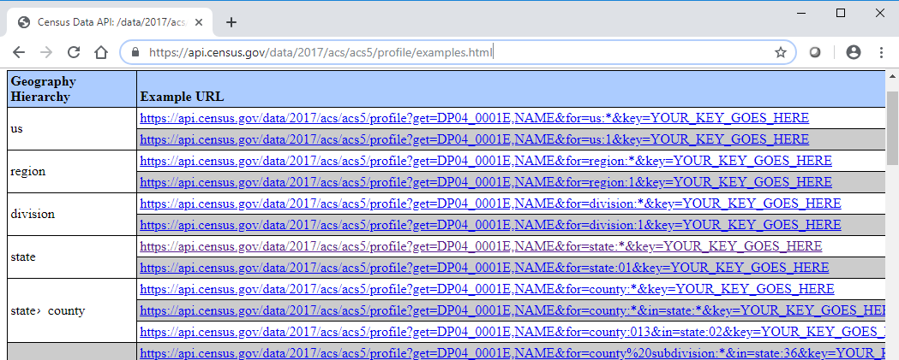
Choose Your Geography – Explore the available geographic levels on the left, copy a sample URL, and open a new tab
https://api.census.gov/data/2017/acs/acs5/profile/examples.html

Slide 23
Paste A Sample URL Into The Address Bar
Enter Your API Key Or Delete “&key=YOUR_KEY_GOES_HERE”
Press Enter And View Results
https://api.census.gov/data/2017/acs/acs5/profile?get=DP04_0001E,NAME&for=county:013&in=state:02

Slide 24
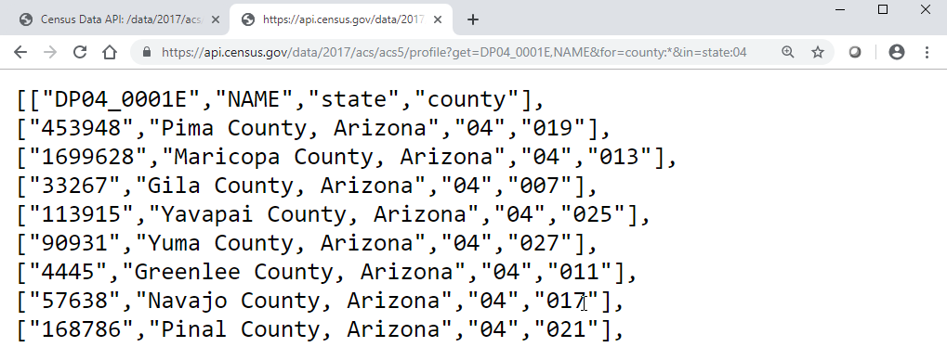
Edit Geography Selection To Retrieve Data for Arizona – In this example, use a wildcard (*) for county and code 04 for state
https://api.census.gov/data/2017/acs/acs5/profile?get=DP04_0001E,NAME&for=county:*&in=state:04

Slide 25
Find Your Variables: Click variables from the dataset page
https://api.census.gov/data/2017/acs/acs5/profile.html

Slide 26
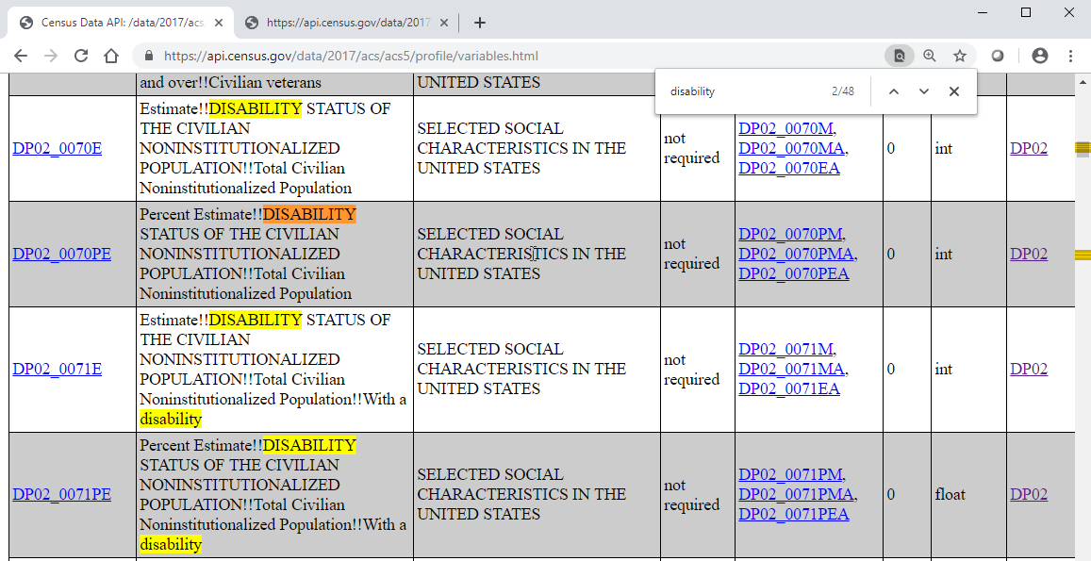
Find Your Variables (cont.): Search the webpage (CTRL+F) to find your variable(s) of interest, such as “disability” to find DP02_0071PE, the percent of the population with a disability
https://api.census.gov/data/2017/acs/acs5/profile/variables.html

Slide 27
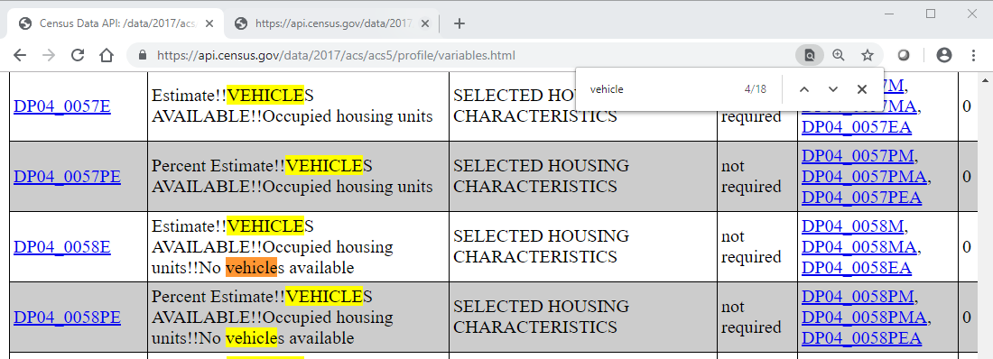
Repeat the CTRL+F process to find other variables of interest, such as “vehicle” to find DP04_0058PE, the percent of households with no vehicles
https://api.census.gov/data/2017/acs/acs5/profile/variables.html

Slide 28
Update Query With Variables Of Interest: DP02_0071PE and DP04_0058PE
View Results – Example: In Maricopa County, an estimated 11% of the population has a disability and 6.3% of households have no vehicle available
https://api.census.gov/data/2017/acs/acs5/profile?get=DP02_0071PE,DP04_0058PE,NAME&for=county:*&in=state:04

Slide 29
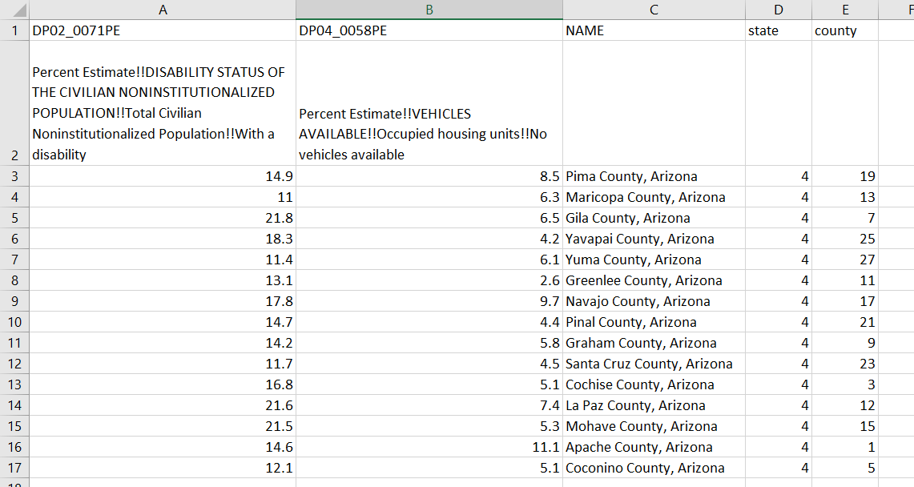
In a few steps, you can save as .csv and create a table view of your results. Learn how:
https://censusevent.webex.com/censusevent/lsr.php?RCID=2029116a413e3044aa2eca51035b17dc

Slide 30
Outline
API Basics
Building an API Request
API Demo
Resources for Learning More
Other Options to Download Data in Bulk
Real World Examples

Slide 31
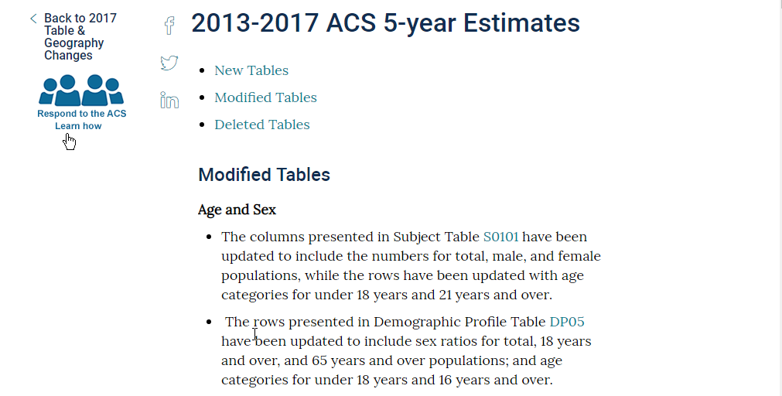
New/Modified/Deleted ACS Tables
census.gov/programs-surveys/acs/technical-documentation/table-and-geography-changes/2017/5-year.html

Slide 32
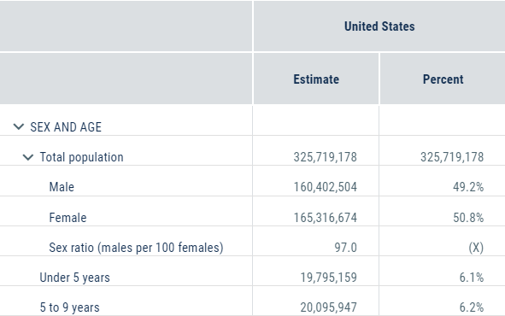
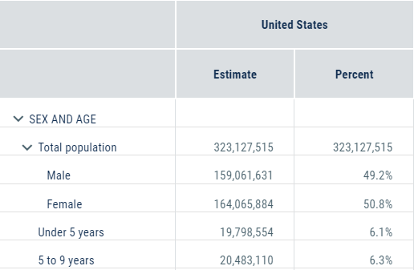
Visualizing ACS Table & Variable Changes
DP05_0004E
2017
2016

Slide 33
Outline
API Basics
Building an API Request
API Demo
Resources for Learning More
Other Options to Download Data in Bulk
Real World Examples

Slide 34
Downloading Data in Bulk
Benefits of API
Get the exact variables and geographies you need
Quickly update queries to get data across years: Most variables are consistent from year to year
Other Ways to Download in Bulk
data.census.gov
ACS Summary File
census.gov/programs-surveys/acs/technical-documentation/summary-file-documentation.html
Population Estimates Website (.csv files and FTP site)
census.gov/programs-surveys/popest/data/tables.2018.html
Notes:
We have a few ways to download Census Bureau data – through the API, through data.census.gov. For ACS , you have the summary file and Populations estimate has a website where you can access .csv files and a FTP site.

Slide 35
Outline
API Basics
Building an API Request
API Demo
Resources for Learning More
Other Options to Download Data in Bulk
Real World Examples

Slide 36
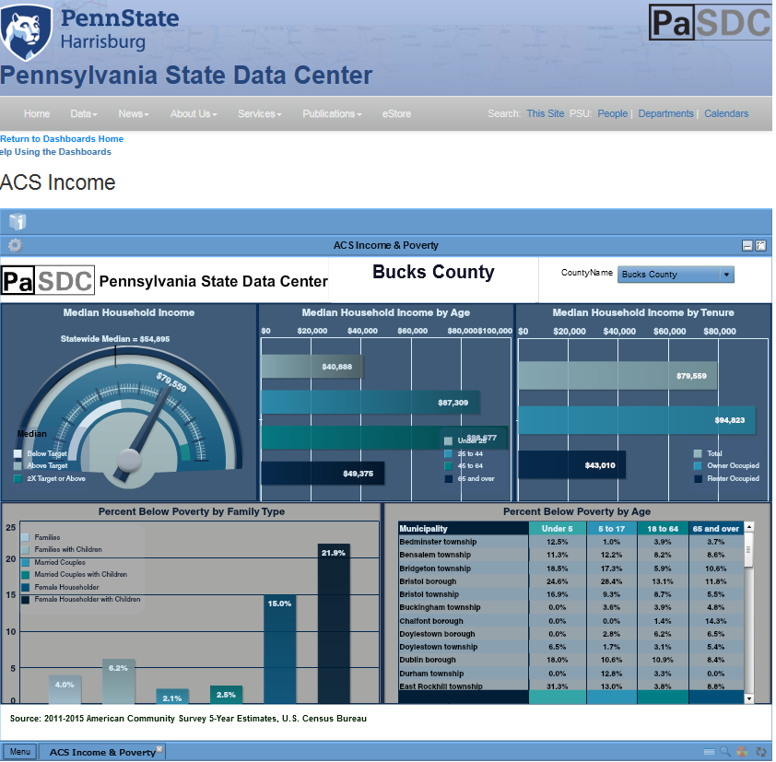
https://pasdc.hbg.psu.edu/Data/PaSDCDashboards/ACSIncome/tabid/1922/Default.aspx
Notes:
And here’s a dashboard created by the PA SDC that accesses 2015 ACS 5-Year poverty and income estimates data for Bucks County, PA from the API,
As data on the API are updated/corrected, they are immediately available for the apps.

Slide 37
https://www.cleargov.com/
Notes:
And here’s an app, ClearGov, that pulls data from the Census API (ACS) and APIs of other government agencies.
This app helps local governments from large cities to small school districts communicate, connect and engage with their constituents to build community support for mission-critical projects.

Slide 38
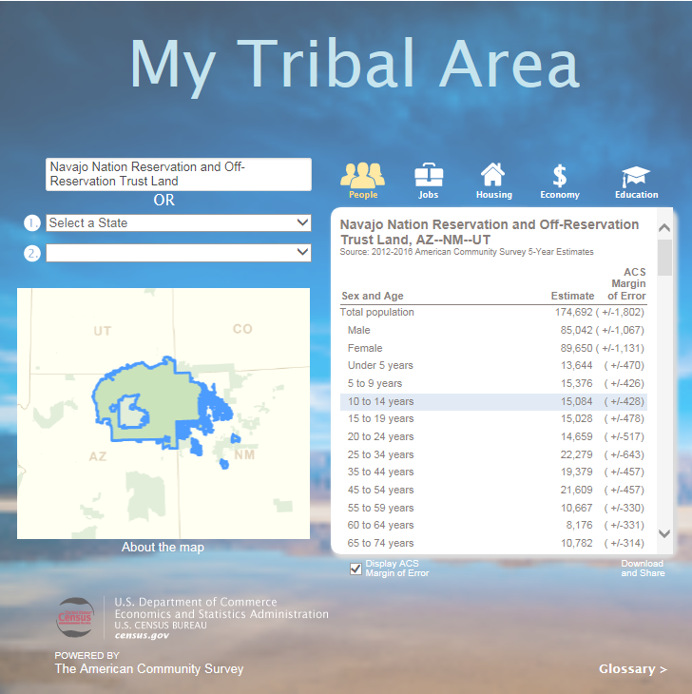
https://www.census.gov/tribal/
Notes:
Here’s an app on the Census website that pulls 2016 ACS 5-Year estimates from the Census Data API, My Tribal Area.
In this example, we see the sex and age breakdown for the Navajo Nation Reservation and Off-Reservation Trust Land in AZ, NM, and UT.

Slide 39
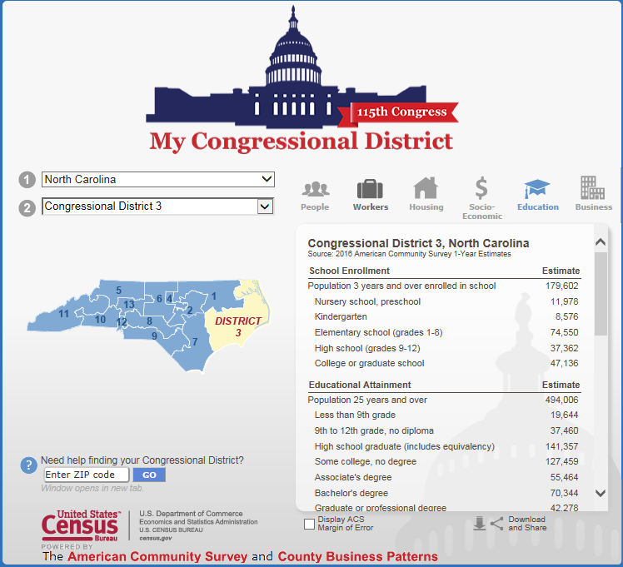
https://www.census.gov/mycd/
Notes:
Here’s another app on the Census website that pulls data from the Census Data API, My Tribal Area, which uses 2016 ACS 1-Year estimates and 2016 County Business Patterns data (the businesses tab).
In this example, we see school enrollment and educational attainment for Congressional District 3 in North Carolina.

Slide 40
Webinars
Upcoming Webinars:
https://census.gov/data/academy/webinars/upcoming.html
Recorded API Webinar:
census.gov/data/academy/webinars/2019/api-acs.html
Resources
API User Guide: census.gov/data/developers/guidance/api-user-guide.html
Developer’s Forum on Slack:
uscensusbureau.slack.com/join/shared_invite/enQtMjQ3NzUyNTM3NDU3LTZmNGI1MmQzY2Y2ZTU1ODJhNDQwMmY2YmZiNmFkNzg4YmJkYmQzZjQyNDhkNDYxN2JhYjkxZDEwMGI2OGU5NzQ
Stay in Touch
kanin.l.reese@census.gov
cedsci.feedback@census.gov
cnmp.developers.list@census.gov

