Slide 1
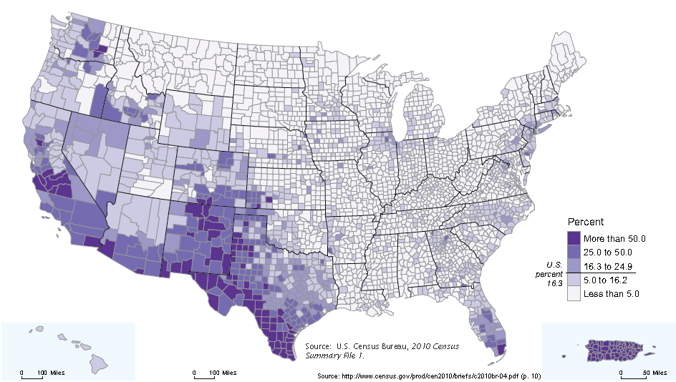
Your Community by the Numbers: Race, Ethnicity, Foreign Born, and Ancestry September 19, 2019 Presented by: Eric Coyle Data Dissemination Specialist U.S. Census Bureau

Slide 2
Agenda
Race, Hispanic Origin, Foreign Born, and Ancestry
Overview
American Community Survey
Overview
Geography
Accessing Census Data
AFF, API, CBB, Infographics, etc.
Q&A

Slide 3
What is the difference?
Race
Hispanic-Origin
Foreign-Born
Ancestry
Notes:
WHAT ANCESTRY IS NOT
Race - Definition
The data on race were derived from answers to the question on race. The U.S. Census Bureau collects race data in accordance with guidelines provided by the U.S. Office of Management and Budget (OMB), and these data are based on self-identification. The racial categories included in the census questionnaire generally reflect a social definition of race recognized in this country and not an attempt to define race biologically, anthropologically, or genetically. In addition, it is recognized that the categories of the race question include race and national origin or sociocultural groups. OMB requires that race data be collected for a minimum of five groups:White, Black or African American, American Indian or Alaska Native, Asian, and Native Hawaiian or other Pacific Islander. OMB permits the Census Bureau to also use a sixth category - Some Other Race. Respondents may report more than one race.
Ethnicity – Definition
The U.S. Office of Management and Budget (OMB) requires federal agencies to use a minimum of two ethnicities in collecting and reporting data: Hispanic or Latino and Not Hispanic or Latino. OMB defines "Hispanic or Latino" as a person of Cuban, Mexican, Puerto Rican, South or Central American, or other Spanish culture or origin regardless of race.
People who identify with the terms “Hispanic” or “Latino” are those who classify themselves in one of the specific Hispanic or Latino categories listed on the decennial census questionnaire and various Census Bureau survey questionnaires – “Mexican, Mexican Am., Chicano” or ”Puerto Rican” or “Cuban” – as well as those who indicate that they are “another Hispanic, Latino, or Spanish origin.”
The 2010 Census question on Hispanic origin included five separate response categories and one area where respondents could write in a specific Hispanic origin group. The first response category was intended for respondents who do not identify as Hispanic. The remaining response categories (“Mexican, Mexican Am., Chicano”; “Puerto Rican”; “Cuban”; and “another Hispanic, Latino, or Spanish origin”) and write-in answers can be combined to create the OMB category of Hispanic.
FOREIGN BORN
The foreign-born population includes anyone who is not a U.S. citizen at birth, including those who become U.S. citizens through naturalization. The native-born population includes anyone who is a U.S. citizen at birth.
ANCESTRY
Ancestry refers to a person’s self-identification of the ethnic origin, descent, roots, heritage, or place of birth of the person or of the person’s ancestors. (*Selected ancestry groups include Arab, Brazilian, Canadian, Czech, Ethiopian, Haitian, Irish, Jamaican, Italian, Nigerian, Russian, etc.) which may reflect their place of birth or that of previous generations of their family. Some ethnic identities, such as “Egyptian” or “Polish” can be traced to geographic areas outside the United States, while other ethnicities such as “Pennsylvania German” or “Cajun” evolved in the United States.
Ethnic identities may or may not represent geographies.
The intent behind the question of Ancestry is not to measure the degree of attachment the respondent has to a particular ethnicity (which we will cover briefly in a moment). Someone who responds as “Swedish” for example, could represent a person who is perhaps a first generation child, or feel the connection to ancestors several generations removed. A person’s ancestry is not necessarily the same as his or her place of birth.
Some people may have one distinct ancestry, while others are descendants of several ancestry groups, and still others may know only that their ancestors were from a particular region of the world or may not know their ethnic origins at all. Currently, when someone reports more than two groups for their ancestry in the American Community Survey, only the first two ancestries are tabulated.
Some people identify their ancestry as American, whether because their ancestors have been in United States for a long time or they have such mixed backgrounds that they do not identify with any particular group. There are many reasons a person may report their ancestors as American, and the growth in this response has been substantial.
Needless to say Ancestry is a broad concept because it means different things to different people. For instance, one person may interpret is as “where my ancestors or parents come from”; another person may consider how they see themselves ethnically.

Slide 4
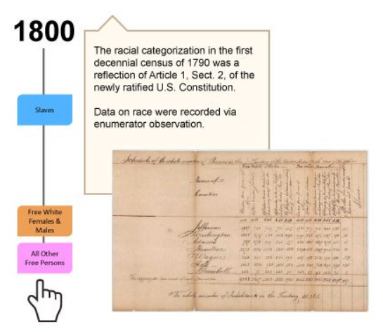
Race and Ethnicity
History of Collection in the U.S. Decennial Census
Measured since 1790 Census
Census form has reflected changes in society
Influenced by social, political, and economic factors
1980 Census to present follows OMB standards
Based on self-identification

Slide 5
Race & Ethnicity Across the Decades
5

Slide 6
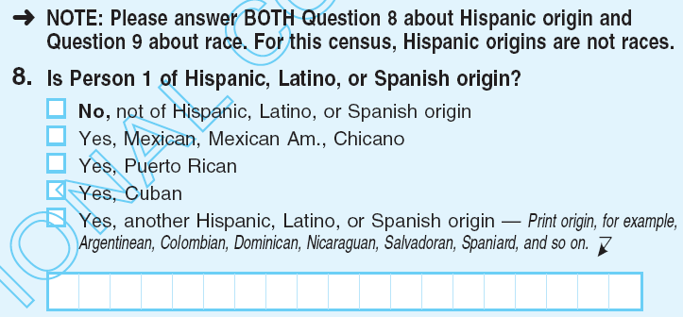
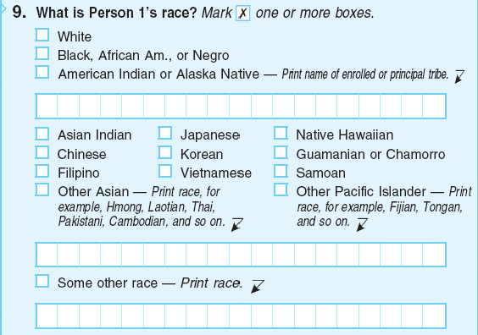
2010 Census Ethnicity Question
(asked since 1970)
2010 Census Race
Question
(asked since 1790)
The Office of Management and Budget (OMB) establishes the standards for the classification of federal data on race and ethnicity: obamawhitehouse.archives.gov/omb/fedreg_1997standards
Notes:
The U.S. Census Bureau must adhere to the 1997 Office of Management and Budget (OMB) standards on race and ethnicity which guide the Census Bureau in classifying written responses to the race question:
White – A person having origins in any of the original peoples of Europe, the Middle East, or North Africa.
Black or African American – A person having origins in any of the Black racial groups of Africa.
American Indian or Alaska Native – A person having origins in any of the original peoples of North and South America (including Central America) and who maintains tribal affiliation or community attachment.
Asian – A person having origins in any of the original peoples of the Far East, Southeast Asia, or the Indian subcontinent including, for example, Cambodia, China, India, Japan, Korea, Malaysia, Pakistan, the Philippine Islands, Thailand, and Vietnam.
Native Hawaiian or Other Pacific Islander – A person having origins in any of the original peoples of Hawaii, Guam, Samoa, or other Pacific Islands.
The 1997 OMB standards permit the reporting of more than one race. An individual’s response to the race question is based upon self-identification.
An individual’s response to the race question is based upon self-identification. The Census Bureau does not tell individuals which boxes to mark or what heritage to write in. For the first time in Census 2000, individuals were presented with the option to self-identify with more than one race and this continued with the 2010 Census. People who identify with more than one race may choose to provide multiple races in response to the race question. For example, if a respondent identifies as "Asian" and "White," they may respond to the question on race by checking the appropriate boxes that describe their racial identities and/or writing in these identities on the spaces provided.
What is Race?
The data on race were derived from answers to the question on race that was asked of individuals in the United States. The Census Bureau collects racial data in accordance with guidelines provided by the U.S. Office of Management and Budget (OMB), and these data are based on self-identification.
The racial categories included in the census questionnaire generally reflect a social definition of race recognized in this country and not an attempt to define race biologically, anthropologically, or genetically. In addition, it is recognized that the categories of the race item include racial and national origin or sociocultural groups. People may choose to report more than one race to indicate their racial mixture, such as “American Indian” and “White.” People who identify their origin as Hispanic, Latino, or Spanish may be of any race.
OMB requires five minimum categories: White, Black or African American, American Indian or Alaska Native, Asian, and Native Hawaiian or Other Pacific Islander.
Reasons for Collecting Information on Race
Information on race is required for many Federal programs and is critical in making policy decisions, particularly for civil rights. States use these data to meet legislative redistricting principles. Race data also are used to promote equal employment opportunities and to assess racial disparities in health and environmental risks.
Race and Ethnicity Research
The Census Bureau has a long history of conducting research to improve questions and data on race and ethnicity. Since the 1970s, the Census Bureau has conducted content tests to research and improve the design and function of different questions, including questions on race and ethnicity.

Slide 7
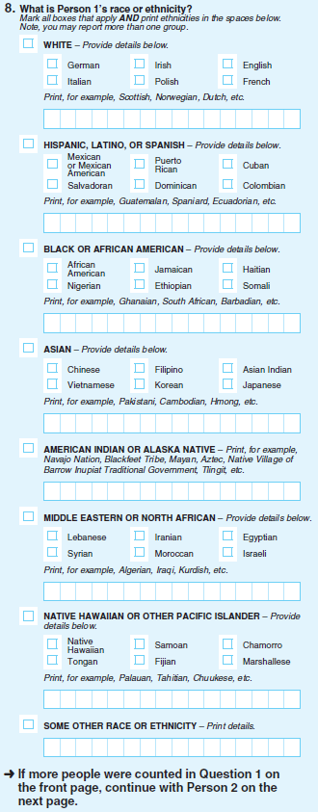
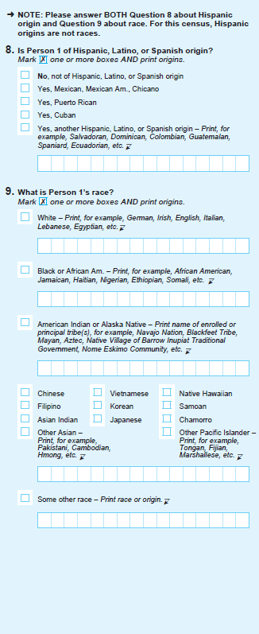
Census Bureau Research on Race Ethnicity for the 2020 Census
Separate Ethnicity Question and Race Question Design
Combined Race/Ethnicity Question Design
Census Bureau conducted extensive research and outreach over past decade, including two groundbreaking national studies on how to improve race and ethnicity question(s)
Based on extensive research and outreach, combined race/ethnicity question with detailed checkboxes and Middle Eastern or North African (MENA) response category was recommended by the Census Bureau as optimal design for collecting 2020 Census data on race and ethnicity
Determining content for the census is an extensive undertaking, involving research, community engagement, and politics.
Extensive research and outreach showed combined race/ethnicity question with detailed checkboxes is the optimal design for improving race/ethnicity data
Determining census content is an extensive undertaking, involving research and stakeholder engagement

Slide 8
Census Bureau Decision for 2020 Census
Separate Ethnicity and Race Questions
The Census Bureau issued memorandum to document 2020 Census Program decision on race and ethnicity questions (January 26, 2018)
Census Bureau needed to make a decision on design of race and ethnicity questions by December 31, 2017 to prepare 2020 Census systems, and deliver final 2020 Census question wording to Congress by March 31, 2018
In accordance with current OMB standards, Census Bureau will use two separate questions for collecting data on race and ethnicity
Source: www.census.gov/programs-surveys/decennial-census/2020-census/planning-management/memo-series/2020-memo-2018_02.html

Slide 9
U.S. Office of Management and Budget (OMB)
Standards for Race and Ethnicity (1997)
OMB Ethnicity Categories:
Hispanic or Latino
Not Hispanic or Latino
OMB Race Categories:
American Indian or Alaska Native
Asian
Black or African American
Native Hawaiian or Other Pacific Islander
White
The Census Bureau is also permitted to use the category “Some Other Race”
Source: www.gpo.gov/fdsys/pkg/FR-1997-10-30/pdf/97-28653.pdf

Slide 10
U.S. Office of Management and Budget
Standards for Race and Ethnicity (1997)
OMB minimum categories for data on race and ethnicity for Federal statistics, program administrative reporting,
and civil rights compliance reporting are defined as follows:
American Indian or Alaska Native - A person having origins in any of the original peoples of North and South America (including Central America), and who maintains tribal affiliation or community attachment.
Asian - A person having origins in any of the original peoples of the Far East, Southeast Asia, or the Indian subcontinent including, for example, Cambodia, China, India, Japan, Korea, Malaysia, Pakistan, the Philippine Islands, Thailand, and Vietnam.
Black or African American - A person having origins in any of the black racial groups of Africa.
Hispanic or Latino - A person of Cuban, Mexican, Puerto Rican, South or Central American, or other Spanish culture or origin, regardless of race.
Native Hawaiian or Other Pacific Islander - A person having origins in any of the original peoples of Hawaii, Guam, Samoa, or other Pacific Islands.
White - A person having origins in any of the original peoples of Europe, the Middle East, or North Africa.
Source: www.gpo.gov/fdsys/pkg/FR-1997-10-30/pdf/97-28653.pdf

Slide 11
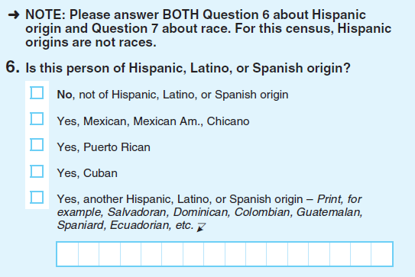
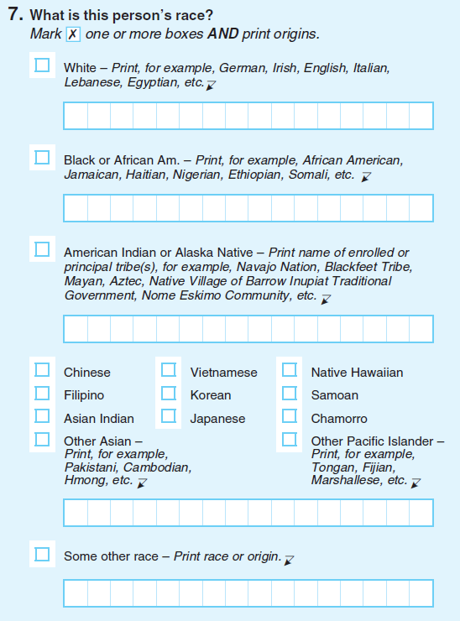
Proposed Design for 2020 Census
Separate Ethnicity Question
Separate Race Question
Question designs for 2020 Census must adhere to 1997 OMB standards for race and ethnicity
Census Bureau will not use combined question format for collecting race and ethnicity; 1997 OMB standards require two separate questions for self-response
Census Bureau will not use “Middle Eastern or North African” category
Several significant changes from 2010 Census questions proposed for race and ethnicity
More information at:
https://www.census.gov/programs-surveys/decennial-census/2020-census.html
https://2020census.gov/en

Slide 12
The American Community Survey Overview

Slide 13
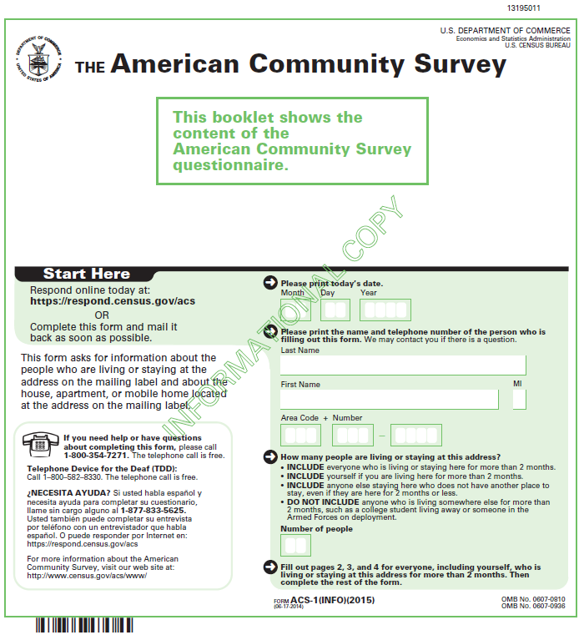
The American Community Survey The Foundation
The American Community Survey (ACS) is on the leading edge of survey design, continuous improvement, and data quality
The nation’s most current, reliable, and accessible data source for local statistics on critical planning topics such as age, children, veterans, commuting, education, income, and employment
Surveys 3.5 million households and informs over $675 billion of Federal government spending each year
Visit 20,000 Group Quarter facilities and sample approximately 194,000 residents each year
Covers 35+ topics, supports over 300 evidence-based Federal government uses, and produces 11 billion estimates each year
Three key annual data releases:
1-year Estimates (for large populations)
1-year Supplemental Estimates (for small populations)
5-year Estimates (for very small populations)

Slide 14
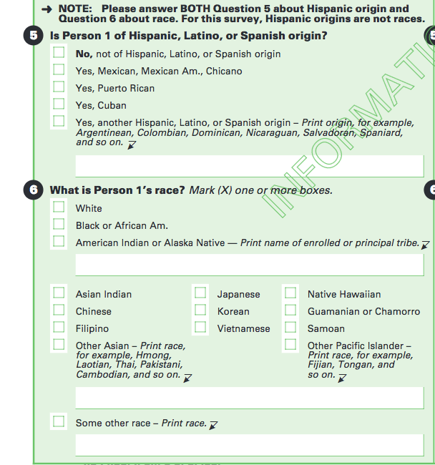
Race and Ethnicity Questions on the ACS

Slide 15
Place of Birth & Ancestry Questions on the ACS
Notes:
The American Community Survey (ACS) provides sample data from the 1-year, 3-year, and 5-year estimates based on population size. Selected Population Profiles enable you to select characteristics by Race or Ethnic Groups (Mexican, Puerto Rican, Cuban, etc.) and by Country of Birth.
Data on race and the Hispanic population from the 2010, 2000, and 1990 decennial censuses also are available. Data can be accessed for the 2010 and 2000 Censuses using American FactFinder.
Data on Hispanic Subgroups Other Than Mexican, Puerto Rican, and Cuban
The American Community Survey (ACS) has data on these groups. In the survey questionnaire, the Hispanic-origin question obtained write-in responses of Hispanic subgroups other than the major groups of Mexican, Cuban, and Puerto Ricans. Persons with other Hispanic origins (e.g.,Salvadoran, Nicaraguan, Argentinean) were able to write in their specific origin group. The Census Bureau's code list contains over 30 Hispanic or Latino subgroups.
You can access the American Community Survey 1-year estimates for a population of 65,000 or more, 3-year estimates for a population of 20,000 or more, and 5-year estimates in American Factfinder. Data on these groups are available in the Detailed Tables, the Subject Tables, and the Selected Population Profiles.
This is the same approach we use in the decennial census. For the 2010 Census, Summary File 2 [PDF 4.5 MB] allows users to access any table in the files for a particular Hispanic subgroup, provided the group meets certain population criteria for the geographic area under consideration. At present, census data provide information on geographic areas smaller than those reported in the ACS.

Slide 16
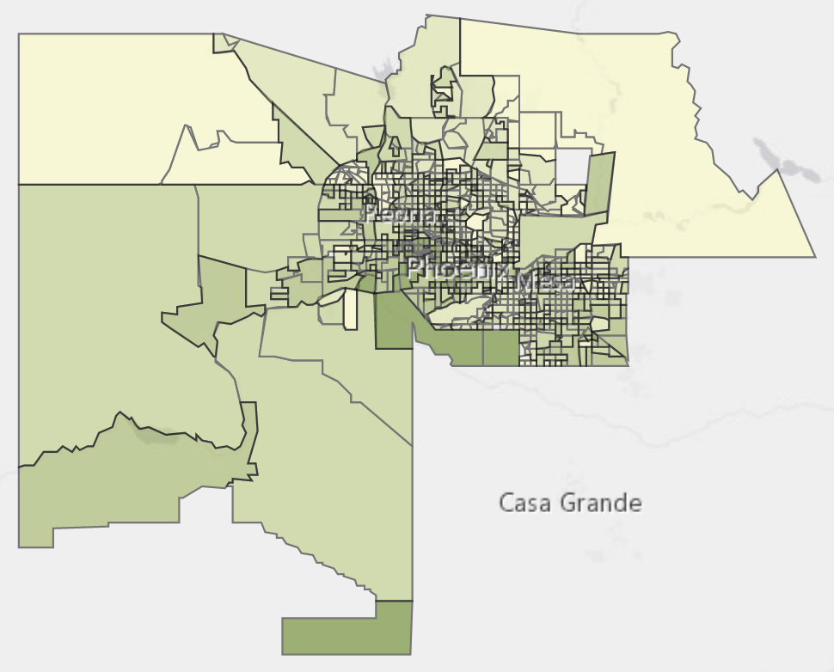
The American Community Survey Market Research
Average Family Size by Census Tracts in Maricopa County
An automobile company wants to understand the different characteristics of communities around high performing and low performing dealerships.
The ACS tells businesses about its potential customers:
Are residents of a different age, sex, or family size in these locations?
Have changes to employment or earnings changed local household budgets? (Maybe rent and utility costs are impacting budgets as well.)
Are new residents part of a demographic that doesn’t drive?
Do residents speak different languages? Does the dealership need signs or products promoted in other languages?
Is a rise in computer and internet use providing opportunities for new ways to reach your customers?
Source: U.S. Census Bureau, 2012-2016 American Community Survey 5-Year Estimates

Slide 17
The American Community Survey Availability of 2018 Data Products
Estimated Population of Geographic Area | 1-Year Estimates | 1-Year Supplemental Estimates | 5-Year Estimates
65,000 or more | X | X | X
20,000 to 64,999 |  | X | X
Less than 20,000 |  |  | X
Release Date | September 26, 2019 | February 6, 2020 | December 19, 2019
census.gov/programs-surveys/acs/news/data-releases
Notes:
ACS data products are released about one year after the data are collected, and the first year of data collection with a full sample was in 2005. The 2018 ACS data products will be released on a modified, staggered schedule due to delays in post data collection processing that resulted from the recent lapse in federal funding. The ACS data collected in 2018 is planned to be released on September 26, 2019 as 1-year estimates with some remaining tables and products coming out on October 17, 2019. ACS 1-year estimates, combining data collected over 12 months, are available for geographic areas with a population of 65,000 or more.
ACS 1-year Supplemental Estimates are a subset of Detailed Tables that are available for geographic areas with populations of 20,000 or more. They are simplified versions of popular ACS tables and provide the most current data to almost twice as many geographies as compared to the standard 1-year release. We plan to release the 1-year Supplemental Estimates on February 6, 2020.
(note: 15,101 geographies in the 2014 Supplemental Estimates vs. 7,819 geographies in the 2014 ACS 1-year release)
ACS 5-year estimates, combining data collected over 60 months, are available for geographic areas of all sizes down to the census tract and block group level. The 2014-2018 ACS 5-year estimates are planned to be released on December 19, 2019 with some remaining tables and products coming out on January 16, 2020.
Thus, ACS data are available for geographic areas with a population of 20,000 or more in the form of 1-year and 5-year estimates. ACS data are only available for geographic areas with a population less than 20,000 in the form of 5-year estimates.
We also release 1-year and 5-year Public Use Microdata Sample (or PUMS) files for users who want to create custom tables, and Variance Replicate Estimates for users who want to calculate margins of error. Use the link on the slide to access our complete release schedule.
Note to speaker:
The Census Bureau used to produce 3-year estimates, but they were discontinued due to budget reasons beginning with the 2014 data release. Past 3-year data products for populations of 20,000+ are still available to the public.

Slide 18
Census Geography

Slide 19
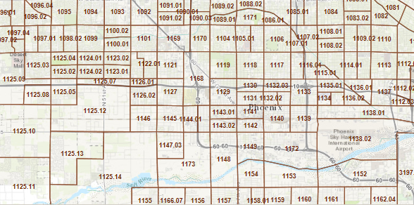
Selected Census Geographic Concepts—Statistical Areas
Regions
Divisions
Census Designated Places
Census County Divisions
Public Use Microdata Areas (PUMA)
Zip Code Tabulation Areas (ZCTAs)
Census Tracts
Block Groups
Block
Notes:
Statistical geographic areas are defined primarily for data tabulation and presentation purposes.
Census Regions are groupings of states and the District of Columbia that subdivide the United States for the presentation of census data. There are four census regions—Northeast, Midwest, South, and West. Each of the four census regions is divided into two or more census divisions (see "Census Divisions" above). Each census region is identified by a single-digit census code. Puerto Rico and the Island Areas are not part of any census region or census division. For more information on census regions, census divisions, and their constituent states, see our list or map [PDF].
Census Divisions are groupings of states and the District of Columbia that are subdivisions of the four census regions (see "Census Region" below). There are nine census divisions, and each is identified by a single-digit census code. Puerto Rico and the Island Areas are not part of any census region or census division. For more information on census regions, census divisions, and their constituent states, see our list or map [PDF].
County Subdivisions are the primary divisions of counties and equivalent entities. They include census county divisions, census subareas, minor civil divisions, and unorganized territories and can be classified as either legal or statistical. Each county subdivision is assigned a five-character numeric Federal Information Processing Series (FIPS) code based on alphabetical sequence within state and an eight-digit National Standard feature identifier.
Census Designated Places (CDPs) are the statistical counterparts of incorporated places, and are delineated to provide data for settled concentrations of population that are identifiable by name but are not legally incorporated under the laws of the state in which they are located. The boundaries usually are defined in cooperation with local or tribal officials and generally updated prior to each decennial census. These boundaries, which usually coincide with visible features or the boundary of an adjacent incorporated place or another legal entity boundary, have no legal status, nor do these places have officials elected to serve traditional municipal functions. CDP boundaries may change from one decennial census to the next with changes in the settlement pattern; a CDP with the same name as in an earlier census does not necessarily have the same boundary. CDPs must be contained within a single state and may not extend into an incorporated place. There are no population size requirements for CDPs.
Hawaii is the only state that has no incorporated places recognized by the Census Bureau. All places shown in decennial census data products for Hawaii are CDPs. By agreement with the state of Hawaii, the Census Bureau does not show data separately for the city of Honolulu, which is coextensive with Honolulu County. In Puerto Rico, which also does not have incorporated places, the Census Bureau recognizes only CDPs and refers to them as comunidades or zonas urbanas. Guam also has only CDPs.
Public Use Microdata Areas (PUMAs) are geographic areas for which the Census Bureau provides selected extracts of raw data from a small sample of census records that are screened to protect confidentiality. These extracts are referred to as public use microdata sample (PUMS) files.
For the 2010 Census, each state, the District of Columbia, Puerto Rico, and some Island Area participants delineated PUMAs for use in presenting PUMS data based on a 5 percent sample of decennial census or American Community Survey data. These areas are required to contain at least 100,000 people. This is different from Census 2000 when two types of PUMAs were defined: a 5 percent PUMA as for 2010 and an additional super-PUMA designed to provide a 1 percent sample. The PUMAs are identified by a five-digit census code unique within state.
ZIP Code Tabulation Areas (ZCTAs) are approximate area representations of U.S. Postal Service (USPS) five-digit ZIP Code service areas that the Census Bureau creates using whole blocks to present statistical data from censuses and surveys. The Census Bureau defines ZCTAs by allocating each block that contains addresses to a single ZCTA, usually to the ZCTA that reflects the most frequently occurring ZIP Code for the addresses within that tabulation block. Blocks that do not contain addresses but are completely surrounded by a single ZCTA (enclaves) are assigned to the surrounding ZCTA; those surrounded by multiple ZCTAs will be added to a single ZCTA based on limited buffering performed between multiple ZCTAs. The Census Bureau identifies five-digit ZCTAs using a five-character numeric code that represents the most frequently occurring USPS ZIP Code within that ZCTA, and this code may contain leading zeros
Census tracts are small, relatively permanent of a county or county equivalent. Census tracts generally have a minimum population of 1,200, or 480 housing units, and a maximum population of 8,000 people or 3,200 housing units. Tracts have an optimum size of 4,000 people or 1,600 housing units.
Block groups are statistical divisions of census tracts and are defined to contain a minimum of 600 persons or 240 housing units and a maximum of 3,000 people or 1,200 housing units. In the American Community Survey, block groups are the lowest level of geography published.
Blocks (Census Blocks) are statistical areas bounded by visible features, such as streets, roads, streams, and railroad tracks, and by nonvisible boundaries, such as selected property lines and city, township, school district, and county limits and short line-of-sight extensions of streets and roads. Generally, census blocks are small in area; for example, a block in a city bounded on all sides by streets. Census blocks in suburban and rural areas may be large, irregular, and bounded by a variety of features, such as roads, streams, and transmission lines. In remote areas, census blocks may encompass hundreds of square miles. Census blocks cover the entire territory of the United States, Puerto Rico, and the Island Areas. Census blocks nest within all other tabulated census geographic entities and are the basis for all tabulated data.
These statistical areas are designed to have stable boundaries. Boundary changes to existing census tracts, as well as newly defined census tracts, may occur at the time of each decennial census.

Slide 20
Geographic Area Relationships— Small Statistical Areas

Slide 21
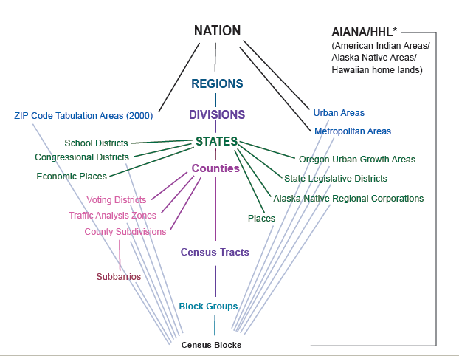
Census Geography Hierarchy
Central axis describes a nesting relationship
600 to 3,000
population
240 to 1,200
housing units
Cities and towns -- incorporated
Census Designated Places (CDPs):
- - Unincorporated; no size threshold
- - Separate and distinct from city/town
- - Redefined each census
Blocks are not defined by population
and are the smallest geographic level at which data are ever released (Decennial Census, not the ACS)
1,200 to 8,000 population (optimum 4,000)
480 to 3,200 housing units
Notes:
Statistical geographic areas are defined primarily for data tabulation and presentation purposes.
CDP: settled concentrations of populations known by name, not legally incorporated
CCD: primary division of county with no legal function
Census tracts are small, relatively permanent of a county or county equivalent. Census tracts generally have a minimum population of 1,200, or 480 housing units, and a maximum population of 8,000 people or 3,200 housing units. Tracts have an optimum size of 4,000 people or 1,600 housing units.
Block groups are statistical divisions of census tracts and are defined to contain a minimum of 600 persons or 240 housing units and a maximum of 3,000 people or 1,200 housing units. In the American Community Survey, block groups are the lowest level of geography published.
These statistical areas are designed to have stable boundaries. Boundary changes to existing census tracts, as well as newly defined census tracts, may occur at the time of each decennial census.

Slide 22
Accessing Census Data

Slide 23
ACS Website
census.gov/acs

Slide 24
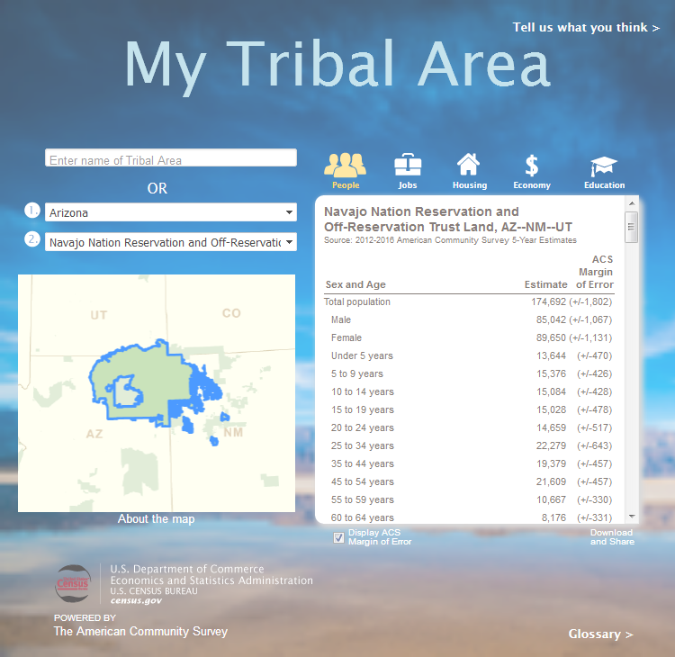
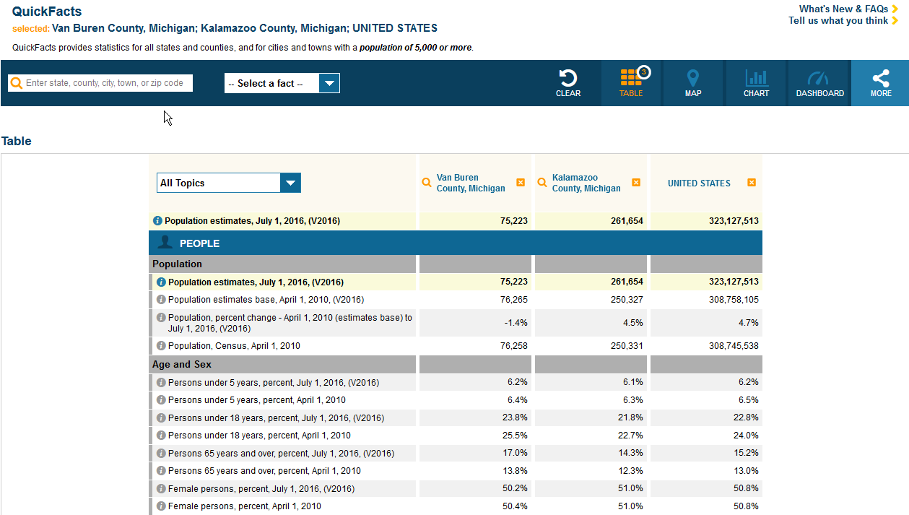
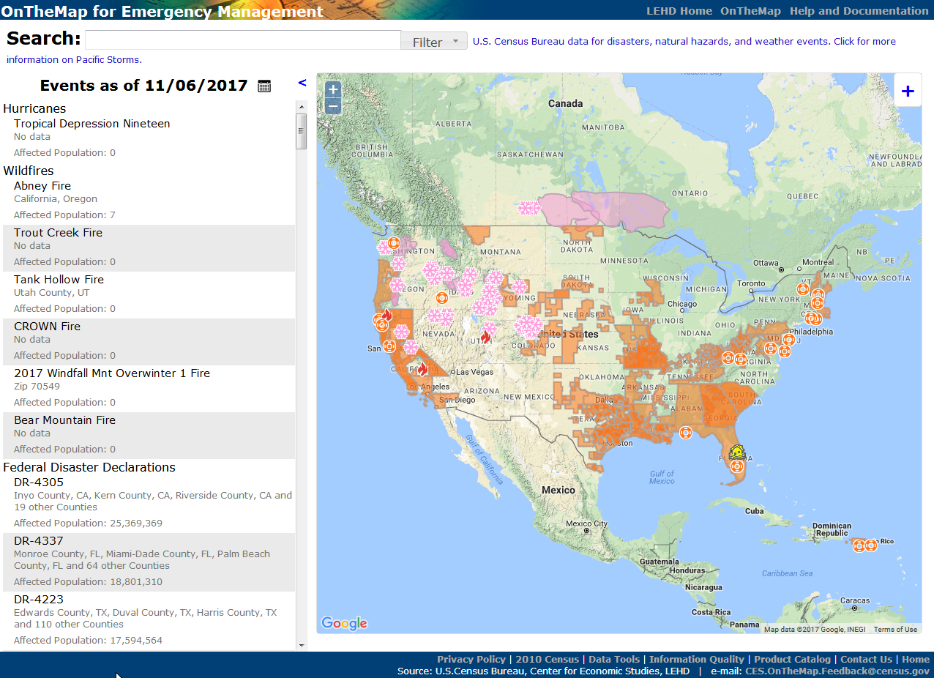
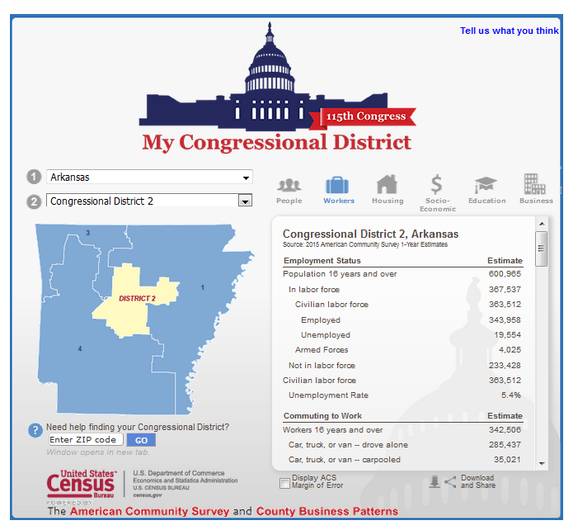
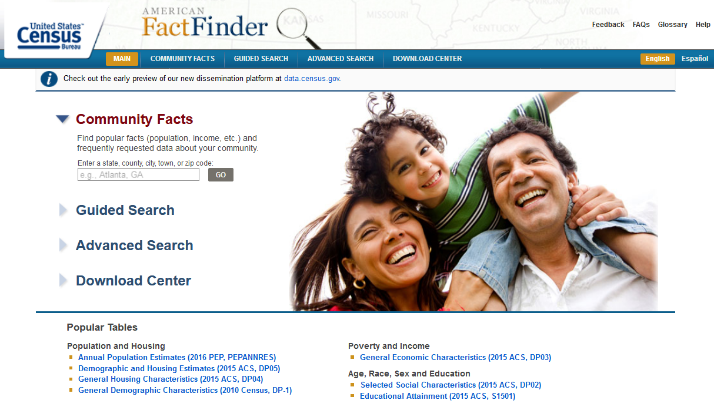
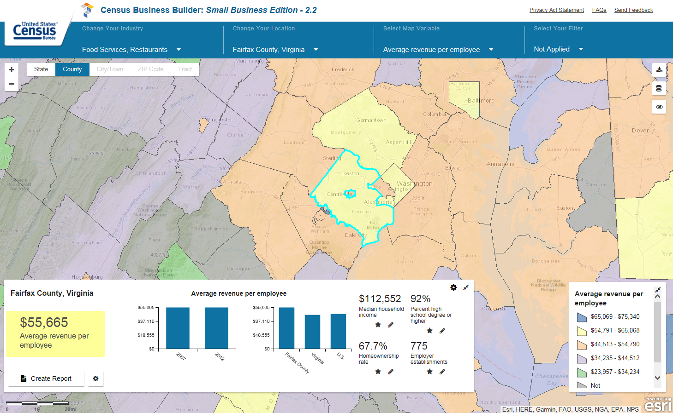
The American Community Survey Selected Ways to Access Data
American FactFinder
Application Programming Interface (API)
Census Business Builder
Census Engagement Navigator
Data Profiles
Infographics
My Congressional District
My Tribal Area
Narrative Profiles
QuickFacts
Response Outreach Area Mapper
census.gov/data/data-tools.html

Slide 25
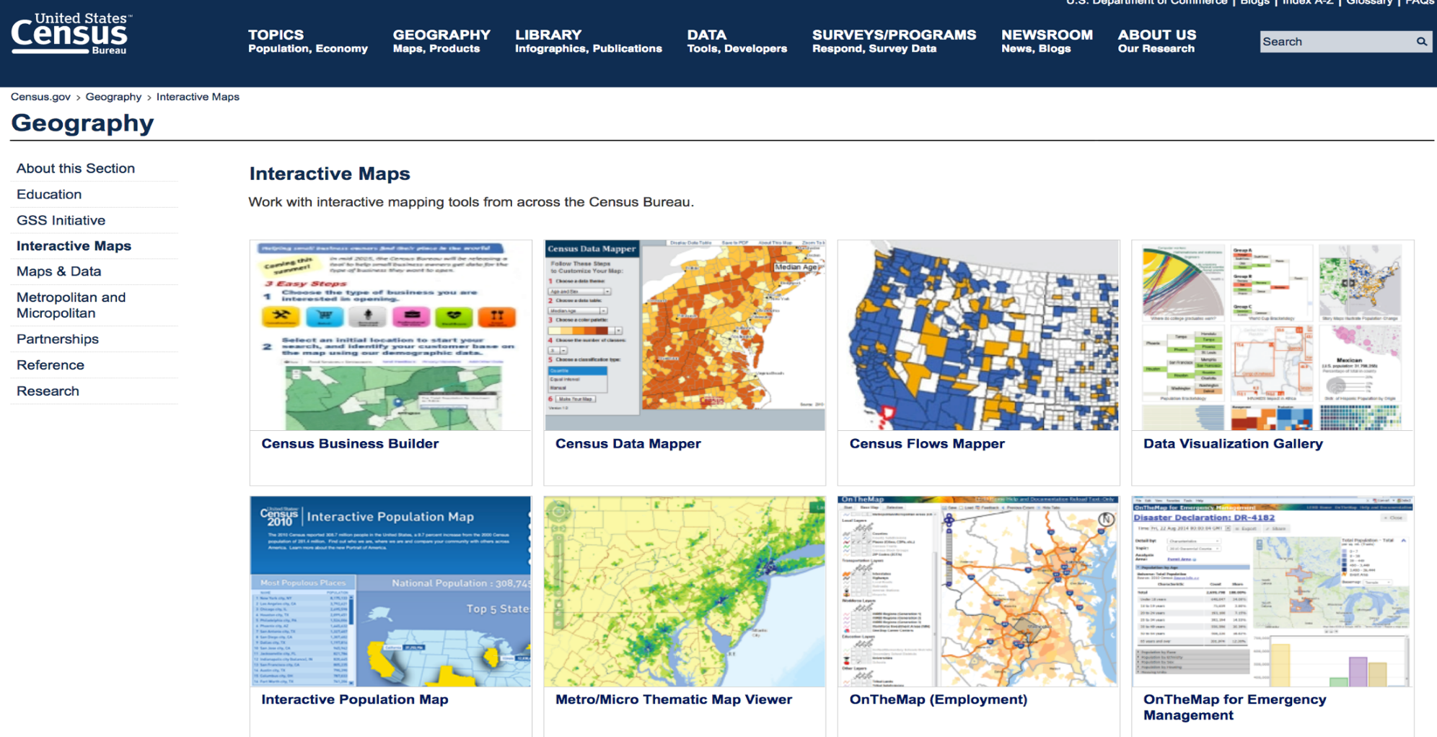
Interactive Maps
census.gov/geography/interactive-maps

Slide 26
Preview New Data Dissemination on Data.census.gov
*For official statistics, continue to use existing data tools on census.gov, such as American FactFinder

Slide 27
Census.gov/Academy: Visit and Subscribe
Receive our Data Gems.
These short “how-to” videos are an easy and quick way to increase your knowledge of Census data. Get them in your inbox!
Get access to our data courses.
You will learn-at-your-own-pace with these video-tutorials designed for different skill levels.
Interact with our instructors via webinars.
Learn about our data releases and tools while attending these live virtual classes.
Bring our data experts to you.
Request free workshops and webinars for your organization: census.askdata@census.gov
Take part in this community
Share your feedback and ideas for our educational content: Census.academy@census.gov

Slide 28
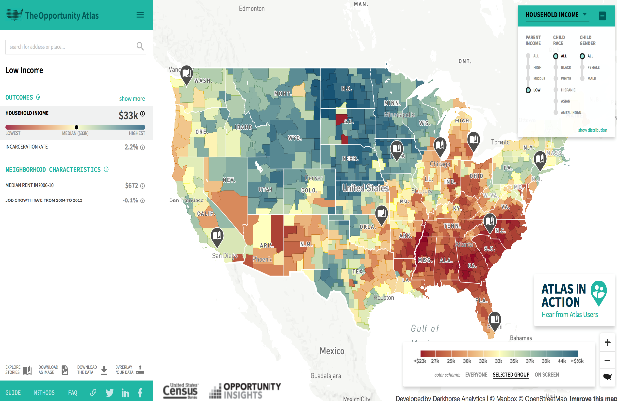
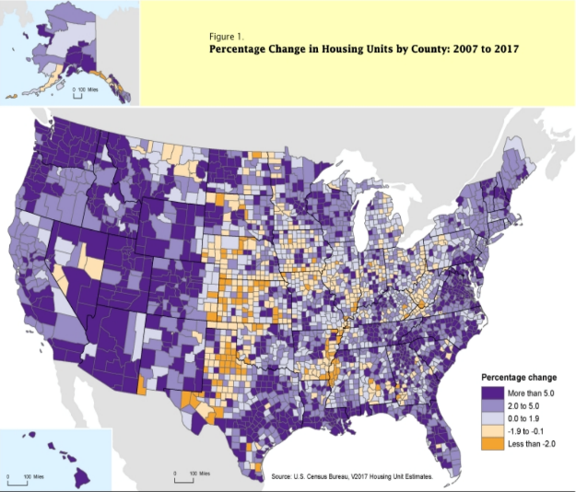
Stay Current
NEWSROOM
DIRECTOR’S BLOG
The latest news releases and statements from the U.S. Census Bureau. Also, find upcoming events, and useful information for media census.gov/newsroom.html
This blog gives the director's point of view on everything from Census Bureau news to how we measure America's people, places and economy.
census.gov/newsroom/blogs/director.html
AMERICA COUNTS
Featured stories on various topics such as families, housing, employment, business, education, the economy, emergency preparedness, and population census.gov/AmericaCounts
STATS FOR STORIES
Provides links to timely story ideas highlighting the Census Bureau's newsworthy statistics that relate to current events, observances, holidays, and anniversaries
census.gov/newsroom/stories.html
census.gov/newsroom/facts-for-features.html

Slide 29
Stay Connected
Sign up for and manage alerts at https://public.govdelivery.com/accounts/USCENSUS/subscriber/new
facebook.com/uscensusbureau
twitter.com/uscensusbureau
youtube.com/user/uscensusbureau
instagram.com/uscensusbureau/
pinterest.com/uscensusbureau/
linkedin.com/company/us-census-bureau
More information on the American Community Survey: https://www.census.gov/acs
Census (Non-media inquiries) 800-923-8282
Public Information Office (Media) 301-763-3030

Slide 30
The American Community Survey Data Tell Stories. Tell Us Yours!
Your story
Your outcome
Your data details
To tell us your story, visit:
census.gov/acs/www/share-your-story/index.php

Slide 31
Additional Resources: Want Free Training?
Need Local Stats?
U.S. Census Bureau
Data Dissemination Specialist
Eric Coyle
(702) 236-3202
eric.a.coyle@census.gov
Additional Assistance:
Toll-free number:
1-844-ASK-DATA (1-844-275-2342)
census.askdata@census.gov

Slide 32
Q&A and Thank You!

