Slide 1

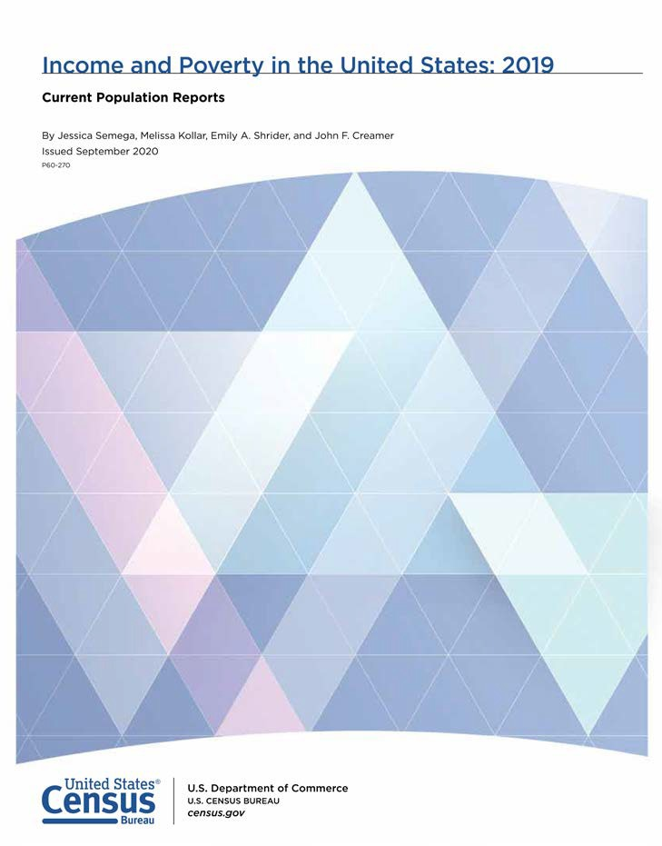

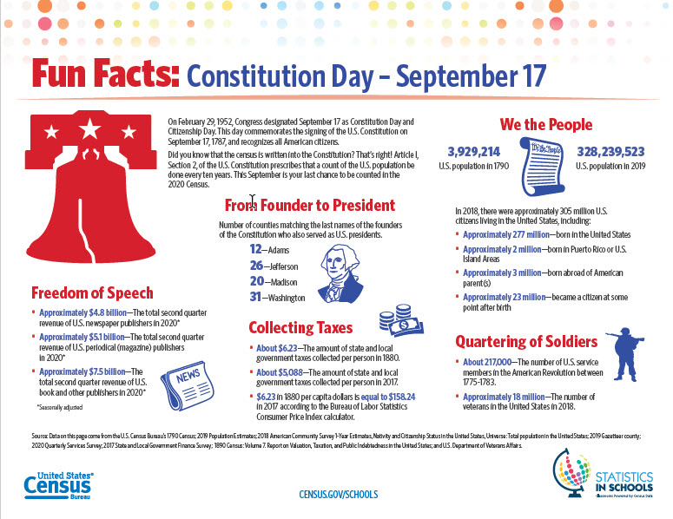
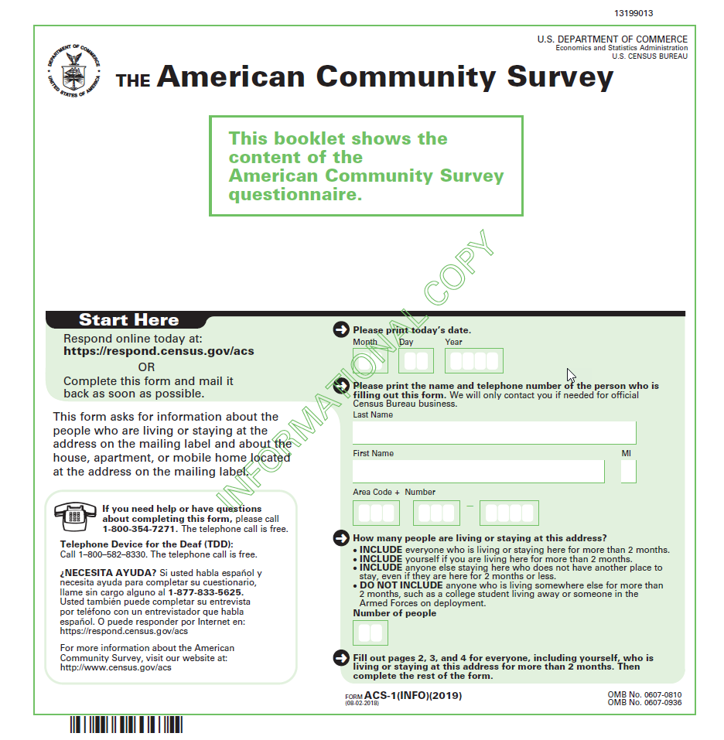
Census Bureau Product Update
Arizona State Data Center Annual Meeting
September 15, 2020
Presented by: Eric Coyle
Data Dissemination Specialist
U.S. Census Bureau

Slide 2
Agenda
Current Population Survey Annual Social and Economic Supplement (CPS ASEC)
2019 Income, Poverty, and Health Insurance Reports
American Community Survey
2019 1-year estimates release schedule
Statistics in School
Constitution Day
Census Academy & Additional Resources
Q&A

Slide 3
Current Population Survey ASEC
CPS ASEC Press Kit
Fact Sheets
Background Material
News Products
News Release (English and Spanish)
2 Media Advisories
3 Pre-Release Blogs
1 Release-Day Blog
2 Release-Day America Counts Stories. Another CPS America Counts story will be released the following week.
News Graphic and Social Media Graphics
Fact Sheets
Notes:
In addition to the news conference we’ll send out a variety of news products. Please note that all of these items – once posted – can be circulated to your stakeholders.
News products include:
The standard news release in English and Spanish -- focusing on IPHI findings.
Pre release day blogs:
CPS ASEC Redesign and Processing Changes
How the Census Bureau Measures Income and Poverty
Varying Degrees of Poverty, Thinking Beyond ‘Poor’ and ‘Not Poor’
What is the Supplemental Poverty Measure and How Does It Differ
1 Release Day Blog
5 release day America Counts stories on the findings
News graphics
Social Media
Soundbites
Fact Sheets

Slide 4
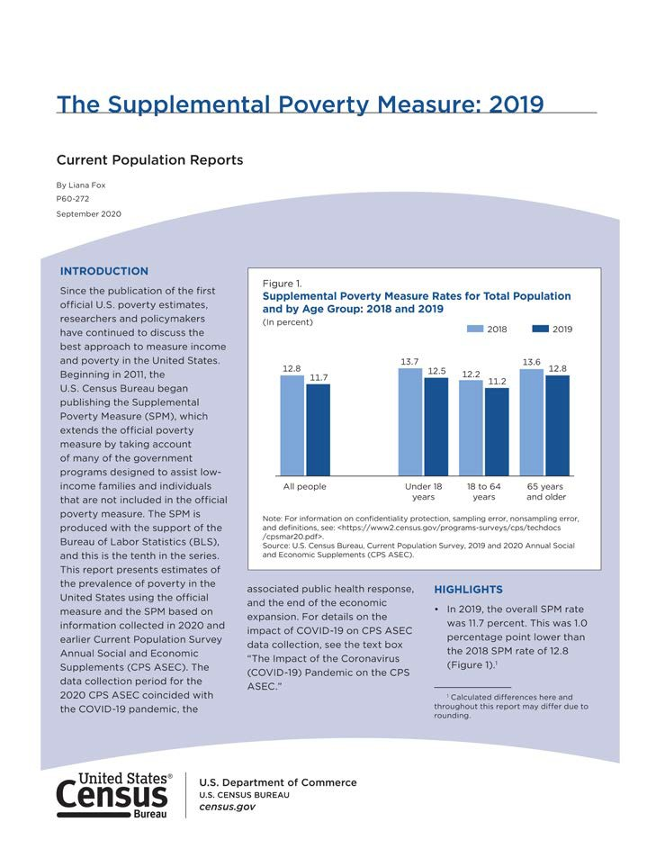
Data are based on the Current Population Survey’s Annual Social and Economic Supplement (CPS ASEC) from February, March, and April 2020.
CPS ASEC is the official source of national poverty estimates.
Official poverty estimates are calculated in accordance with OMB Statistical Policy Directive 14.
Notes:
The income and poverty report and the SPM report are based on data from the Current Population Survey’s Annual Social and Economic Supplement or CPS ASEC. The Current Population Survey is the longest-running survey conducted by the Census Bureau and is the official source of the national poverty estimates.

Slide 5
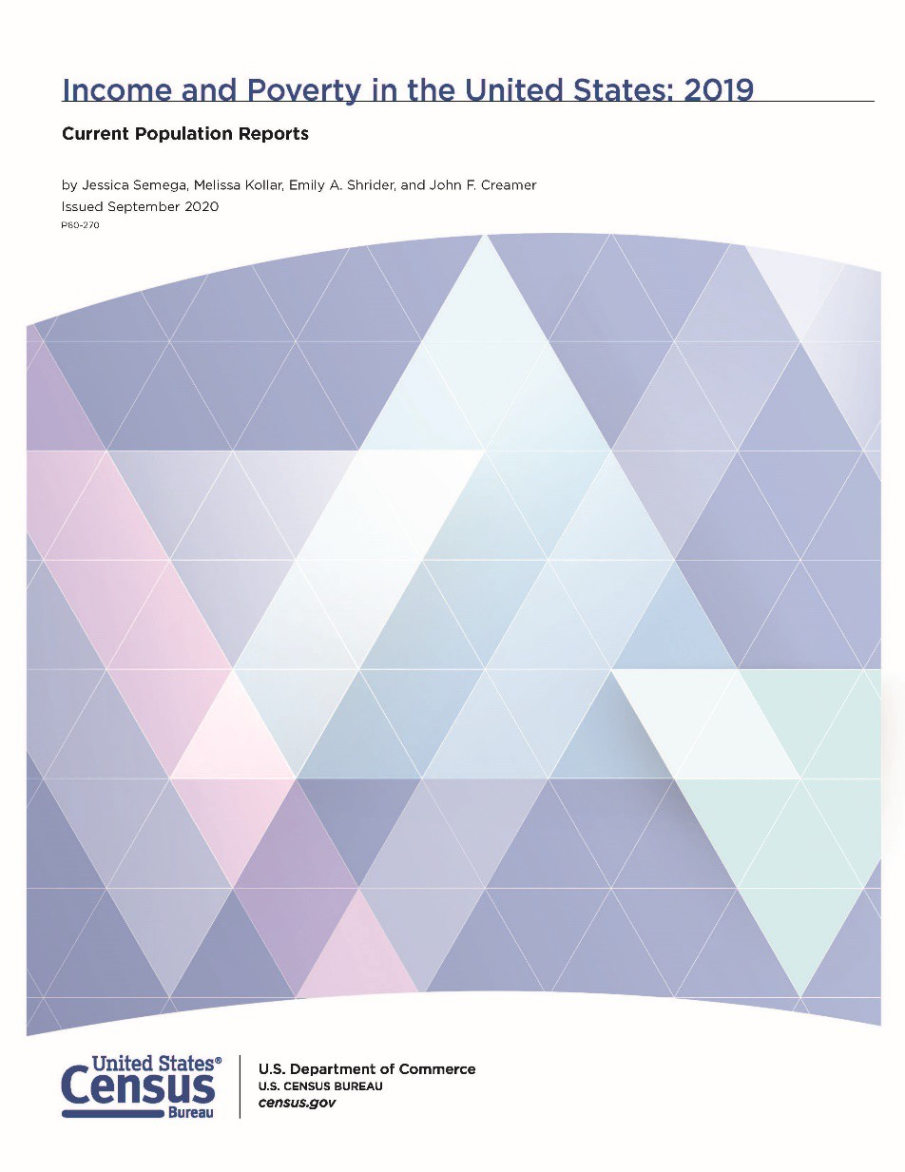
Highlights:
Income, earnings and workers
Real median household income increased 6.8 percent to $68,700 between 2018 and 2019.
The real median earnings of all workers increased 1.4 percent, while the real median earnings of full-time, year-round workers increased 0.8 percent between 2018 and 2019.
Between 2018 and 2019, the total number of people with earnings increased by about 2.2 million. The number of full-time, year-round workers increased by approximately 1.2 million.
Note: Income rounded to nearest $100.
Source: U.S. Census Bureau, Current Population Survey, 2019 and 2020 Annual Social and Economic Supplements (CPS ASEC).
Notes:
Median household income was $68,700 in 2019, a 6.8 percent increase from 2018.

Slide 6
Highlights:
Official Poverty
The official poverty rate in 2019 was 10.5 percent, down 1.3 percentage points from 11.8 percent in 2018. This is the fifth consecutive annual decline in poverty.
The number of people in poverty in 2019 was 34.0 million, approximately 4.2 million fewer than 2018.
In 2019, a family with two adults and two children was categorized as “in poverty” if their income was less than $25,926 dollars.
Source: U.S. Census Bureau, Current Population Survey, 2019 and 2020 Annual Social and Economic Supplements (CPS ASEC).
Notes:
The official poverty rate in 2019 was 10.5 percent, down 1.3 percentage points from 2018.
In 2019, there were 34.0 million people in poverty, a decrease of 4.2 million people from 2018.
Between 2018 and 2019 poverty rates declined for most major demographic groups. No group saw an increase in poverty rates. Poverty rates declined for:
• men and women, (next slide 39)
• native-born and foreign-born individuals, (next slide 40)
• all regions, and (next slide 41)
• inside and outside metropolitan statistical areas.

Slide 7
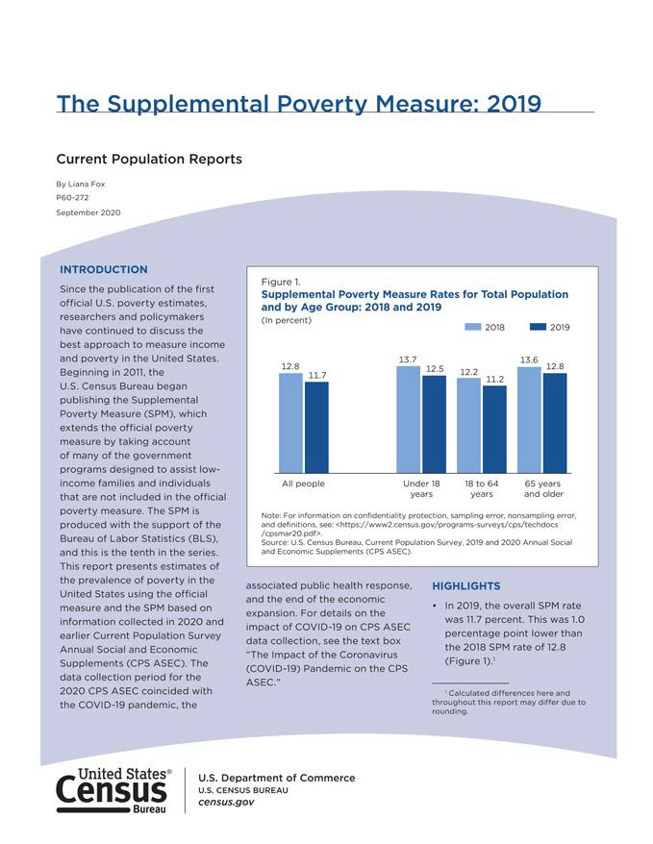
Highlights
The Supplemental Poverty Measure (SPM) rate in 2019 was 11.7 percent. This was 1.0 percentage point lower than 2018 and the lowest rate since estimates were initially published for 2009.
The SPM rate for 2019 was 1.3 percentage points higher than the official poverty rate of 10.5 percent.
There were 16 states plus the District of Columbia for which SPM rates were higher than official poverty rates, 25 states with lower rates, and 9 states for which the differences were not statistically significant.
Source: U.S. Census Bureau, Current Population Survey, 2019 and 2020 Annual Social and Economic Supplements (CPS ASEC).
Notes:
The Supplemental Poverty Measure (or SPM) report is based on data from the CPS ASEC. The SPM extends the official poverty measure by taking into account many of the government programs designed to assist low-income families and individuals that are not included in the official measure. Noncash benefits, such as housing or nutritional assistance, are added to pre-tax cash income, while necessary expenses, such as taxes, work and medical expenses, are subtracted. The SPM does not replace the official poverty measure and is not used to determine eligibility for government programs.
This slide shows SPM rates over time for individuals categorized by race and Hispanic-origin groups. Between 2018 and 2019, all major groups shown in this figure experienced a decline in poverty. SPM rates in 2019 were also at their lowest level since 2009 for all groups shown. In 2019, the SPM rate for Hispanics was 18.9 percent, 18.3 percent for Blacks, 11.7 percent for Asians, and 8.2 percent for Non-Hispanic Whites.

Slide 8

Health Insurance Coverage
Estimates come from two surveys: the Current Population Survey (CPS ASEC) and the American Community Survey (ACS).
This report presents CPS ASEC estimates of calendar-year coverage in 2019 and ACS estimates of changes in coverage at the time of interview and for key populations.
Notes:
Health insurance coverage is an important measure of our nation’s overall well-being. Whether it’s for illness, injury or preventive needs, health insurance provides greater access to medical care, protection from high unexpected costs and more economic stability.
Each year, the Census Bureau provides data on health insurance coverage. We look at who is and isn’t covered, where they live and what type of insurance they have.
The health insurance estimates released today come from two surveys.
• The CPS ASEC asks people about their health insurance coverage at any time in the previous calendar year.
• The American Community Survey or ACS is conducted throughout the year and asks people about their coverage at the time they are interviewed.
In the health insurance report, the CPS ASEC provides calendar-year coverage estimates at the national level; The ACS presents changes in coverage over time and for states and smaller populations.

Slide 9
Calendar-Year Coverage in 2019
92.0%
Any Coverage
The percentage of people without health insurance coverage for the entire calendar year was 8.0 percent, or 26.1 million people.
68.0%
Private Coverage
68.0 percent of people were covered by private health insurance at some point during the year.
34.1%
Public Coverage
The percentage of people with public coverage was 34.1 percent
Note: The estimates by type of coverage are not mutually exclusive; people can be covered by more than one type of health insurance. Source: 2020 Current Population Survey, Annual Social and Economic Supplement (CPS ASEC).
Notes:
• An estimated 92.0 percent of the population had health insurance coverage for some or all of 2019. 8.0 percent, or about 26.1 million people, did not have health insurance at any time in 2019.
• 68.0 percent of people were covered by private health insurance at some point during the year.
• The percentage of people with public coverage was 34.1 percent
Looking at private coverage more closely:
• Employer-based insurance was the most common subtype of coverage overall, covering 56.4 percent of the population;
• while 10.2 percent of people purchased their coverage directly.
Turning to people who had public coverage for some or all of 2019,
• Medicare covered 18.1 percent of the population,
• Medicaid covered 17.2 percent, and
• VA and CHAMPVA covered 1.0 percent.

Slide 10
Percentage of People by Type of Health Insurance Coverage: 2019
Uninsured
8.0
Uninsured
With health insurance
92.0
With health insurance
Any private plan
68.0
Any Private Plan
Employment-based
56.4
Employment-based
Direct-purchase
10.2
Direct-purchase
TRICARE
2.6
TRICARE
Any public plan
34.1
Any Public Plan
Medicare
18.1
Medicare
Medicaid
17.2
Medicaid
VA and CHAMPVA*
1.0
VA and CHAMPVA
*Includes CHAMPVA (Civilian Health and Medical Program of the Department of Veterans Affairs), as well as care provided by the Department of Veterans Affairs and the military.
Source: U.S. Census Bureau, Current Population Survey, 2020 Annual Social and Economic Supplement (CPS ASEC).

Slide 11
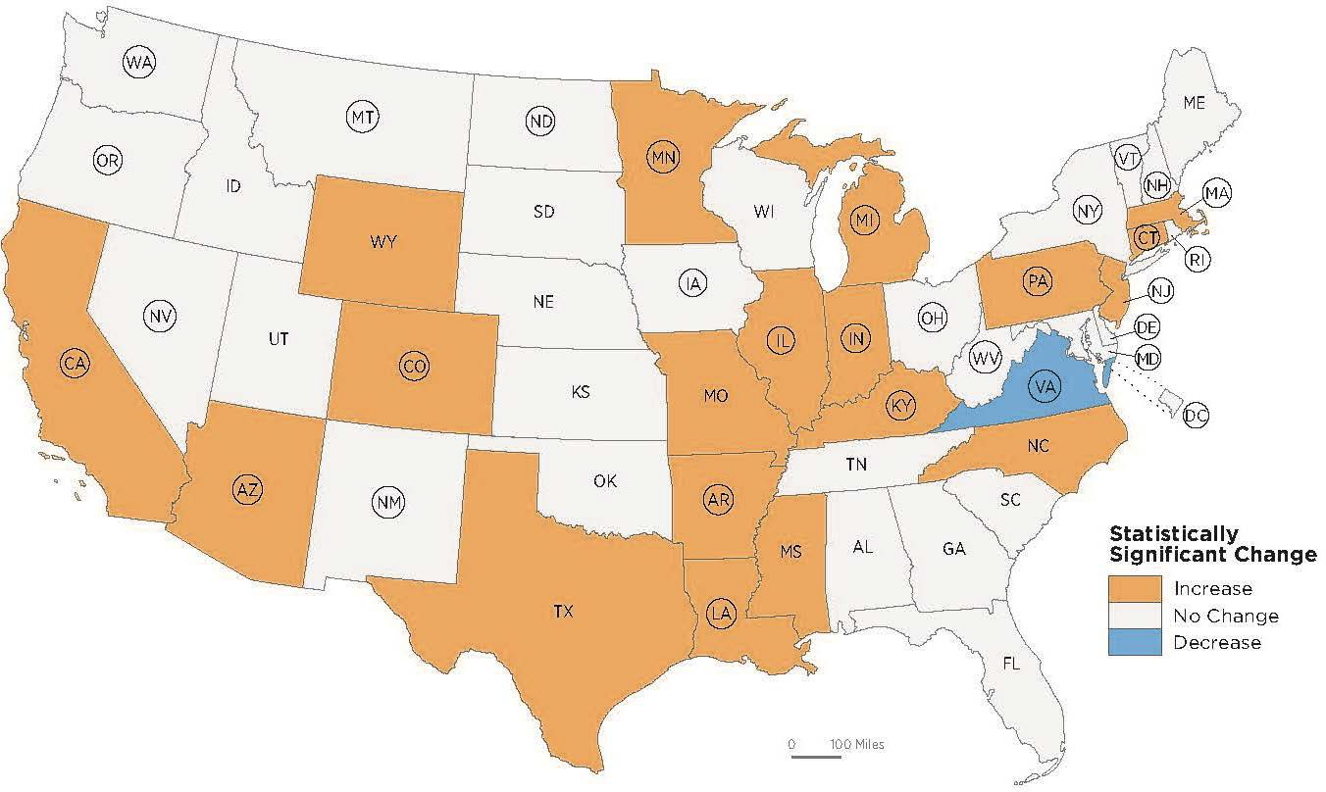
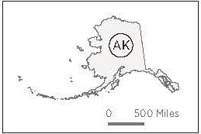
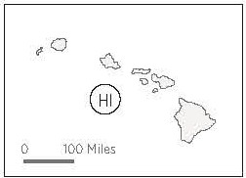


Change in Uninsured Rate by State: 2018 to 2019
U.S. Total +0.3
: A state with a circle around its abbreviation expanded Medicaid eligibility on or before January 1, 2019. Source: U.S. Census Bureau, 2018 and 2019 American Community Surveys, 1-Year Estimates.
Notes:
Overall for the United State, the uninsured rate increased by 0.3 percentage points between 2018 and 2019. However, as you can see on the map, there are differences by state.
Between 2018 and 2019, the percentage of people without health insurance coverage increased in nineteen states. These states are shaded in orange.
The state of Virginia, which expanded Medicaid eligibility under the ACA in 2019, is the only state that had a decrease in the its uninsured rate (by 0.9 percentage points) and is shaded in blue.

Slide 12
CPS ASEC Highlights
Real median household income increased 6.8 percent to $68,700 between 2018 and 2019.
The official poverty rate in 2019 was 10.5 percent, down 1.3 percentage points from 2018. In 2019, there were 34.0 million people in poverty, a decrease of
4.2 million people from 2018.
The Supplemental Poverty Measure (SPM) rate in 2019 was 11.7 percent. This was 1.0 percentage point lower than 2018.
The percentage of people without health insurance coverage for the entire calendar year was 8.0 percent, or 26.1 million people.
.
Note: Income rounded to nearest $100.
Source: U.S. Census Bureau, Current Population Survey, 2019 and 2020 Annual Social and Economic Supplements (CPS ASEC).

Slide 13

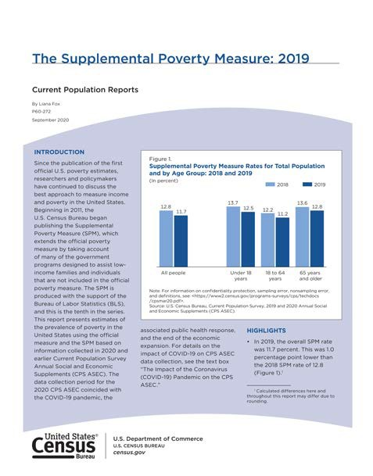

For More Information:
Income and Poverty in the United States: 2019
<https://www.census.gov/library/publications/2019/demo/p60-270.html>
The Supplemental Poverty Measure: 2019
<https://www.census.gov/library/publications/2019/demo/p60-272.html>
Health Insurance Coverage in the United States: 2019
<https://www.census.gov/library/publications/2019/demo/p60-271.html>
Detailed and Historical Tables
America Counts: Stories Behind the Numbers
“Was Household Income the Highest Ever in 2019?”
“Poverty Rates for Blacks and Hispanics Reached Historic Lows in 2019”
“More Young Adults Lived in Shared Households in 2019”
Research Matters Blog
“How Does the Pandemic Affect Survey Response: Using Administrative Data to Evaluate Nonresponse in the CPS ASEC”

Slide 14
2019 American Community Survey 1-Year Release: Sept 17
10 a.m. 12:01 a.m. | Embargo: Sept. 15 Embargo Ends: Sept. 17
7-10 a.m. By 10 a.m. | 2019 ACS 1-Year: Available at data.census.gov, API, QuickFacts, Search Promotions Begin
Notes:
Embargo subscribers will have access to the 2018 ACS 1 year data beginning at 10 am Tuesday, Sept. 24, for public release at 12:01 a.m., Thursday, Sept. 26.

Slide 15
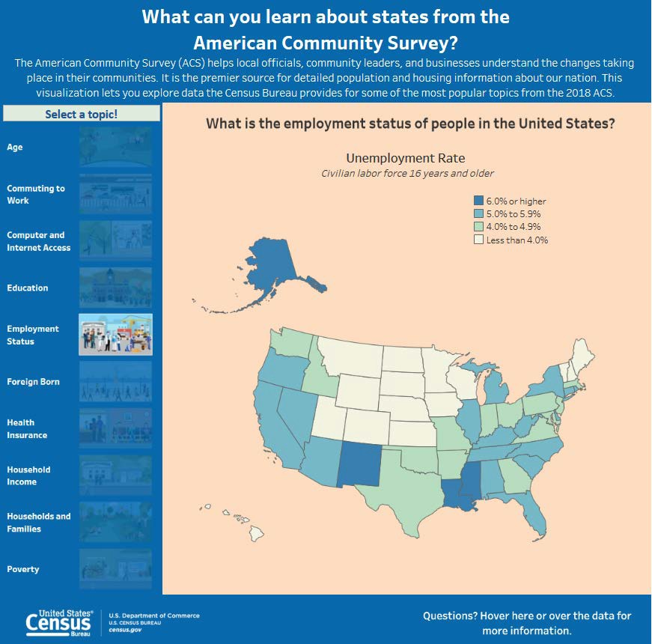
ACS Product Release
Thursday, September 17th (Sept. 15 for Embargo users)
2019 ACS 1-year public release
Data Profiles
Detailed Tables
Comparison Profiles
Selected Population Profiles
Subject Tables
Summary File
ACS Data Tools: data.census.gov, My Congressional District, QuickFacts, API
Visualizations
census.gov/library/visualizations.html
census.gov/programs-surveys/acs/news/data-releases/2019/release-schedule

Slide 16
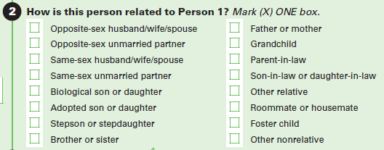
ACS Content Changes Impacting Data Products
Relationship to Householder
Specific information now collected
for the following categories:
Opposite-sex spouse
Opposite-sex unmarried partner
Same-sex spouse
Same-sex unmarried partner
Roomer/boarder category deleted
census.gov/programs-surveys/acs/technical-documentation/table-and-geography-changes/2019/1-year

Slide 17
ACS Content Changes Impacting Data Products (cont.)
2018 categories:
Bus or trolley bus
Streetcar or trolley car (carro publico in Puerto Rico)
Subway or elevated rail
Railroad
Worked at home
2019 categories:
Bus
Subway or elevated rail
Long-distance train or commuter rail
Light rail, streetcar, or trolley (carro público in Puerto Rico)
Worked from home

Slide 18
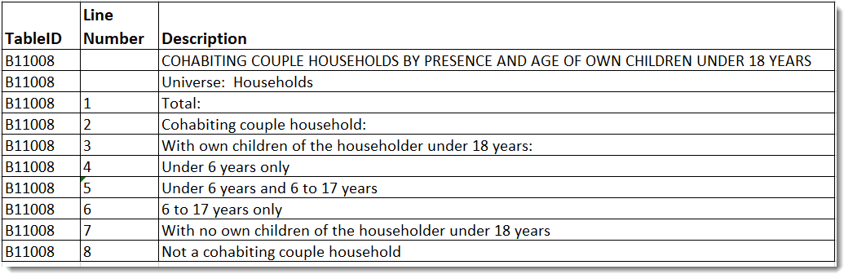
ACS New Tables
Households and Families
B11008: Cohabiting Couple Households By Presence And Age Of Own Children Under 18 Years
B11012: Households By Type
Foreign-Born Population
B05015: Place Of Birth By Year Of Entry For The Foreign-Born Population
Quality Measures
B98003: Unweighted Total Population Sample
Health Insurance
S2713: Private Health Insurance Coverage By Type And Selected Characteristics
census.gov/programs-surveys/acs/technical-documentation/table-shells

Slide 19
ACS Modified Tables
Table ID | 2018 Title | 2019 Title
HOUSEHOLDS AND FAMILIES
B11009 | Unmarried-Partner Households by Sex of Partner | Coupled Households by Type
FERTILITY
B13004 | Women 15 to 50 Years Who Had a Birth in the Past 12 Months by Marital Status | Women 15 to 50 Years Who Had a Birth in the Past 12 Months by Presence of Spouse or Unmarried Partner
JOURNEY TO WORK
B08011 | Sex Of Workers By Time Leaving Home To Go To Work | Sex Of Workers By Time Of Departure To Go To Work
B08132 C08132 | Means Of Transportation To Work By Time Leaving Home To Go To Work | Means Of Transportation To Work By Time Of Departure To Go To Work

Slide 20
ACS Modified Tables (cont.)
Table ID | 2018 Title | 2019 Title
JOURNEY TO WORK (continued)
B08133 | Aggregate Travel Time To Work (In Minutes) Of Workers By Time Leaving Home To Go To Work | Aggregate Travel Time To Work (In Minutes) Of Workers By Time Of Departure To Go To Work
B08302 | Time Leaving Home To Go To Work | Time Of Departure To Go To Work
B08532 C08532 | Means Of Transportation To Work By Time Arriving At Work From Home For Workplace Geography | Means Of Transportation To Work By Time Arriving At Work For Workplace Geography
B08602 | Time Arriving At Work From Home For Workplace Geography | Time Arriving At Work For Workplace Geography
B99083 | Allocation Of Time Leaving Home To Go To Work | Allocation Of Time Of Departure To Go To Work

Slide 21
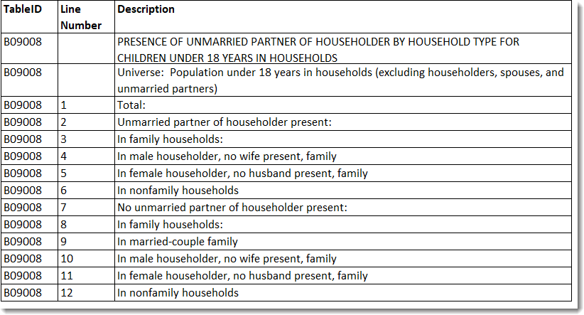
ACS Deleted Tables
Sample Counts
B00001: Unweighted Sample Count Of The Population
B00002: Unweighted Sample Housing Units
Relationship
B09008 & C09008: Presence Of Unmarried Partner Of Householder By Household Type For Children Under 18 Years In Households
census.gov/programs-surveys/acs/technical-documentation/table-and-geography-changes/2019/1-year.html

Slide 22
ACS Geography Update
New Geographies:
American Indian off-reservation trust lands: 3 new geographies in Arizona, California, and Washington
County Subdivisions: 1 new geography in Illinois
Census Designated Places: 2 new geographies in Florida and Missouri
Boundary changes due to annexation, disincorporation, and geocoding updates
census.gov/programs-surveys/acs/technical-documentation/table-and-geography-changes/2019/1-year.html

Slide 23



ACS Geography Update
Compare across geographies and population subgroups using 2019 ACS
Compare similar period lengths (i.e., 1-year to 1-year)
Compare percentages, means, medians, and rates instead of totals whenever possible
Don’t expect ACS estimates to match decennial census counts or estimates from other surveys
census.gov/programs-surveys/acs/guidance/comparing-acs-data.html

Slide 24
ACS vs. CPS
2019 income, poverty, and health insurance estimates from the Current Population Survey (CPS) will be released Tuesday, September 15th
Estimates from CPS and ACS differ for a number of reasons, but trends over time tend to be similar across the surveys
Recommendations:
National estimates
CPS
Subnational estimates
ACS

Slide 25
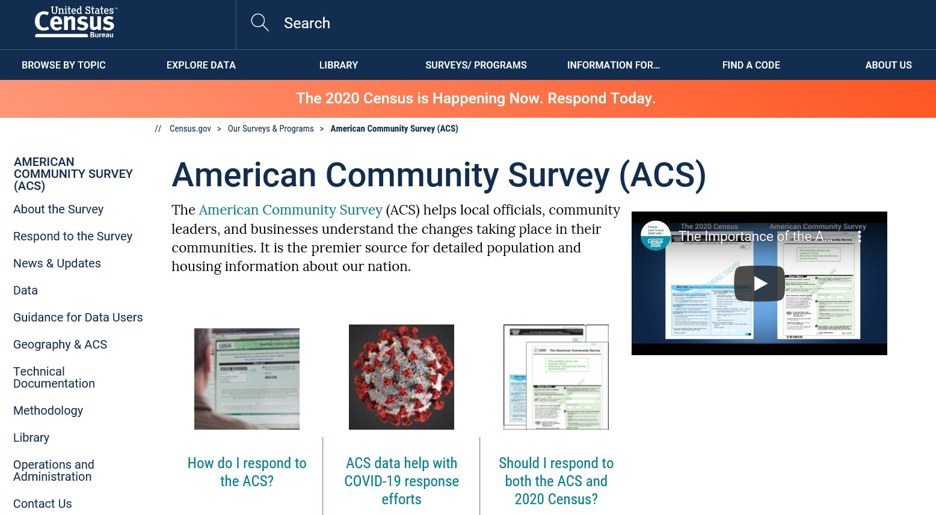
ACS Website
census.gov/acs

Slide 26
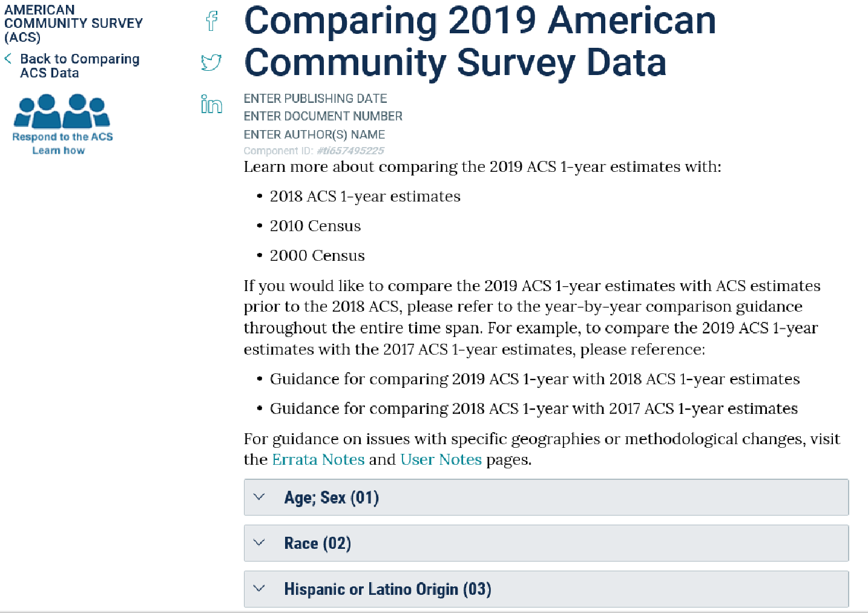
Comparison Guidance
census.gov/programs-surveys/acs/guidance/comparing-acs-data/2019

Slide 27
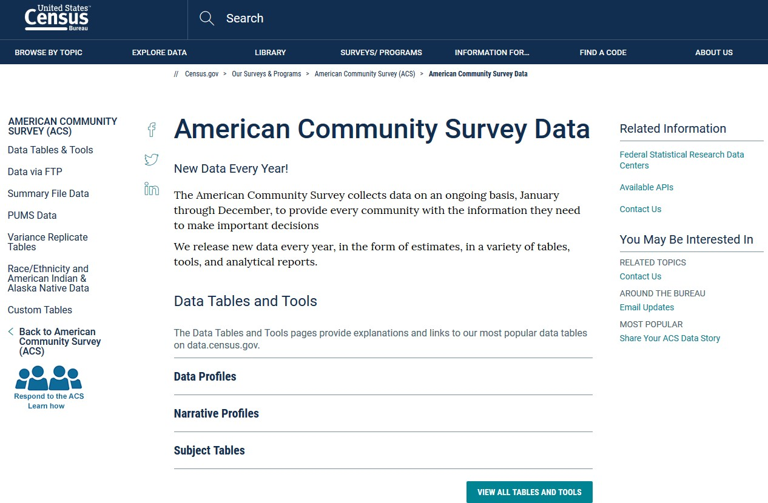
Data
census.gov/acs/data/

Slide 28
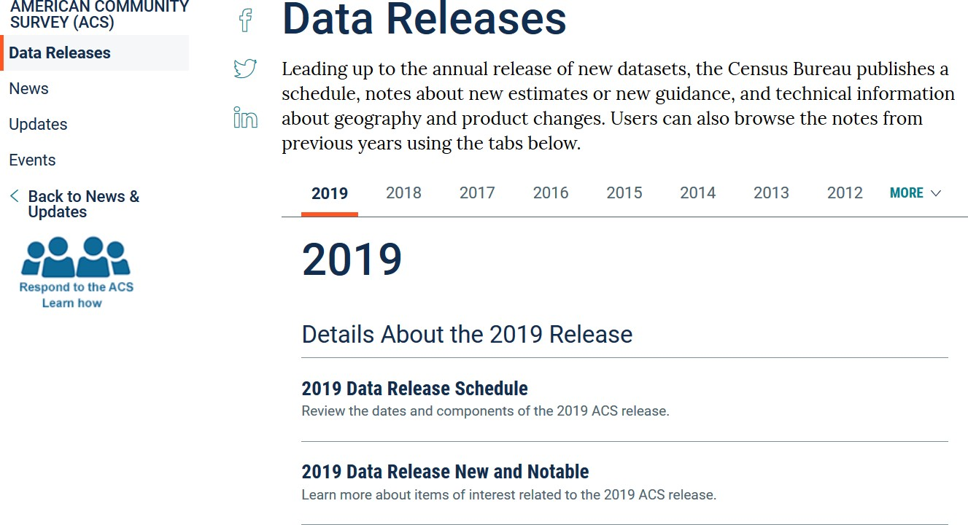
2019 Data Release Information
census.gov/programs-surveys/acs/news/data-releases.html

Slide 29
Future ACS Data Releases
2019 ACS 1-Year Supplemental Estimates (Geographies of 20,000+)
October 15, 2020: Public Release
2015-2019 ACS 5-Year Estimates (All geographic areas)
December 8, 2020:
December 10, 2020:
Embargo Begins Public Release Begins
Public Use Microdata Sample Files (PUMS)
October 15, 2020:
January 14, 2021:
2019 1-Year PUMS File
2015-2019 5-Year PUMS File
2015-2019 Variance Replicate Estimates
January 14, 2021: Public Release

Slide 30
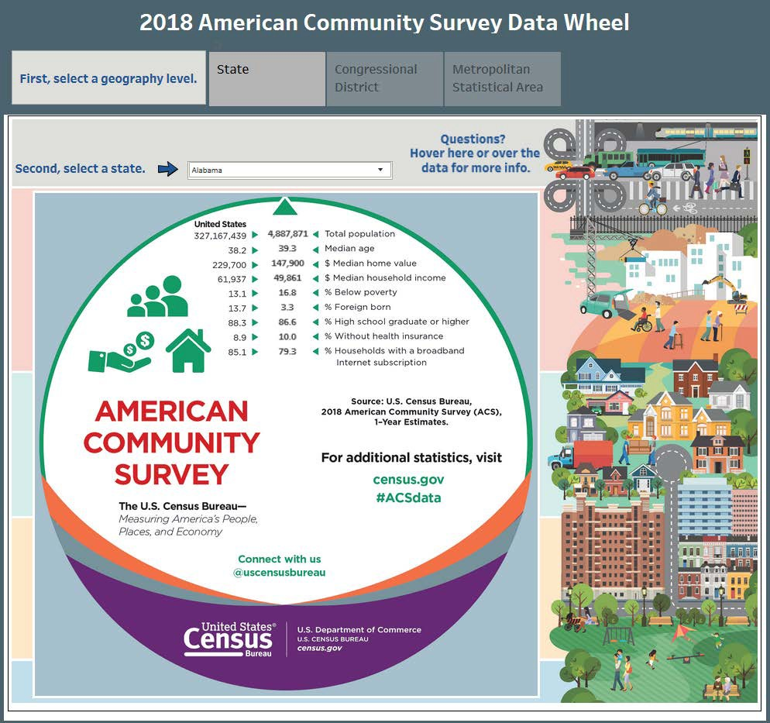
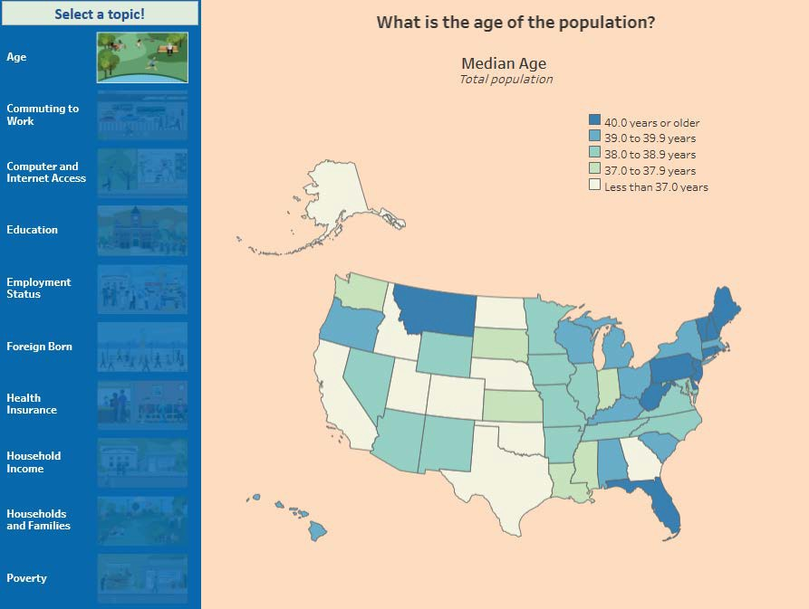
Application Programming Interface (API)
census.gov/data/developers/data-sets
census.gov/data/academy/webinars/2020/demystifying-the-census-api

Slide 31

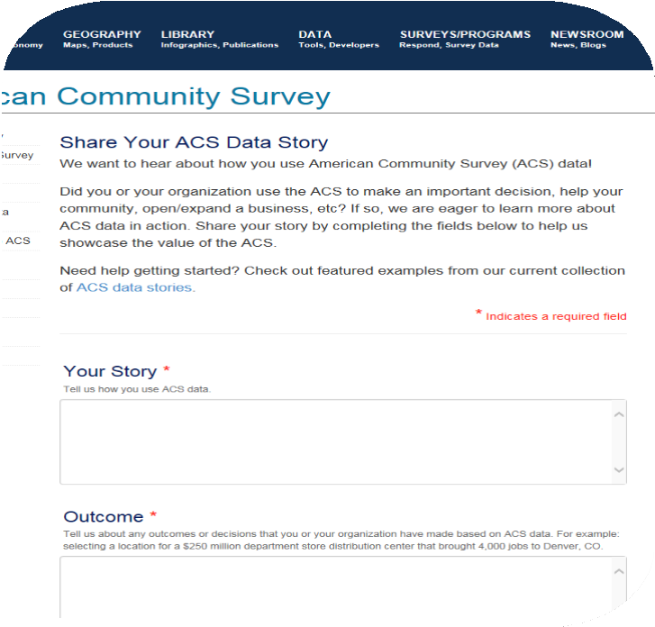


Data Tell Stories. Tell Us Yours!
Your story
Your data details
Your outcome
census.gov/acs/www/share-your-story

Slide 32


Statistics in Schools - New Materials
census.gov/programs-surveys/sis/resources/constitution-day
Notes:
It is a free program.
It provides opportunities
to teach statistics in various
subjects.
It is designed to support
teachers’ existing lesson plans.
The program started in 2000
as Census in Schools.
The program was revised
over the last few years.
Encourage teachers of all subjects to incorporate statistics in their lessons.
Establish a connection now with the next generation of census respondents.
This September 17, join us in celebrating the anniversary of the Constitution’s signing. Constitution Day is an opportunity for students to learn why the census is conducted every 10 years—and why a complete and accurate population count is so important. It’s also a perfect time to remind your students and their families that it is not too late to respond to the 2020 Census and that their responses will help shape the future.
On Constitution Day, students of all ages can use Statistics in Schools activities and resources to learn about how the census enables funding and planning for education as well as determines the number of seats each state gets in Congress for the next 10 years. Explore Constitution Day-related fun facts, view a video on the Apportionment process, or download topical worksheets that are sure to engage students.

Slide 33
Census Academy & Additional Resources

Slide 34

Data Dissemination and Training: census.gov/academy
Bring our data experts to you.
Request a free data training for your organization.
Subscribe to Census.gov/academy.
Join our educational hub to receive our updates and training products
Receive our Data Gems.
These short “how-to” videos are an easy and quick way to increase your knowledge of Census data. Get them in your inbox!
Get access to our data courses.
You will learn-at-your-own-pace with these video- tutorials designed for different skill levels.
Interact with our instructors via webinars.
Learn about our data releases and tools while attending these live virtual classes.
Contact us:
census.askdata@census.gov
1-844-ASK-DATA
Connect with us on Social Media
Notes:
Census Academy, offers ongoing updates for users to access training via upcoming classes, recorded webinars, data gems – your presentation will be posted on YoutTube and a linked to Census Academy, under the Webinars Tab once editing is complete.

Slide 35
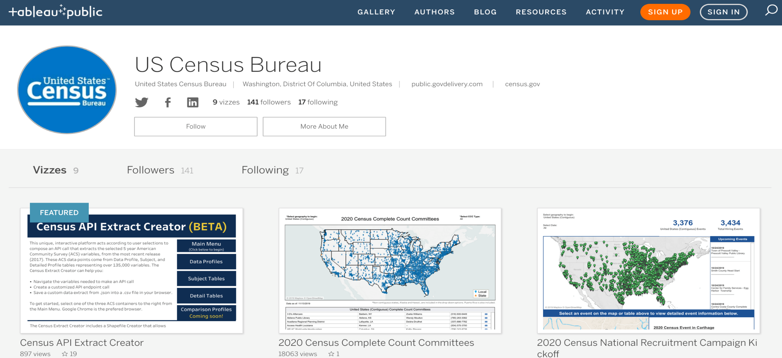
US Census Bureau - Profile | Tableau Public
public.tableau.com/profile/us.census.bureau#!/

Slide 36
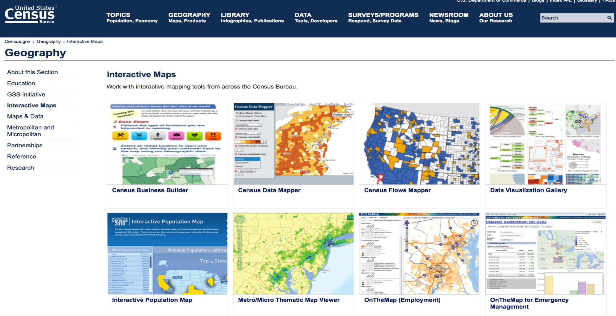
Interactive Maps
census.gov/geography/interactive-maps

Slide 37


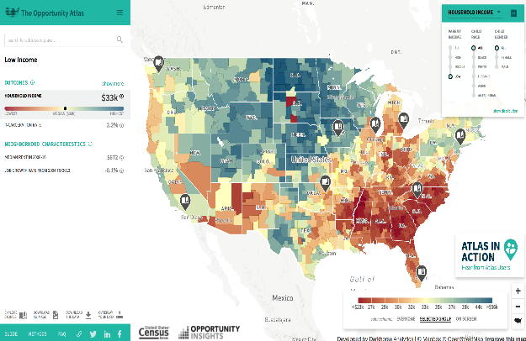
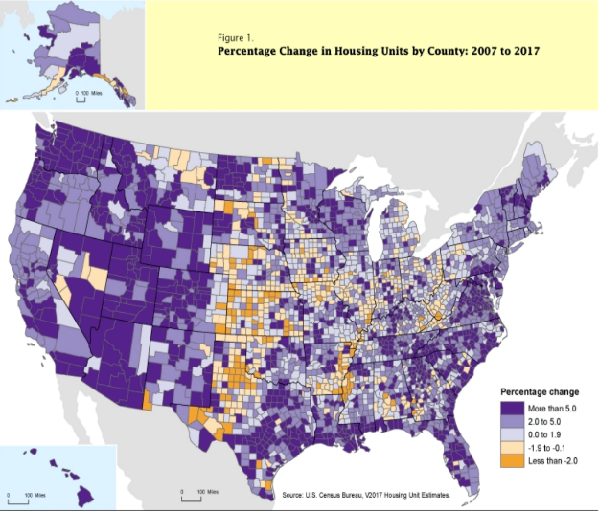
Stay Current
NEWSROOM
DIRECTOR’S BLOG
The latest news releases and statements from the U.S. Census Bureau. Also, find upcoming events, and useful information for media census.gov/newsroom.html
This blog gives the director's point of view on everything from Census Bureau news to how we measure America's people, places and economy.
census.gov/newsroom/blogs/director.html
AMERICA COUNTS
Featured stories on various topics such as families, housing, employment, business, education, the economy, emergency preparedness, and population census.gov/AmericaCounts
STATS FOR STORIES
Provides links to timely story ideas highlighting the Census Bureau's newsworthy statistics that relate to current events, observances, holidays, and anniversaries
census.gov/newsroom/stories.html
census.gov/newsroom/facts-for-features.html

Slide 38









Stay Connected #CensusData
Sign up for and manage alerts at https://public.govdelivery.com/accounts/USCENSUS/subscriber/new
facebook.com/uscensusbureau
twitter.com/uscensusbureau
youtube.com/user/uscensusbureau instagram.com/uscensusbureau
More information on the American Community Survey: https://www.census.gov/acs
Census (Non-media inquiries) 800-923-8282
Public Information Office (Media) 301-763-3030
pinterest.com/uscensusbureau
linkedin.com/company/us-census-bureau

Slide 39


Additional Resources: Want Free Training?
Need Local Stats?
U.S. Census Bureau
Data Dissemination Specialist
Eric Coyle
(702) 236-3202
eric.a.coyle@census.gov
Additional Assistance:
Toll-free number:
1-844-ASK-DATA (1-844-275-2342)
census.askdata@census.gov

Slide 40





Q&A and Thank You!

