Slide 1

Impacts and Recovery
Using the Longitudinal Employer-Household Dynamics Data Tools
Arizona State Data Center
Annual Meeting
Presented by:
Earlene K.P. Dowell

Slide 2
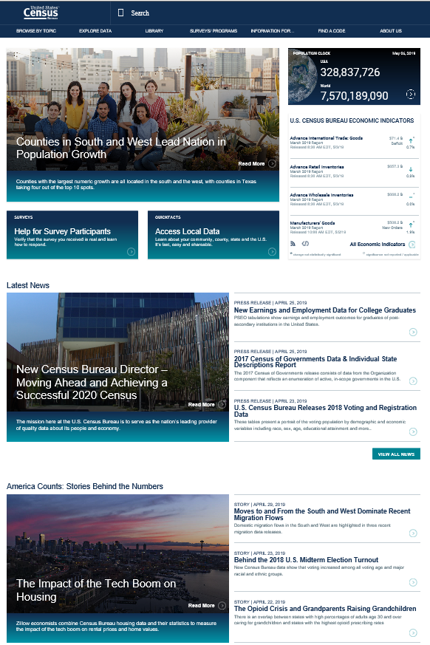
Agenda
LEHD Introduction
Accessing the Longitudinal Employer-Household Dynamics Program’s Data Tools
LODES - OnTheMap and OnTheMap for Emergency Management
QWI - QWI Explorer
J2J Data Flows – J2J Explorer
PSEO - PSEO Explorer
VEO - VEO Explorer
https://www.census.gov/
2

Slide 3
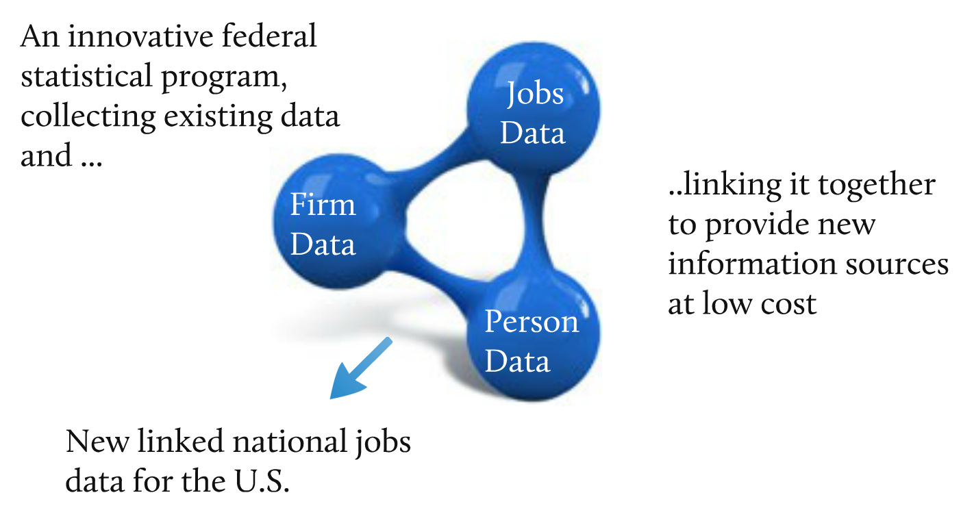
What are LEHD and LED?
The LEHD Program at Census

Slide 4
Longitudinal Employer-Household Dynamics (LEHD)
Where Data is Published:
Data Product | Explore the data, answer questions, or get visualizations | Bulk data for use in analysis process/software | Live queries for building web applications
QWI | QWI Explorer | LED Extraction Tool and Raw data download | Census Bureau API
LODES | OnTheMap OnTheMap for Emergency Management | Raw data download | Future development
J2J | J2J Explorer | Raw data download | Future Development
PSEO | PSEO Explorer | Raw data download | Future Development
VEO | VEO Explorer | Raw data download | Future Development

Slide 5

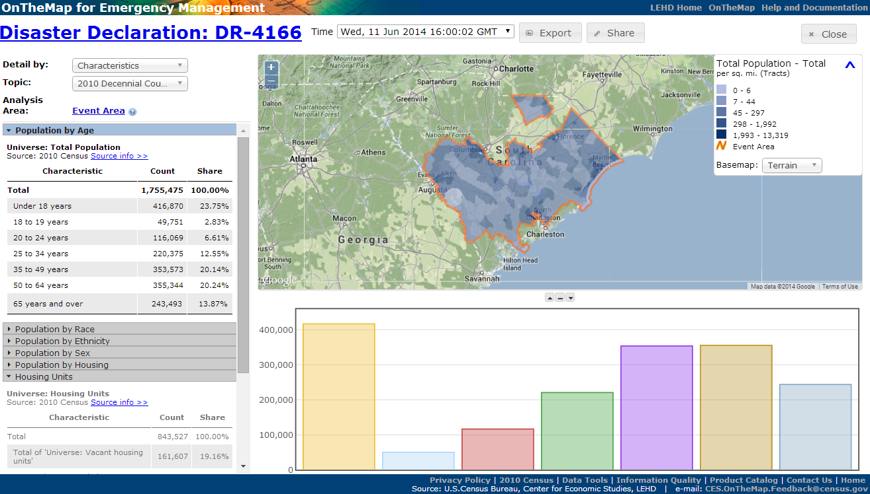



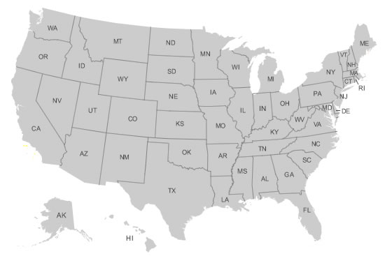

OnTheMap for Emergency Management
Hurricanes, Floods,
Winter Storms
Disaster Areas
Wildfires
Demographic & Economic Data
New Public Data Service for Emergency Preparedness & Response
Comprehensive Reports
Real-time Data Updates
Easy-to-use & Interoperable
Historical Event Archive
Flexible Analyses & Visualizations

Slide 6
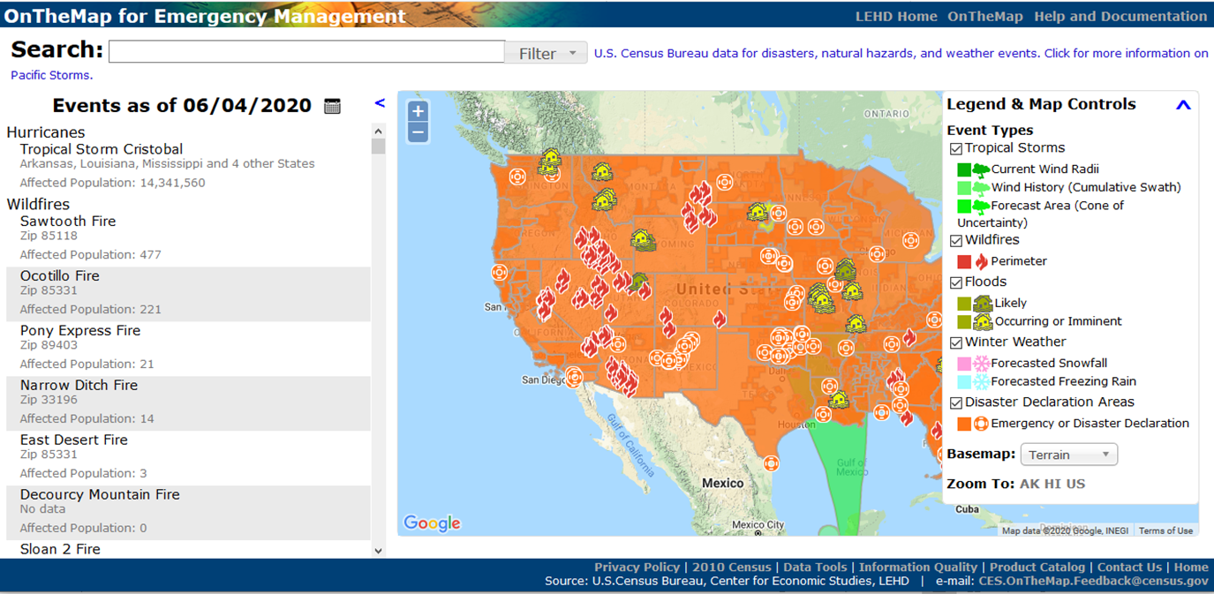
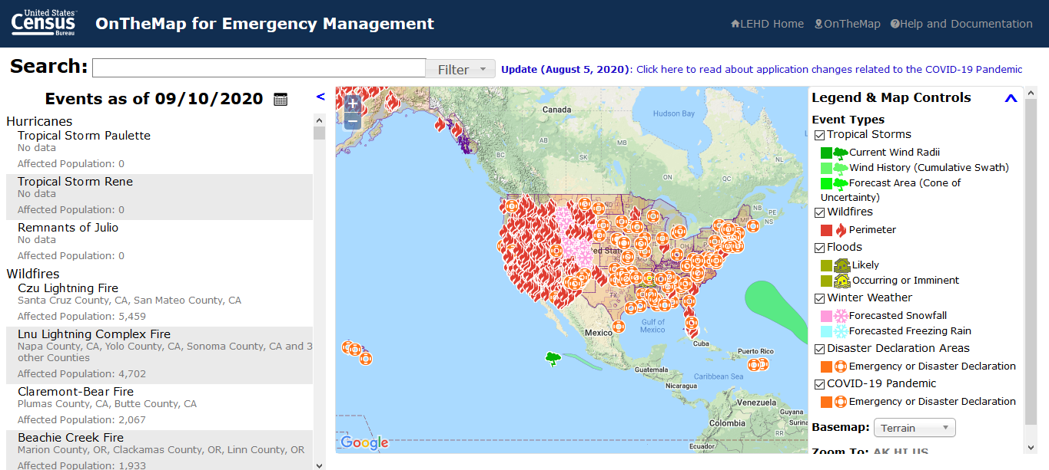
https://onthemap.ces.census.gov/em/
Before
After
Notes:
The after shot was taken on September 10.

Slide 7
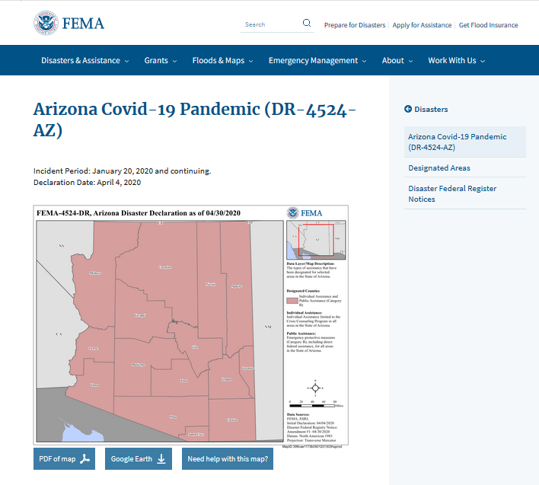
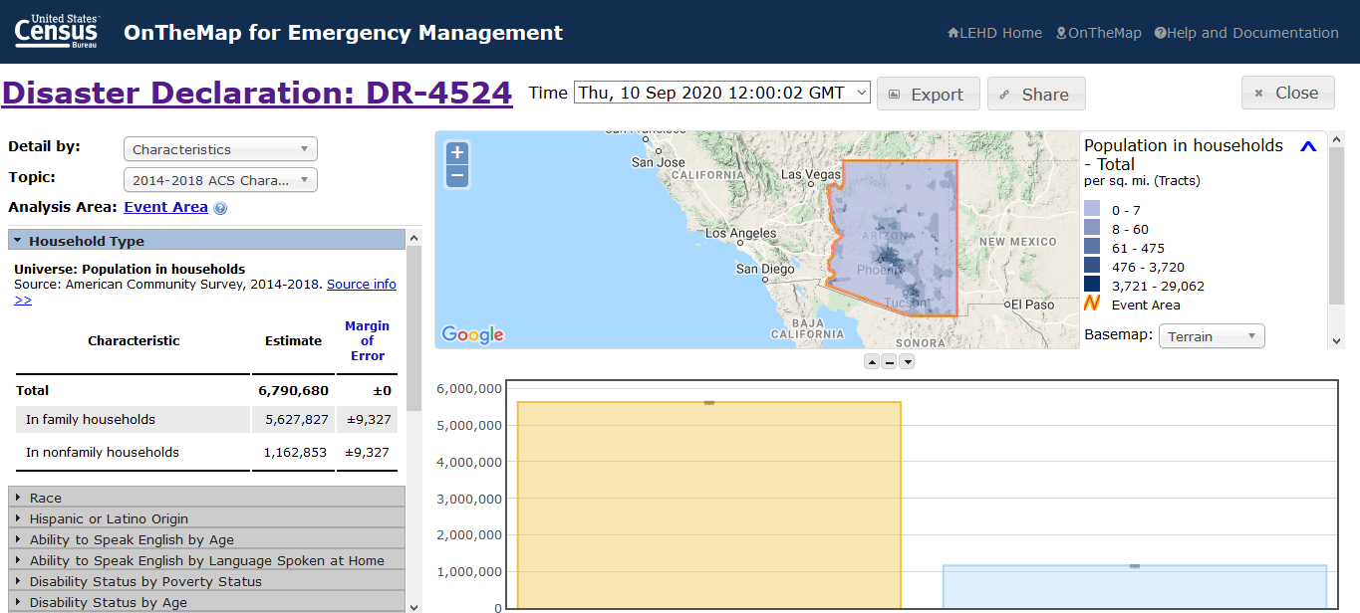
Disaster Declaration – DR-4524

Slide 8
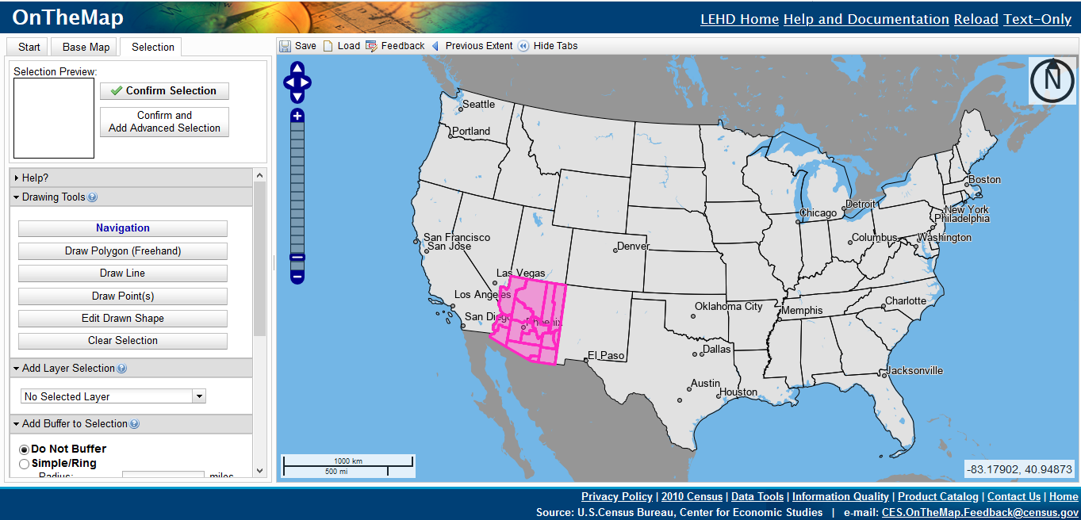
OnTheMap.CES.Census.Gov
Notes:
Go Live – Destination – 50 spoke

Slide 9
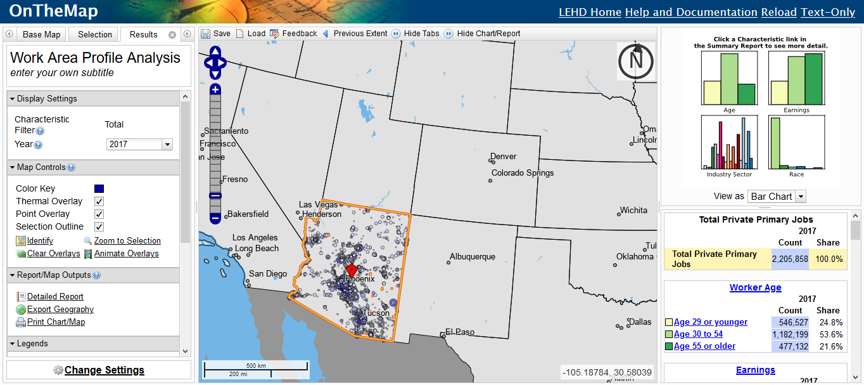
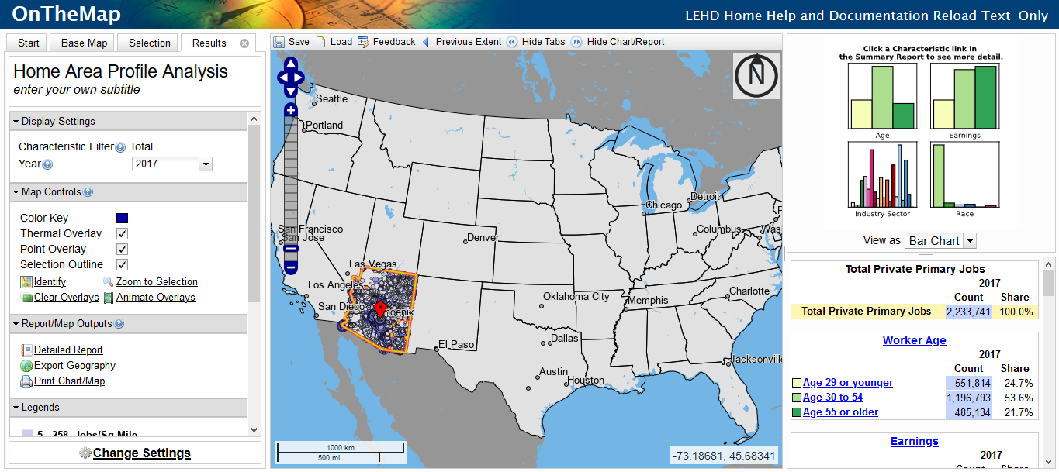
Area Profile – Imported KML
Where Workers Work
Where Works Live

Slide 10
Recovery

Slide 11
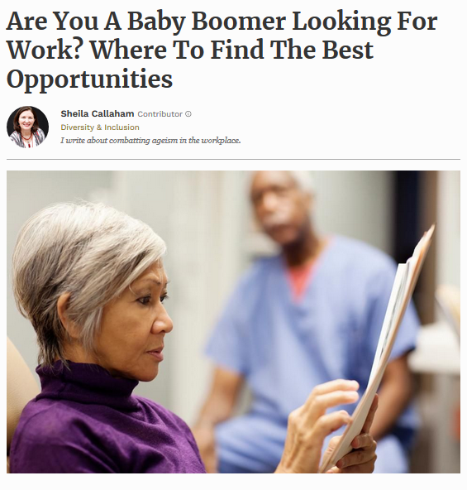
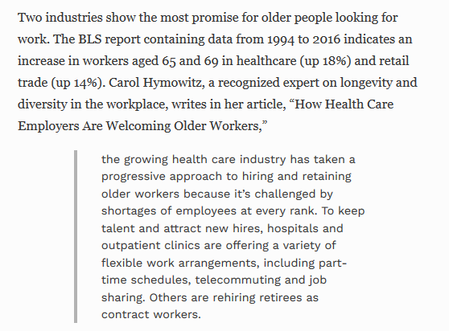
Baby Boomers in Healthcare and Retail Trade
https://www.forbes.com/sites/sheilacallaham/2019/03/21/are-you-a-baby-boomer-looking-for-work-where-to-find-the-best-opportunities/#1629432360bd

Slide 12
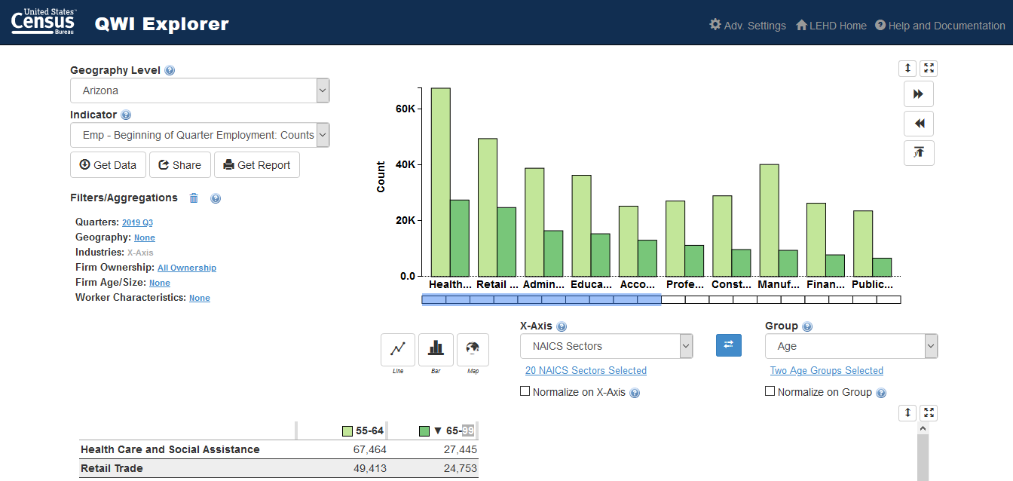
https://qwiexplorer.ces.census.gov/
Notes:
Age friendly industries

Slide 13
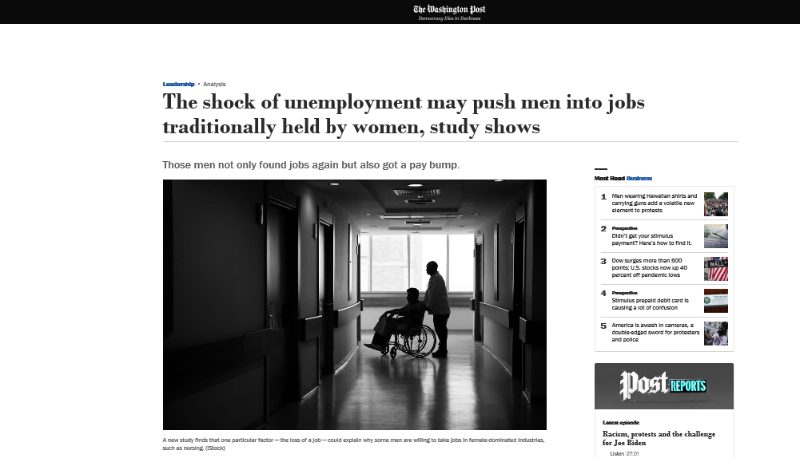
Pink Collared
https://www.washingtonpost.com/business/2020/01/15/shock-unemployment-may-push-men-into-jobs-traditionally-held-by-women-study-shows/
Notes:
Article summary: "Men who worked in male-dominated occupations and became unemployed were more likely to take jobs in female-dominated industries than men who changed jobs without a gap in their employment, the researchers found."
J2J Explorer link: https://j2jexplorer.ces.census.gov/explore.html#245752 (Compare Education and Health to the others; Education and Health have more hires from persistent nonemployment than hires from job-to-job flows while the reverse is usually true for other industries).

Slide 14
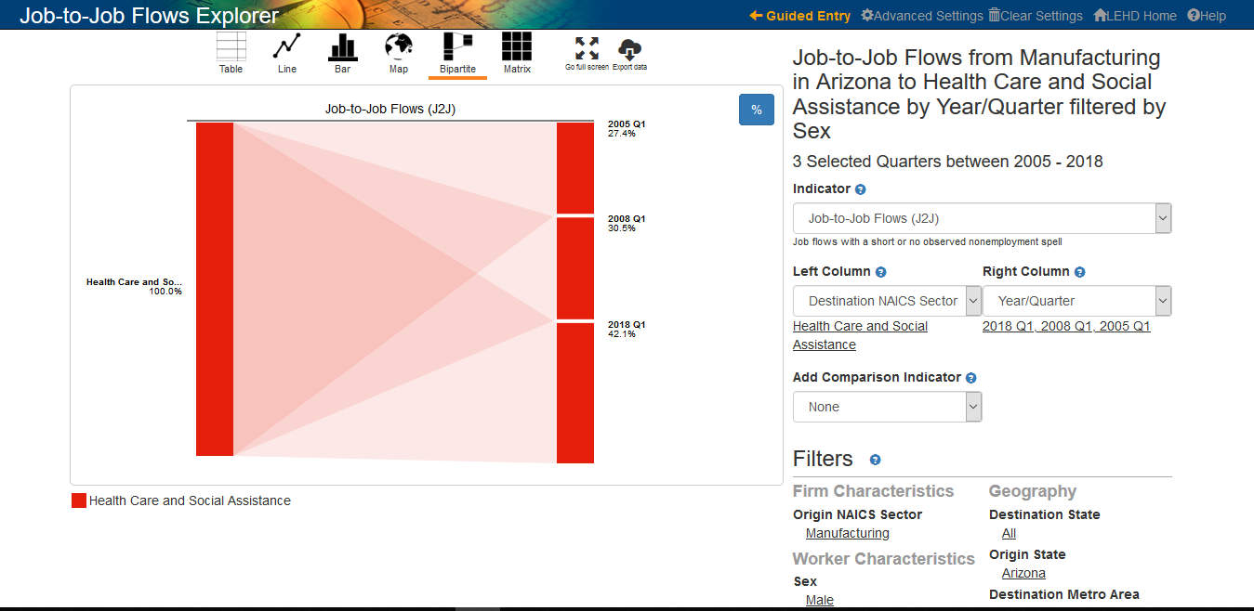
https://j2jexplorer.ces.census.gov/

Slide 15
Post Secondary Employment Outcomes - PSEO
Current PSEO partners:
  The University of Texas system (2017)
  Colorado Department of Higher Education (2017)
  University of Michigan, Ann Arbor (2018)
  University of Wisconsin, Madison (2018)
Future Partners
  Ohio
  New York
A joint pilot project between university systems, state higher education systems, and the Census Bureau, the Post-Secondary Employment Outcomes (PSEO)are experimental tabulations providing national earnings statistics for graduates of post-secondary institutions.
  PSEO Provides
    25th, 50th, and 75th percentiles of annual earnings for college and university graduates.
    Employment by industry and region of the country.
    By degree level, degree major, and post-secondary institution.
    One year, five years, and 10 years after graduation.

Slide 16


LED in Action
https://news.umich.edu/professional-services-health-care-top-industries-for-u-m-graduates/

Slide 17
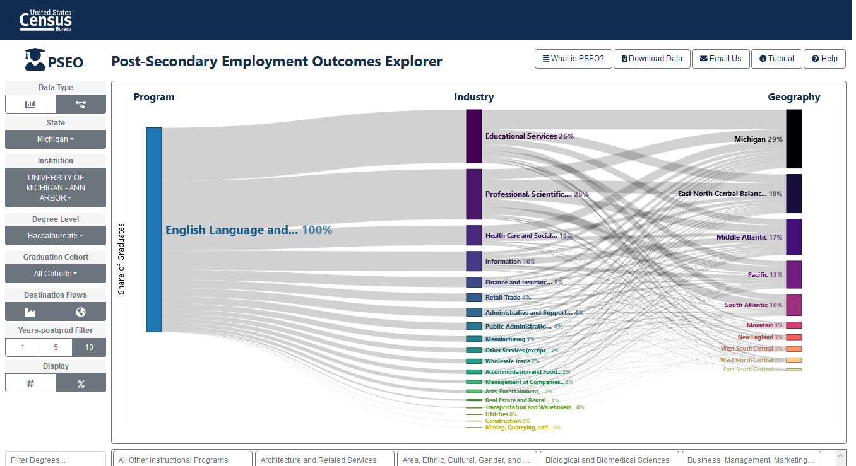
PSEO Explorer

Slide 18
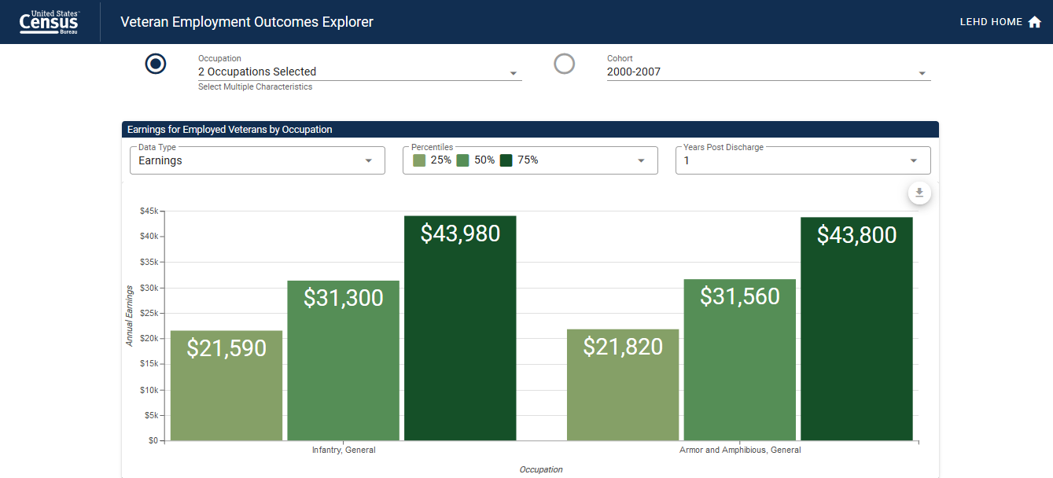
Veteran’s Employment Outcome
Notes:
PSEO’-like statistics for Army veterans, 1, 5, and 10 years after exit.

Slide 19
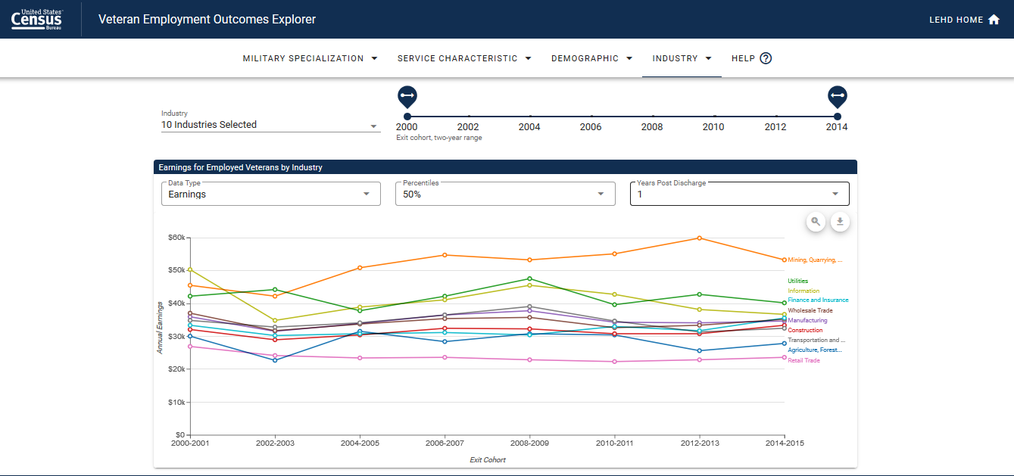
Industry

Slide 20
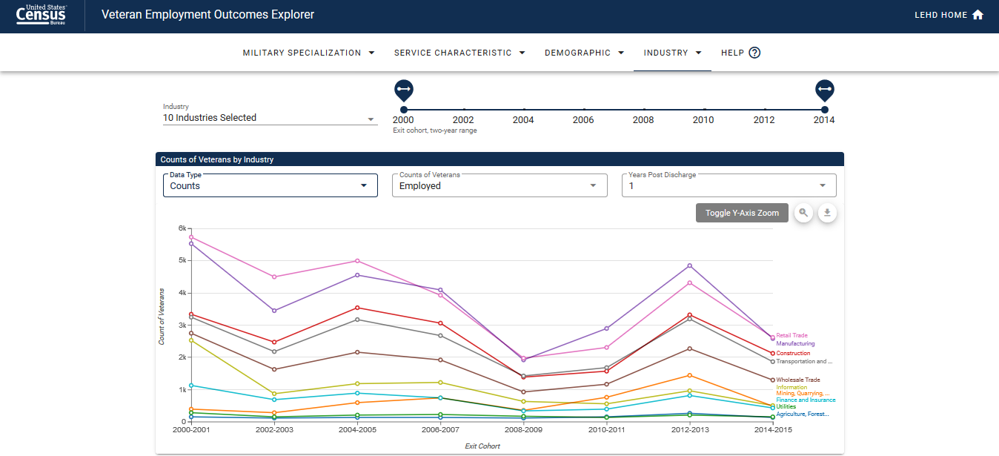
Employment Rates

Slide 21
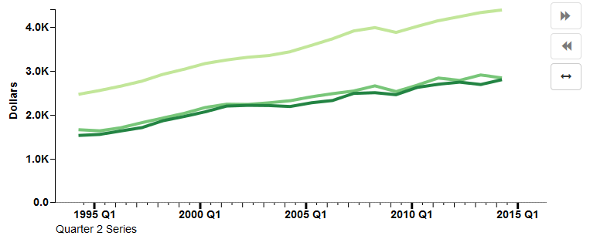
Takeaways: Why Are LED Data Tools Important?
Accessibility
“Explorability”
Provide context
Visualizations lead to insight
Promote/market the data
Provide “value-add” for our state partners

Slide 22





Q & A and Thank You!
Contact me at:
Earlene.KP.Dowell@census.gov
(301)763-9628

