Slide 1
Census Has Business Data?
An Update on the
2017 Economic Census Data for Arizona (and a brief overview of the COVID data)
AZ SDC webinar
September 16th, 2020
Presented by: Andrew W. Hait
U.S. Census Bureau
AZ SDC webinar | Sept 2020| 1

Slide 2
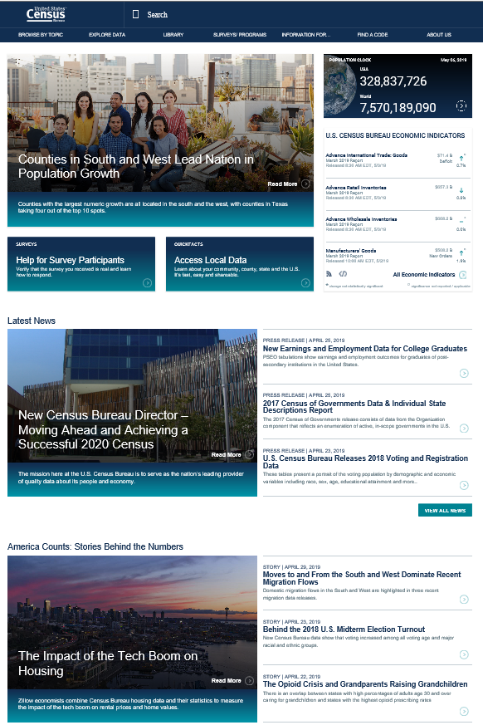
About the Census Bureau
The U.S. Census Bureau is the federal government’s largest statistical agency.
We conduct more than 130 censuses and surveys each year, including
The Decennial Census – the once-a-decade population and housing count of the United States
The American Community Survey – the ongoing annual survey of the nation’s population
The Census of Governments – identifies the scope and nature of the nation's state and local government sector
The Economic Census – the official five-year measure of American business
Our mission is to serve as the leading source of quality data about America’s people, places, and economy.
https://www.census.gov/
AZ SDC webinar | Sept 2020 | 3

Slide 3
Monthly
and Quarterly
Surveys
Annual Surveys
Economic Census – Every 5 years
Census Economic Surveys
Census Bureau Economic Surveys are a key source for official statistics companies can use:
Monthly and Quarterly are small sample surveys that provide the most TIMELY data available
Annual surveys have larger samples and provide the most up-to-date TREND data available
Every 5 years, the Economic Census measures all businesses and provides the most COMPREHENSIVE data available
These surveys set the standard for U.S. economic statistics, and are fueled by the data provided by individual businesses
AZ SDC webinar | Sept 2020 | 4

Slide 4
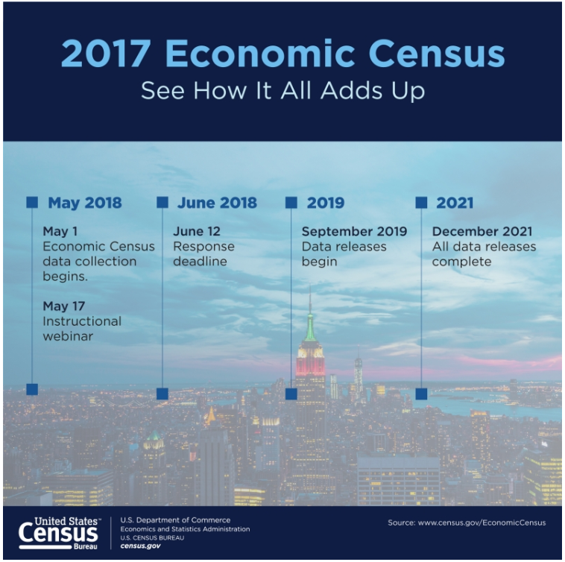
The Economic Census (EC)
NAICS: Every 2- thru 6-digit code covered by the Census Bureau
Excludes Agriculture (NAICS 11) and other selected types of business (see https://www.census.gov/programs-surveys/economic-census/guidance/understanding-naics.html#par_textimage for full list of exclusions)
Geography: Provides data at the national, state, metro area, county, and place levels
Other Dimensions: Data by business size, Franchise status, etc.
Over 200 data variables shown, including variables like the number of establishments, employment, payroll, and sales plus sector-specific variables (inventories, assets, expenses, etc.)
Product Lines data
Released on data.census.gov, Census Business Builder, and other Census tools
Also have related data based on the race, ethnicity, gender, and veteran status of the business owner in the Survey of Business Owners and the Annual Survey of Entrepreneurs
AZ SDC webinar | Sept 2020 | 5
Notes:
Covers almost 8 million employer businesses… excludes nonemployers (which are insignificant in some industries in this sector but NOT others!)

Slide 5
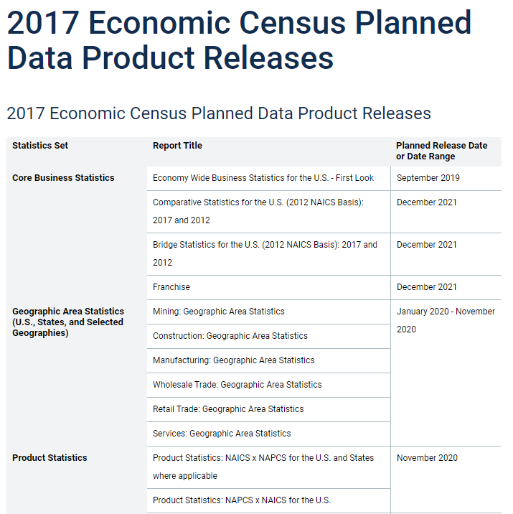
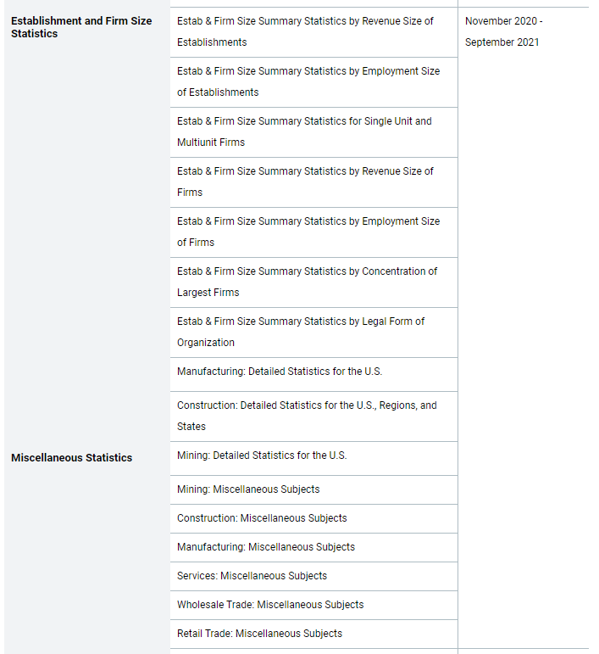
https://www.census.gov/programs-surveys/economic-census/about/release-schedules.html
AZ SDC webinar | Sept 2020 | 6
Notes:
Just compled GAS releases on 8/20… EARLY!

Slide 6
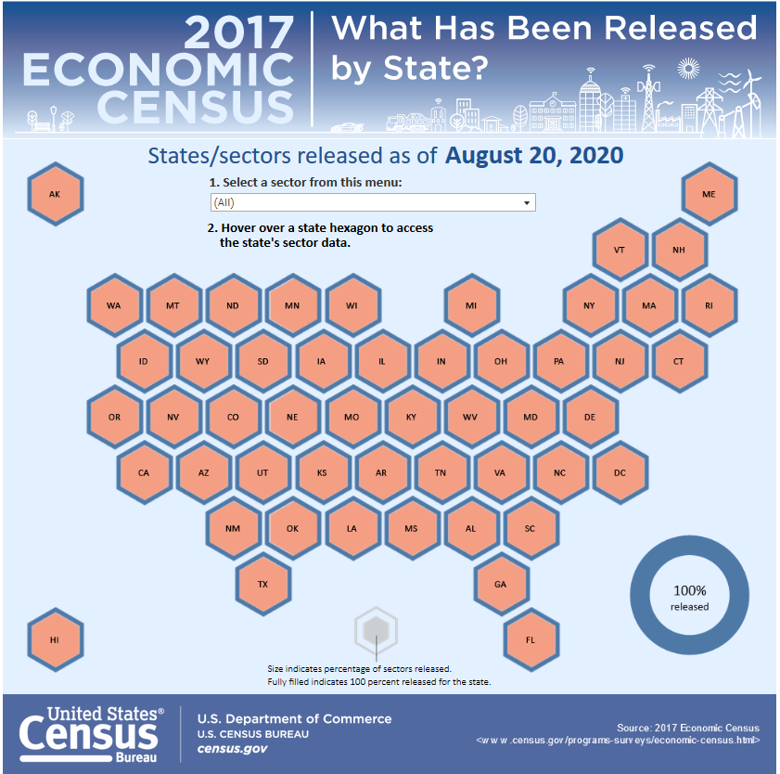
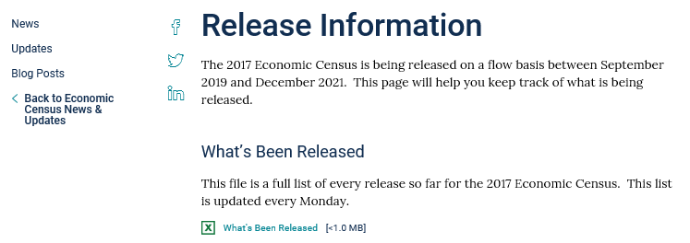
2017 Economic Census GAS Release Resources
https://www.census.gov/programs-surveys/economic-census/news-updates/releases.html
AZ SDC webinar | Sept 2020 | 7
Notes:
Even though series is now complete (all data released) this viz is still useful as it provides deep links into data.census.gov to data by state and sector.
(User can also use menus to drill down by geo and industry.)

Slide 7
Key Changes in the 2017 Economic Census
Geographic area changes (counties, places, metros)
See https://www.census.gov/programs-surveys/economic-census/geographies/change-notes.html
North American Industry Classification System (NAICS) changes
The New North American Product Classification System (NAPCS)
Other changes
Dropped and Changed “Miscellaneous Subjects” tables
New Disclosure Rules (and their impacts)
New Data.census.gov dissemination platform
For a summary of the key changes, view our recorded webinar at https://www.census.gov/data/academy/webinars/2019/2017-econ-census.html
AZ SDC webinar | Sept 2020 | 9

Slide 8
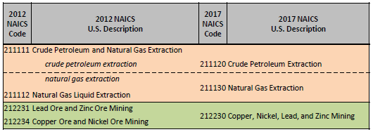
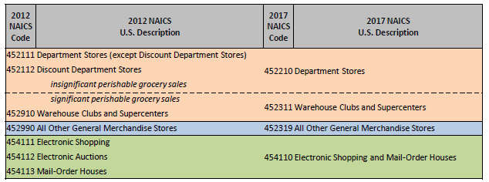
NAICS Changes for 2017
Mining
Manufacturing
Retail Trade
Visit the NAICS website for more information (https://www.census.gov/eos/www/naics/)
AZ SDC webinar | Sept 2020 | 11

Slide 9
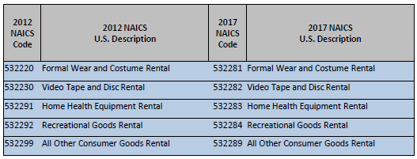
NAICS Changes for 2017 (cont.)
Information
Real Estate & Rental & Leasing
Professional, Scientific, and Technical Services
AZ SDC webinar | Sept 2020 | 12

Slide 10
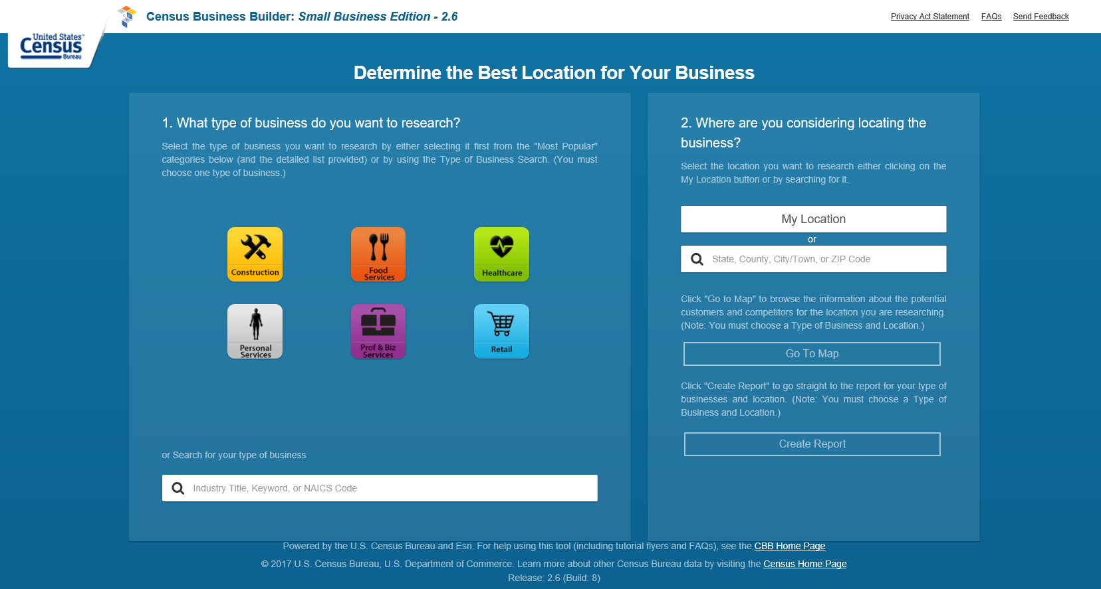
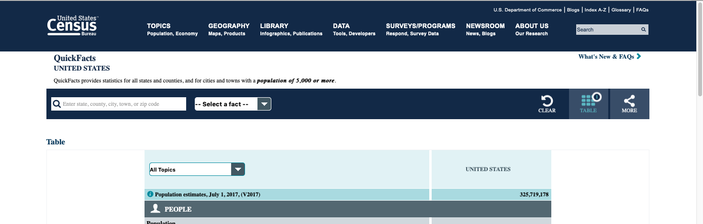
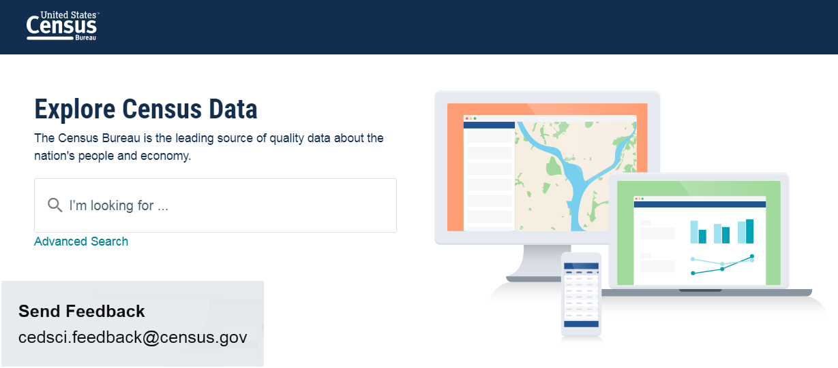
Where to Access the 2017 Economic Census Data
Census Business Builder 3.1
QuickFacts
Data for cities and towns with population 5,000 or more
Data.census.gov
AZ SDC webinar | Sept 2020 | 13
Notes:
2017 EC data will be added to CBB in the August 3.1 update

Slide 11
What’s Coming Next
North American Product Classification System Data (Nov. 2020)
Learn more at https://www.census.gov/programs-surveys/economic-census/guidance/understanding-napcs.html
Establishment and Firm Size Data (Nov. 2020 thru Sept 2021)
Revenue size, establishment size, single/multi-unit, concentration of largest firms, legal form of organization, and franchise status
Miscellaneous Subjects Data (Nov. 2020 thru Sept 2021)
AZ SDC webinar | Sept 2020 | 21

Slide 12
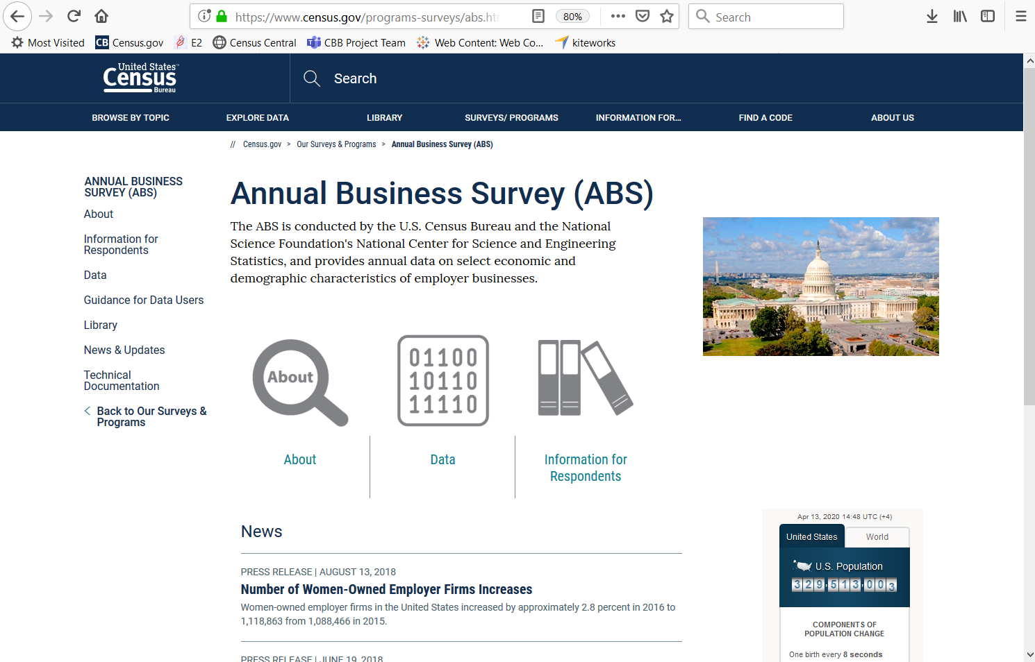
Annual Business Survey
Provides similar data as the SBO and ASE
Data on business ownership by race, ethnicity, gender, and veteran status for employer businesses
Geographies
Nation and State by 2- thru 6-digit NAICS
County, Metro, and Place by 2-digit NAICS
Released May 19th
https://www.census.gov/programs-surveys/abs.html
AZ SDC webinar | Sept 2020 | 7

Slide 13
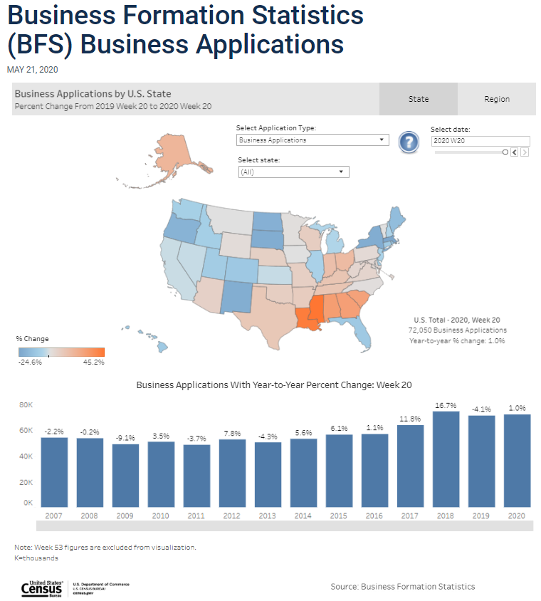
Business Formation Statistics
Provides weekly data on Business Applications and Formations
Data on Total Business Applications, plus breakout for
BAs from Corporations
High Propensity Bas
BAs with Planned Wages
Estimate and Year-to-Year % change
Geographies
Nation, Region, and State (no NAICS detail)
Released May 21st
https://www.census.gov/econ/bfs/index.html?#
https://www.census.gov/library/visualizations/interactive/bfs-weekly-business-applications.html
AZ SDC webinar | Sept 2020 | 8

Slide 14
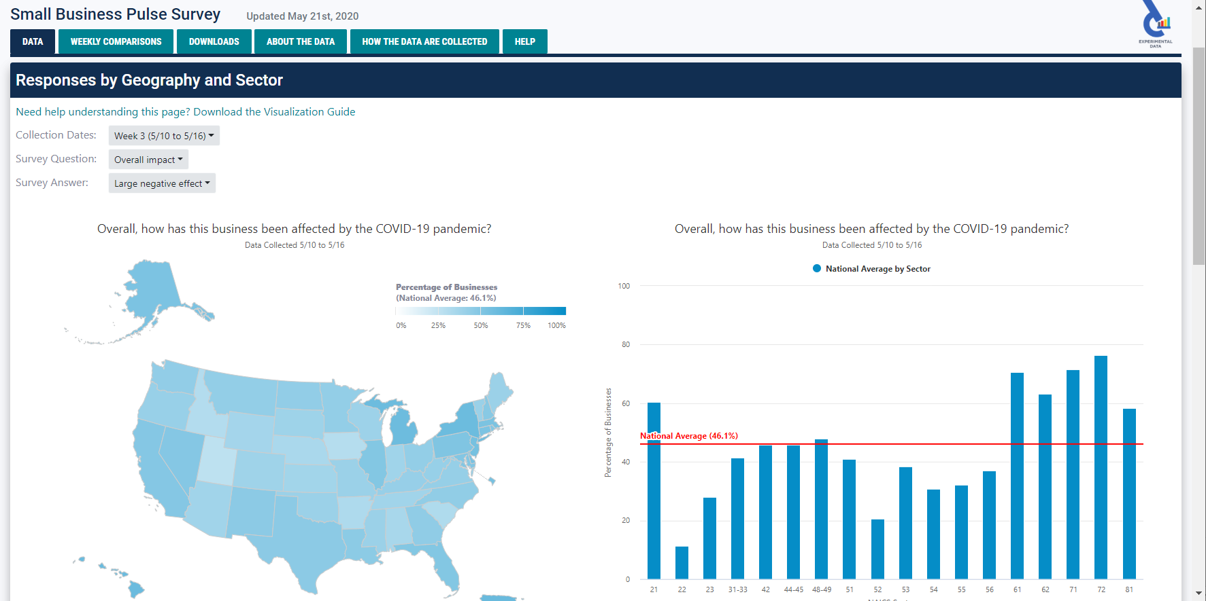
Small Business Pulse Survey
Measures the changes in business conditions on small businesses during the COVID-19 pandemic
Data on the impact of COVID-19 on small employer businesses
Geographies
Nation and State by 2-digit NAICS
Released May 14th
https://www.census.gov/data/experimental-data-products/small-business-pulse-survey.html
AZ SDC webinar | Sept 2020 | 9

Slide 15
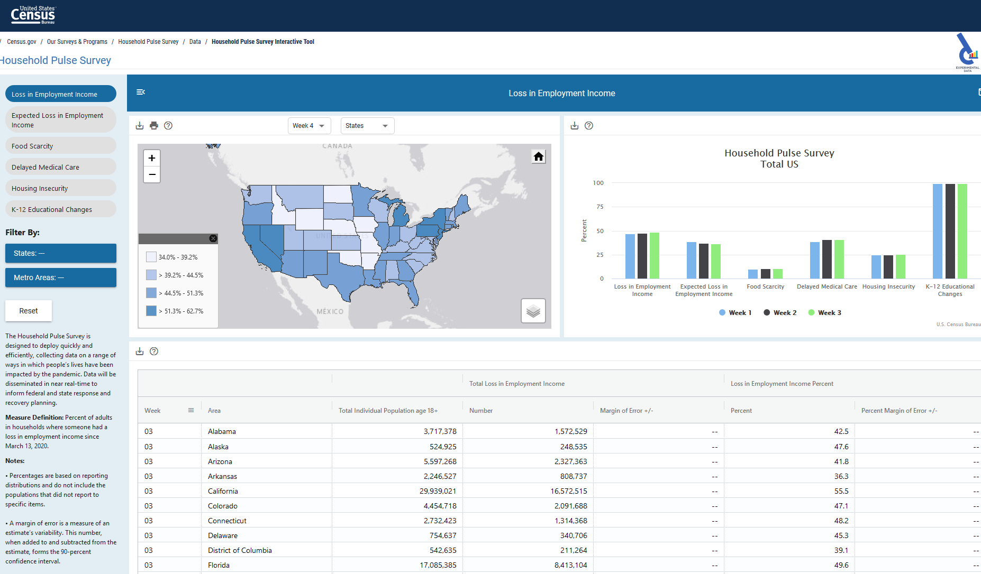
Household Pulse Survey
The Household Pulse Survey is designed to deploy quickly, and efficiently collect data to measure household experiences during the Coronavirus (COVID-19) pandemic.
Data is being disseminated in near real-time to inform federal and state response and recovery planning.
https://www.census.gov/programs-surveys/household-pulse-survey/data.html
https://www.census.gov/data-tools/demo/hhp/#/

Slide 16
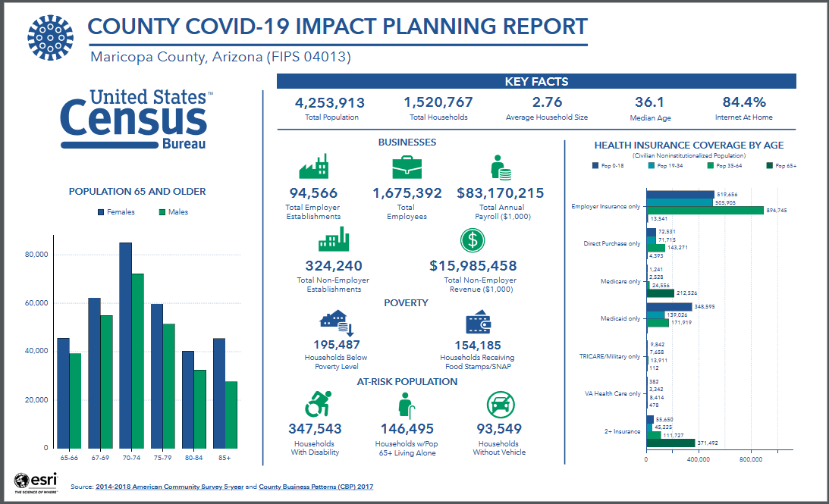
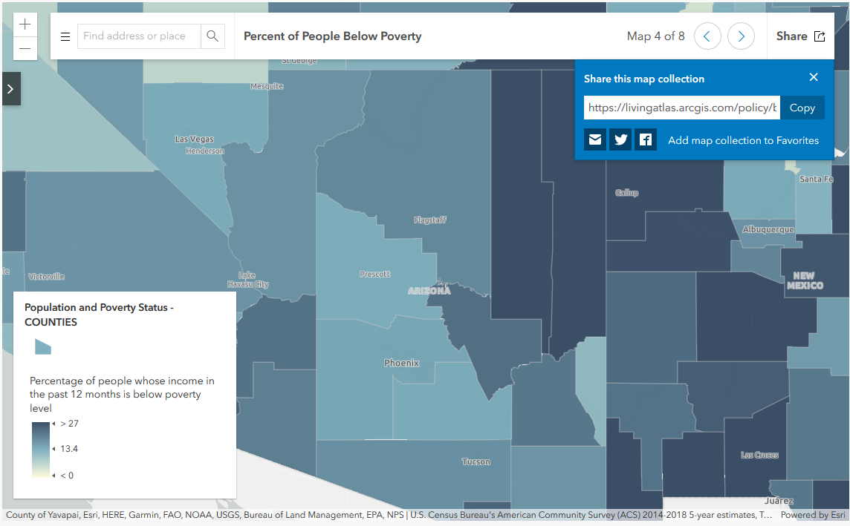
COVID-19 Hub
https://covid19.census.gov/
https://www.census.gov/topics/preparedness/events/pandemics/covid-19.html
AZ SDC webinar | Sept 2020 | 11

Slide 17
Summary
The Economic Census provides a wealth of business data
Learn more at https://www.census.gov/programs-surveys/economic-census.html
The data are released on a flow basis
Learn more at https://www.census.gov/programs-surveys/economic-census/news-updates/releases.html
NAICS changes every 5 years… make sure data are comparable
Learn more at https://www.census.gov/eos/www/naics/
The data are now being released on data.census.gov
More EC data are coming…
The new COVID programs and Hub provide a glimpse into the impacts of the pandemic on households and businesses
AZ SDC webinar | Sept 2020 | 22

Slide 18
Q & A and Thank You!
Contact me at:
Andrew.W.Hait@census.gov
(301)763-6747
AZ SDC webinar | Sept 2020 | 23

