Slide 1
US Census Bureau Updates
October 2022
Agenda
2020 Follow-up - CQR , Data Releases, Special Census
New Look to Census.gov
Field Division Tribal Relations Program
Planning for 2030 – Decennial Specialist, Fed Register Notice
Questions & Answer
Vicki McIntire, Assistant Regional Director
Jim Castagneri, Geographer
Tamia Morris, Decennial Specialist
Denver Regional Office, Denver
U.S. Census Bureau

Slide 2
CQR
Submission end – June 30
AZ request thus far
Chandler City Somerton City
Flagstaff City Yuma City
PCGQR
Submission end – June 30
AZ request thus far
Yuma Florence
More 2020 Census Data
October 6th – Operational Quality Metrics for Counties and Tracts
Summer 2023 – More detailed data such as Tribal Affiliation
Special Census Program
March 2023 – Cost Estimate Requests Begin
January 2024 – Earliest Data Collection to start
New Special Census Website to be Released
Initial Internet Self-Response Has Been Added
Paper follow-up with Non-Responders
Census Bureau will pay enumerators not the GU as in the past

Slide 3
New Look for Census.gov
Global Search (type in)
TOPIC - search by subjects in dropdown or A-Z list
DATA & Maps - search by directly using a data product tool
SURVEYS/PROGRAMS – search by the specific source of the data – ACS, population estimates …
https://www.census.gov/

Slide 4
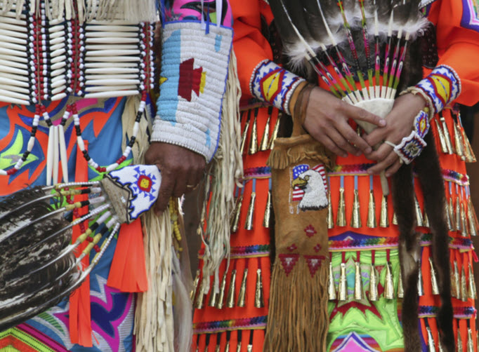
Field Division Tribal Relations Program
Permanent On-Going Program
Formed in March 2022
Maintain Relationships Throughout the Decade
Support
Ongoing Surveys
Recruiting and Hiring
2030 Planning and Efforts

Slide 5
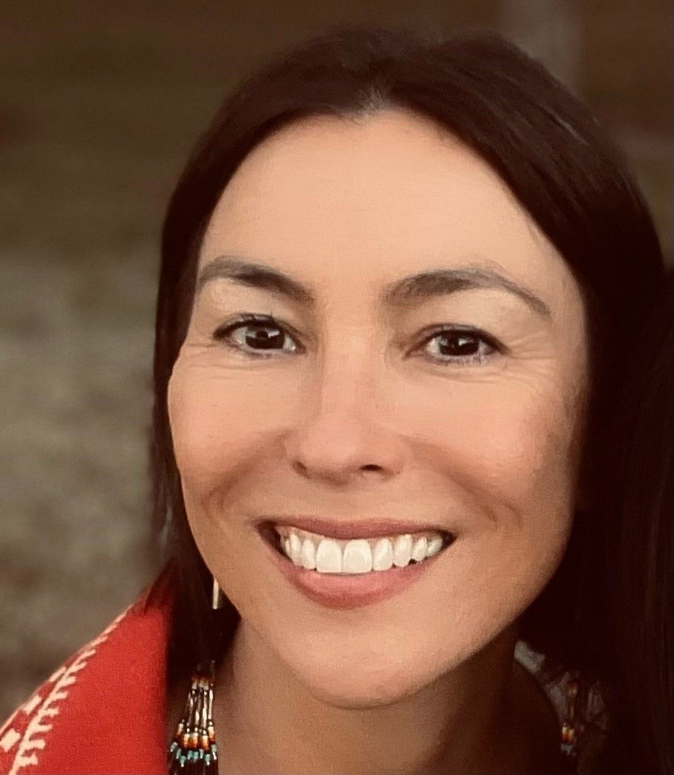
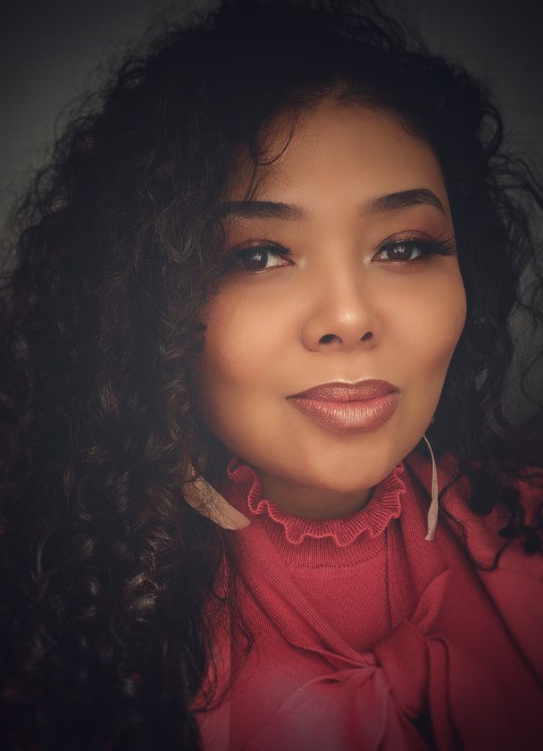
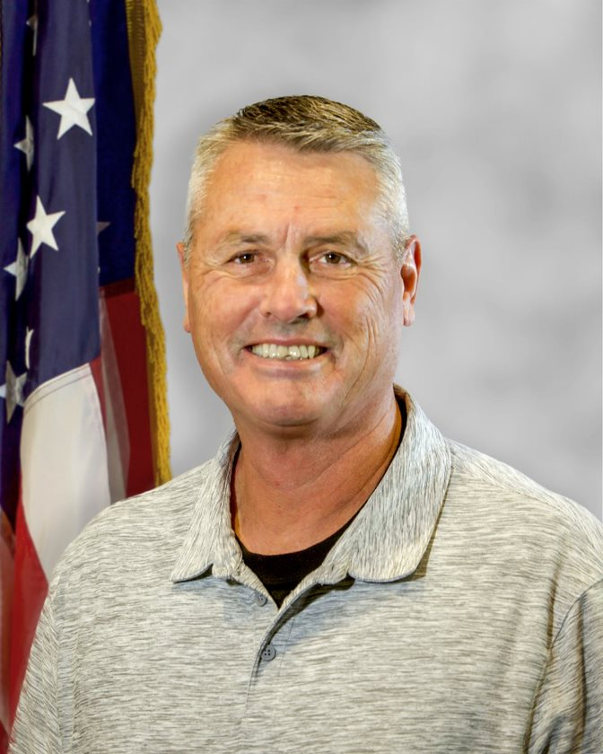
Tribal Relations Specialists
BERNADECE BODA
Little Traverse Bay Bands of Odawa bernadece.a.boda@census.gov
JESSICA IMOTICHEY
Chickasaw Nation jessica.a.imotichey@census.gov
SHADANA SULTAN
Oglala Lakota
shadana.m.sultan@census.gov
CHARLES TIPPECONNIC
Comanche Nation of Oklahoma charles.tippeconnic@census.gov

Slide 6
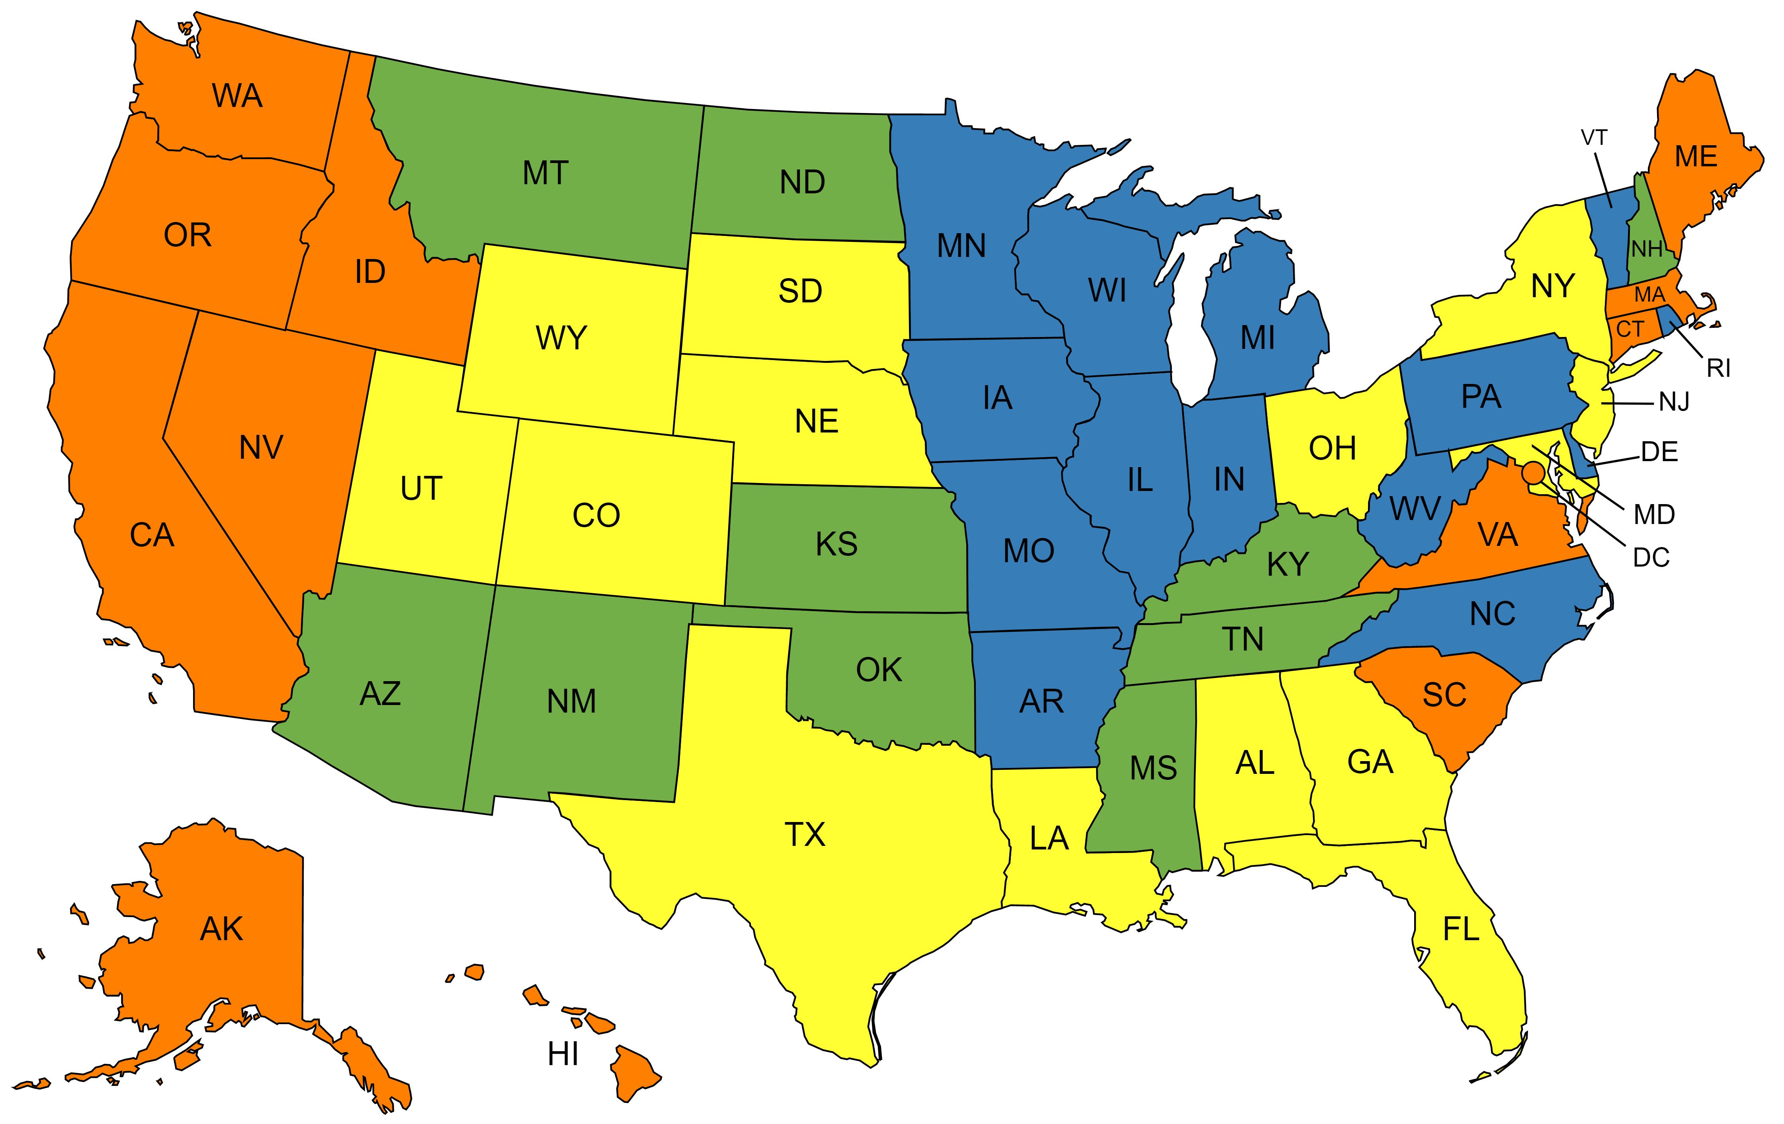
The Tribal Relations Program A Field Division Initiative
Four specialists reporting to Regional Offices
Focus on maintaining and improving tribal relations in support of both current surveys and the Decennial Census
Engage Federal Tribes, State Tribes, and Urban Indian Partners
Inform Tribal Leaders/Liaisons on updates and resources for ongoing surveys
Support ongoing surveys by securing access to tribal lands, raising response rates, and assisting with recruiting and hiring
Support ongoing Geographic Programs
Increase awareness of Census data products among Tribal partners
Train Census staff on Tribal Cultural Awareness and Engagement Protocols
Collaborate with Census Bureau offices to ensure coordinated outreach for AIAN communities
Bernadece Boda
Jessica Imotichey
Shadana Sultan
Charles Tippeconnic
6

Slide 7
Next Planning for 2030!

