Slide 1

Census Has Business Data?
An Overview of Key Economic Data for Arizona (including COVID data)
AZ SDC Virtual Annual Meeting
October 13th and 14th, 2021
Presented by: Andrew W. Hait
U.S. Census Bureau
AZ SDC meeting | Oct 2021| 1

Slide 2
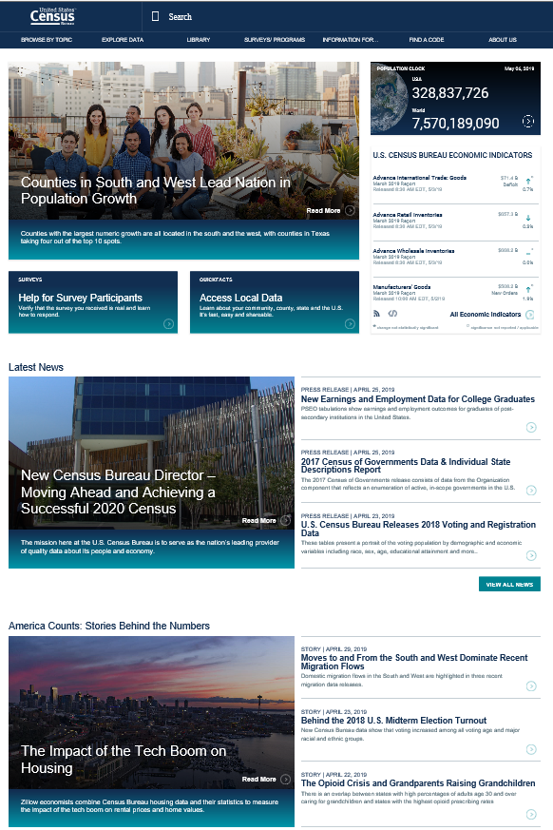
About the Census Bureau
The U.S. Census Bureau is the federal government’s largest statistical agency.
We conduct more than 130 censuses and surveys each year, including
  The Decennial Census – the once-a-decade population and housing count of the United States
  The American Community Survey – the ongoing annual survey of the nation’s population
  The Census of Governments – identifies the scope and nature of the nation's state and local government sector
  The Economic Census – the official five-year measure of American business
Our mission is to serve as the leading source of quality data about America’s people, places, and economy.
https://www.census.gov/
AZ SDC meeting | Oct 2021| 2

Slide 3

Monthly
and Quarterly
Surveys
Annual Surveys
Economic Census – Every 5 years
Census Economic Surveys
Census Bureau Economic Surveys are a key source for official statistics companies can use:
  Monthly and Quarterly are small sample surveys that provide the most TIMELY data available
  Annual surveys have larger samples and provide the most up-to-date TREND data available
  Every 5 years, the Economic Census measures all businesses and provides the most COMPREHENSIVE data available
These surveys set the standard for U.S. economic statistics, and are fueled by the data provided by individual businesses
AZ SDC meeting | Oct 2021| 3

Slide 4
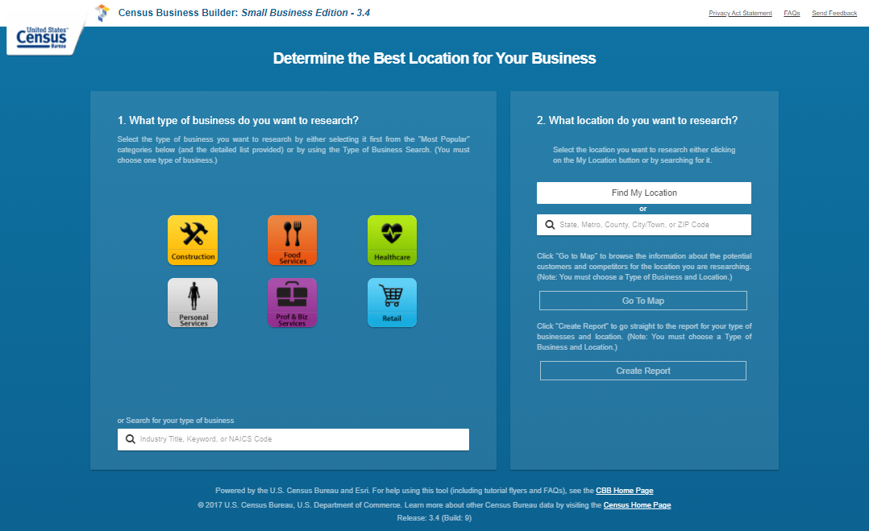
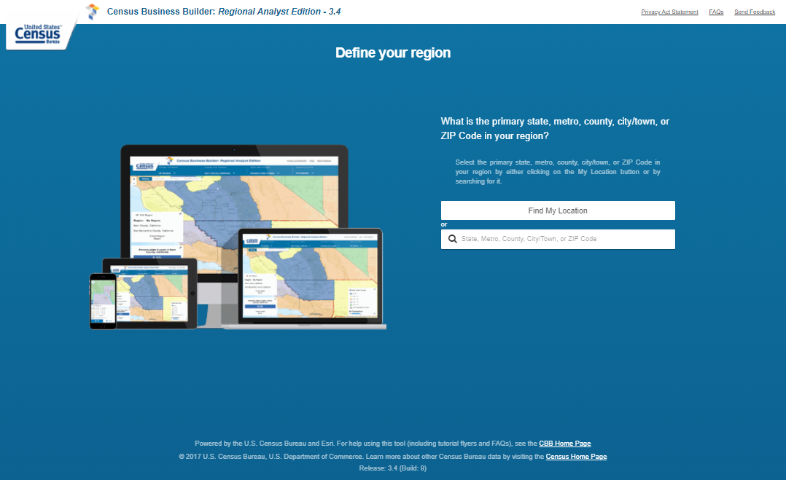
Business Data in CBB
County Business Patterns
  Estabs, Emp, Pay down to county
  Estabs by emp size
Nonemployer Statistics
  Firms and Sales down to county
Economic Census
  Revenue down to place
Quarterly Workforce Indicators
  Workforce down to county
BLS Quarterly Census of Employment and Wages
USDA Census of Agriculture
Census Business Builder
v. 3.4
(4.0 coming late Oct)
CBB Home Page
https://www.census.gov/data/data-tools/cbb.html
AZ SDC meeting | Oct 2021| 4

Slide 5
Selected Economic Census Links for Arizona
Core Stats by Industry and Geography: https://data.census.gov/cedsci/table?g=0400000US04&y=2017&d=ECN%20Core%20Statistics%20Summary%20Statistics%20for%20the%20U.S.,%20States,%20and%20Selected%20Geographies%3A%202017&tid=ECNBASIC2017.EC1700BASIC
Industry by Products: https://data.census.gov/cedsci/table?q=&g=0400000US04&y=2017&d=ECN%20Core%20Statistics%20Economic%20Census&tid=ECNNAPCSIND2017.EC1700NAPCSINDPRD
Comparative (NEW): https://data.census.gov/cedsci/table?g=0400000US04&y=2017&d=ECN%20Core%20Statistics%20All%20Sectors%3A%20Comparative%20Statistics%20for%20the%20U.S.,%20States,%20and%20Selected%20Geographies%20%28Previous%20NAICS%20Basis%29&tid=ECNCOMP2017.EC1700COMP
Franchise (NEW): https://data.census.gov/cedsci/table?g=0400000US04&y=2017&d=ECN%20Core%20Statistics%20Selected%20Sectors%3A%20Franchise%20Status%20for%20the%20U.S.%20and%20States&tid=ECNFRAN2017.EC1700FRAN
16 Additional Sector-Specific Tables
AZ SDC meeting | Oct 2021| 5
Notes:
Just compled GAS releases on 8/20… EARLY!

Slide 6
Selected County Business Patterns, Nonemployer Statistics, and Business Dynamics Statistics Links for Arizona
CBP
  Number of Establishments, Employment and Payroll by Industry, Geography, Employment Size of Establishments, and Legal Form of Organization: https://data.census.gov/cedsci/table?g=0400000US04&y=2019&d=ECNSVY%20Business%20Patterns%20County%20Business%20Patterns&tid=CBP2019.CB1900CBP
NES
  Number of Firms and Sales by Industry, Geography, and Sales Size: https://data.census.gov/cedsci/table?g=0400000US04&y=2018&d=ECNSVY%20Nonemployer%20Statistics&tid=NONEMP2018.NS1800NONEMP
BDS (New in data.census.gov)
  Number of Firms and Establishments and Employment by Industry, Geography, and Establishment Age: https://data.census.gov/cedsci/table?g=0400000US04&y=2018&d=ECNSVY%20Business%20Dynamics%20Statistics&tid=BDSTIMESERIES.BDSEAGE
  12 Additional Tables, including ones by Firm Age, Size, and Initial Size
AZ SDC meeting | Oct 2021| 6
Notes:
Just compled GAS releases on 8/20… EARLY!

Slide 7
Selected Annual Business Survey Links for Arizona
Basic Stats by Industry and Geography by Race/Ethnicity/Gender/Veteran: https://data.census.gov/cedsci/table?g=0400000US04&y=2018&d=ECNSVY%20Annual%20Business%20Survey%20Annual%20Business%20Survey&tid=ABSCS2018.AB1800CSA01
Basic Stats by Industry and Geography by Race/Ethnicity/Gender/Veteran and Years in Business: https://data.census.gov/cedsci/table?g=0400000US04&y=2018&d=ECNSVY%20Annual%20Business%20Survey%20Annual%20Business%20Survey&tid=ABSCS2018.AB1800CSA02
Basic Stats by Industry and Geography by Race/Ethnicity/Gender/Veteran and Receipts Size: https://data.census.gov/cedsci/table?g=0400000US04&y=2018&d=ECNSVY%20Annual%20Business%20Survey%20Annual%20Business%20Survey&tid=ABSCS2018.AB1800CSA03
Basic Stats by Industry and Geography by Race/Ethnicity/Gender/Veteran and Employment Size: https://data.census.gov/cedsci/table?g=0400000US04&y=2018&d=ECNSVY%20Annual%20Business%20Survey%20Annual%20Business%20Survey&tid=ABSCS2018.AB1800CSA04
22 Additional Tables, including ones on both Business and Owner Characteristics and a number of ones on Technology
TIP: 2018 data are for the state and broad categories. 2017 data are down to place and more detailed breakouts!
AZ SDC meeting | Oct 2021| 7
Notes:
Just compled GAS releases on 8/20… EARLY!

Slide 8
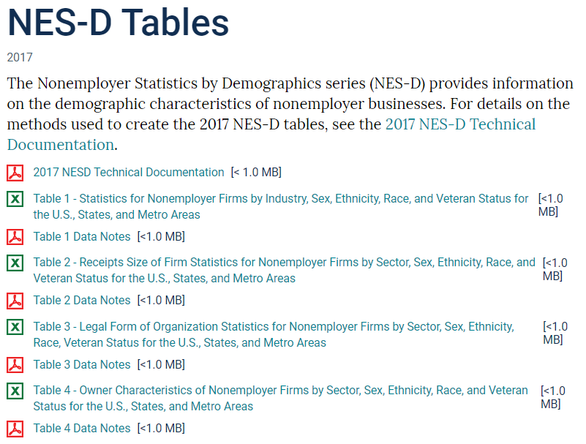
The Nonemployer Statistics – Demographics Program
Enhances the ABS by providing annual data on the demographic characteristics of nonemployer businesses
Data on business ownership by race, ethnicity, gender, and veteran status for self-employed persons
Geographies
  Nation, State, and Metro by selected 2- thru 6-digit NAICS
Firm size and LFO data too
See https://www.census.gov/programs-surveys/abs/data/nesd.html

Slide 9
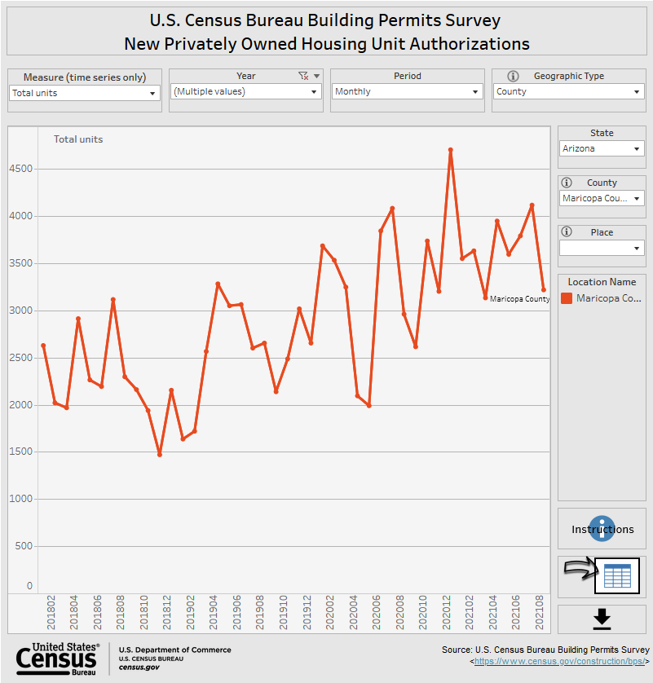
Economic Indicators
17 Census Bureau surveys that provide key economic statistics for nearly every sector
  Monthly, including the Monthly Retail Trade Survey
  Quarterly, including the Quarterly Services Survey
Sample surveys
Shown at the national level only, except:
  Building Permits (state, permit issuing areas)
  International Trade data
  Some new Experimental Data Products
Released on the Economic Indicators Briefing Room and FRED: www.census.gov/economic-indicators/index.php (NEW) https://fred.stlouisfed.org/
How Can This Help Me?
Indicators provide most timely data that helps users understand changes since last annual program
Fun Fact: Privately-owned housing unit authorizations in Maricopa County peaked at 4,704 in Dec 2020 and were at 3,218 in Aug 2021
Notes:
Indicators provided first glimpse into impacts of pandemic on businesses; SBPS adds more info

Slide 10
International Trade
A Census Bureau program that provide monthly and annual U.S. exports and imports statistics
Data reported via ACE AESDirect and Customs and Border Protection documents
Data shown at the national, state, district, and port levels
Data provided by NAICS (Ag, Mining, and Manufacturing sectors only), Commodity, and Country of origination and destination
Census Bureau also issues export regulations from the U.S.
See census.gov/foreign-trade/data/index.html for more info
See USA Trade Online (https://usatrade.census.gov/ ) for the data
Trade flyer
Fun Fact: $491.7 million worth of beer was imported thru the port of Nogales in 2021 (thru Aug).
Notes:
Trade data a key source of info on potential markets
Census is the official source of this data (not ITA, USTR...)
Approx. 18,000 classification numbers used to classify imported and exported products (much more detailed then NAICS)

Slide 11
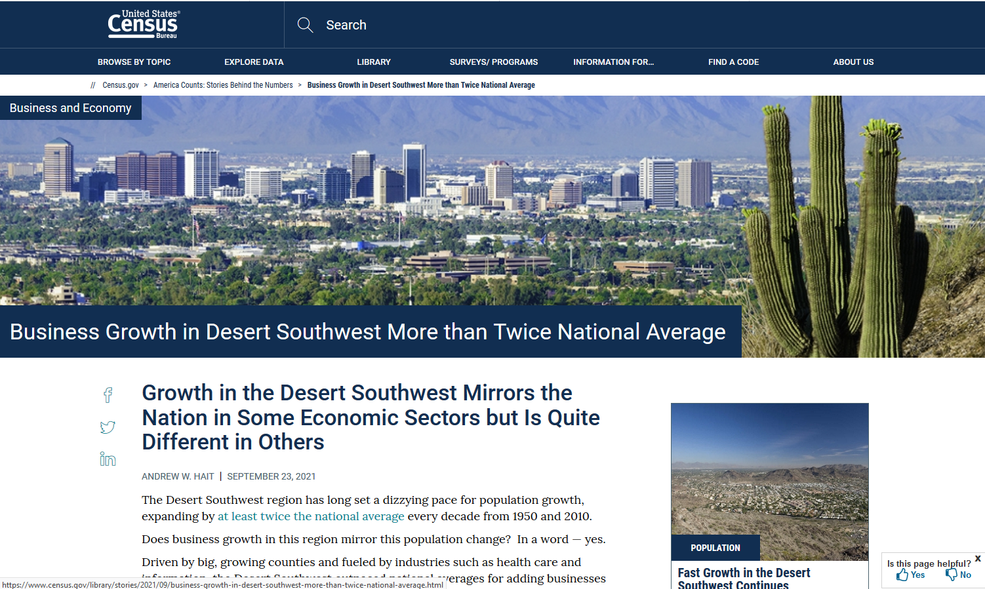
https://www.census.gov/library/stories/2021/09/business-growth-in-desert-southwest-more-than-twice-national-average.html
AZ SDC meeting | Oct 2021| 11
Notes:
Just compled GAS releases on 8/20… EARLY!

Slide 12
COVID Data and Tools
AZ SDC meeting | Oct 2021| 12
Notes:
Just compled GAS releases on 8/20… EARLY!

Slide 13
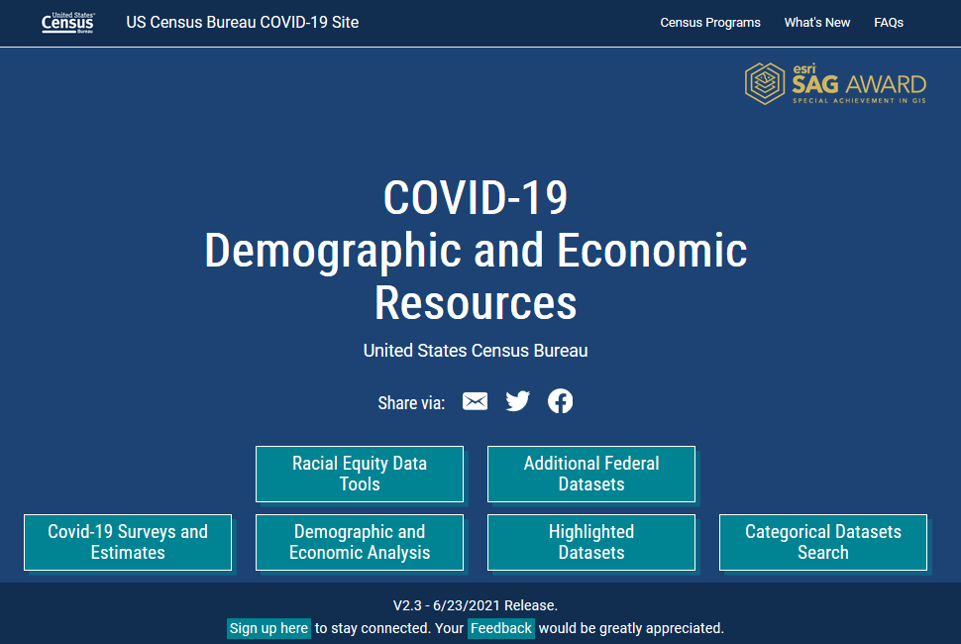
COVID-19 Hub
https://covid19.census.gov/
https://www.census.gov/topics/preparedness/events/pandemics/covid-19.html
AZ SDC meeting | Oct 2021| 13

Slide 14
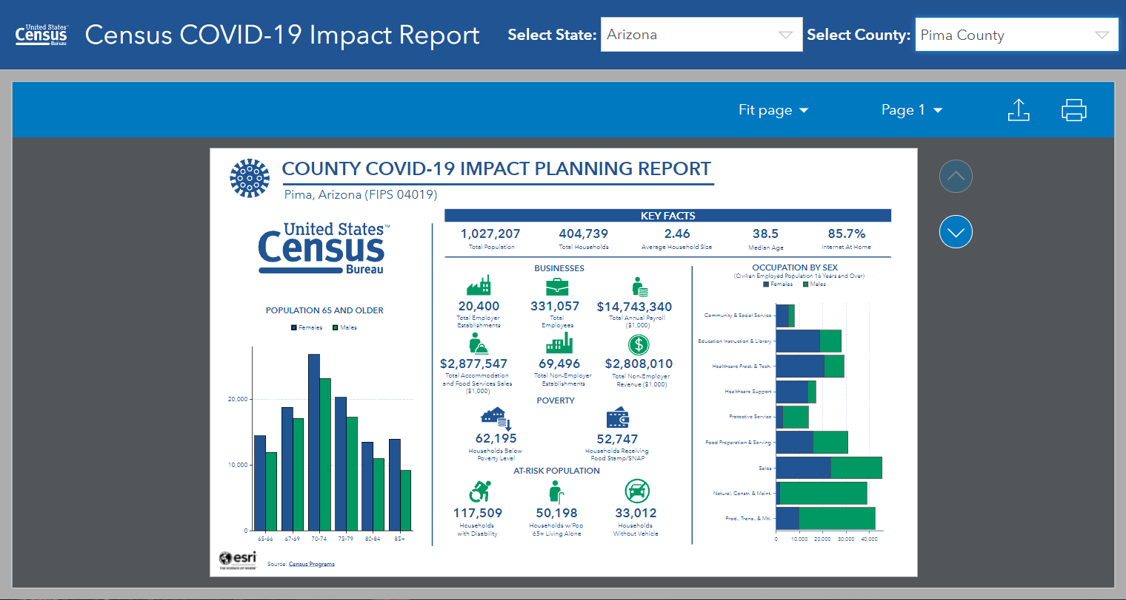
The Hub includes Interactive Dashboards, Policy Maps, and Downloadable Resources
AZ SDC meeting | Oct 2021| 14

Slide 15
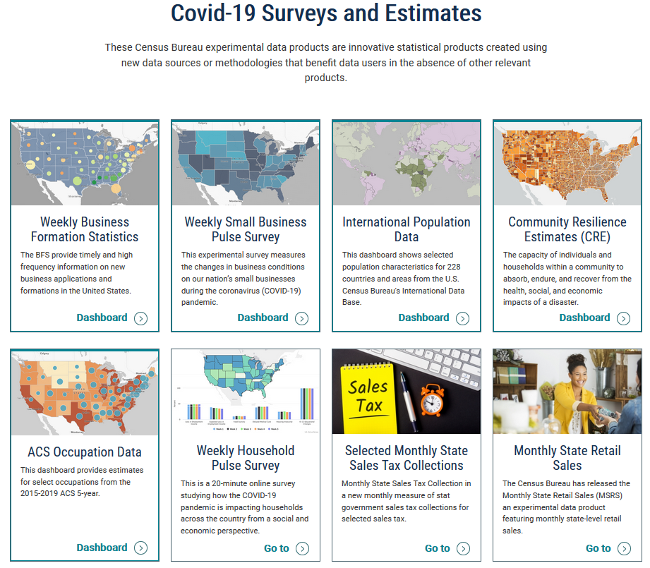
Access to Interactive Dashboards and Web Sites for COVID-Specific Programs

Slide 16
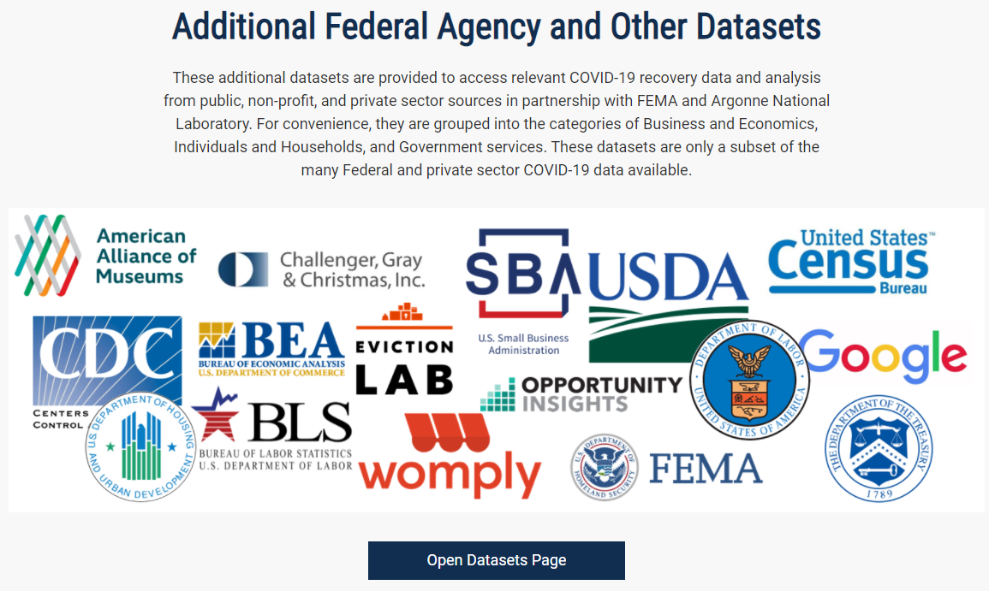
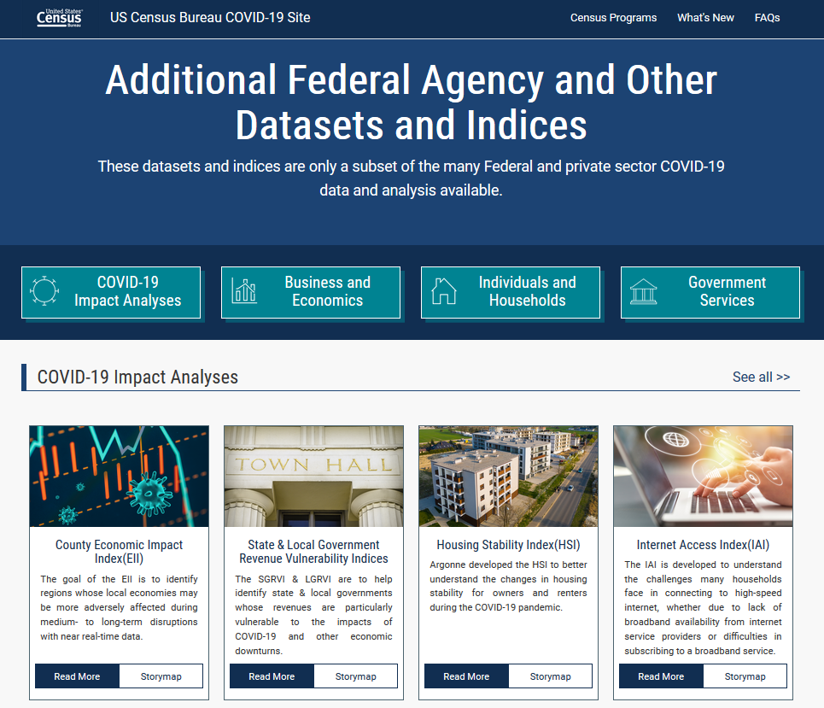
Additional Datasets
Notes:
This is the brand new part of the hub… access to other covid data. It’s just links… none of this data are actually on the Hub, but that might change…

Slide 17
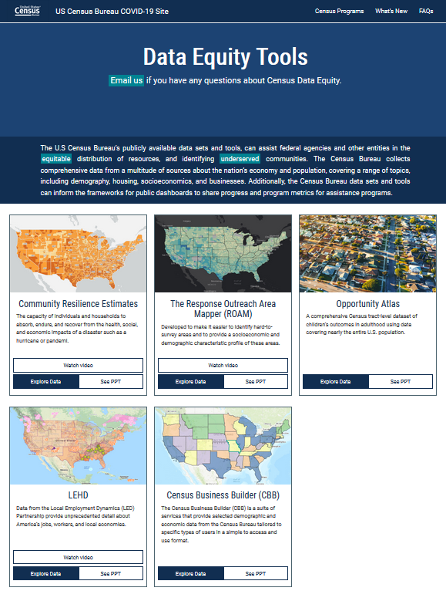
New Data Equity Tools
Provides links to 5 programs or data tools that can assist users equitably distribute resources to underserved communities
We Want Your Feedback!
What are we doing well?
What is the Hub missing that we should add?
How are you using this resource in your work?
Notes:
This is the brand new part of the hub… access to other covid data. It’s just links… none of this data are actually on the Hub, but that might change…

Slide 18




Q & A and Thank You!
Contact me at:
Andrew.W.Hait@census.gov
(301)763-6747
AZ SDC meeting | Oct 2021| 18

