Slide 1
Optimizing your LinkedIn profile

Slide 2
Why do you want to be on LinkedIn?
Is it to enhance your brand and creditability?
Connect with your target audience to grow your business?
Looking for investors or funding, even joint venture partners?
Build your network?
Stay top of mind and be seen as the expert in your field?
Looking for a job?
Leverage industry professionals?
Seek out speaking gigs?

Slide 3
7 Habits of Highly Successful LinkedIn Users.
They invest their time strategically by putting fresh content on LinkedIn
They use their status update to post something new every 24 to 48 hours and 80% of those updates include a link with a call to action.
They answer target-specific questions that are related to their target market
They change their profile every 4 to 6 months
They answer every LinkedIn email and InMail
They post their company events on the events application provided by LinkedIn and use this to measure interest and involvement for such things as conferences, webinars, or seminars.
They have identified their target markets and goals on LinkedIn and execute their plan every day.

Slide 4
Create a Captivating Banner
Notes:
Your banner should be your elevator pitch with minimal words

Slide 5
Select a Professional Profile Photo
Notes:
A high-quality, professional profile photo significantly impacts first impressions. Ensure the image is clear, with a plain background, and that you are dressed appropriately for your industry. Your face should occupy about 60% of the frame to make the photo both professional and personable.
Put yellow or green around your picture.
Make sure your photo is professional

Slide 6
Craft a Compelling Headline
Notes:
Your headline is one of the first elements visitors notice. Instead of merely listing your current job title, create a headline that highlights your unique value proposition and expertise. For example, instead of "Marketing Manager," consider "Strategic Marketing Manager Specializing in Digital Campaigns and Brand Development."
Maximize your keywords every chance you get
Use every character allowed when developing your headline
Most people will only look at your banner, photo, and headline to make the decision to click through to your profile page or website

Slide 7
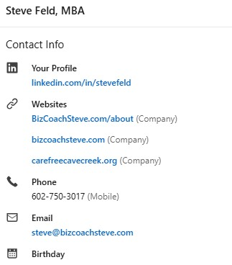
Complete Your Contact Information
Notes:
Links to your website, social media profiles, e-commerce are extremely important

Slide 8
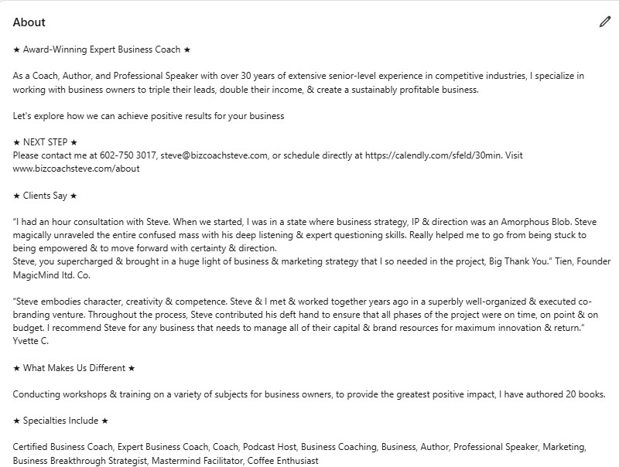
Develop an Engaging Summary
Notes:
The "About" section is your opportunity to tell your professional story. Write a concise and engaging summary that showcases your career journey, key achievements, and what drives you professionally. Incorporate relevant keywords to enhance searchability, but ensure the narrative remains natural and authentic.
This is your long-form sales pitch
Make sure the first 2 sentences make people want to click to see MORE
Focus on your ideal client’s WIIFM when you write this

Slide 9
Simple Summary Template fill in the blank example
WHAT I DO: I help [MY TARGET AUDIENCE] achieve [THEIR GOAL] by providing [MY PRODUCT/SERVICE].
WHO I WORK WITH: I partner with [TARGET AUDIENCE or INDUSTRY TYPE] including: [INSERT BULLETED “EMOJI” LIST OF JOB TITLES, INDUSTRY NAMES, etc.]
WHERE YOU’VE SEEN ME: [INSERT BULLETED “EMOJI” LIST OF MEDIA LOGOS or BIG-NAME CLIENT LOGO]
SERVICES I PROVIDE: [INSERT BULLETED “EMOJI” LIST OF SERVICES YOU PROVIDE, etc.]
WHAT MAKES ME UNIQUE: [Answer that question! What makes you unique/different/better than your competitors? XYZ years of experience? Certifications/Patents/etc.? Personal, 1-on-1 attention and Customer Service/ Support?]
WHAT OTHERS SAY: [COPY AND PASTE IN 2-3 TESTIMONIALS IN THIS AREA. USE A REAL PERSON, FULL NAME, COMPANY NAME, ETC. AND EXPLAIN SPECIFIC VALUE/BENEFIT THE PERSON RECEIVED FROM YOU OR YOUR BUSINESS.]
READY TO TALK? Reach out to me directly here on LinkedIn or [visit me online at URL or email me at XYZ or call me directly at XYZ].

Slide 10
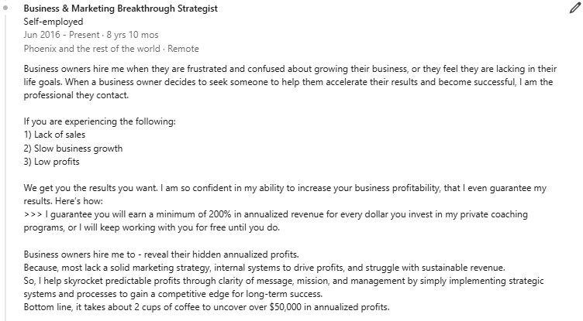
Detail your Experience with Achievements
Notes:
When listing your work experience, focus on accomplishments rather than just responsibilities. Use bullet points to highlight specific achievements, metrics, or projects that demonstrate your impact in previous roles. This approach provides tangible evidence of your skills and contributions.

Slide 11
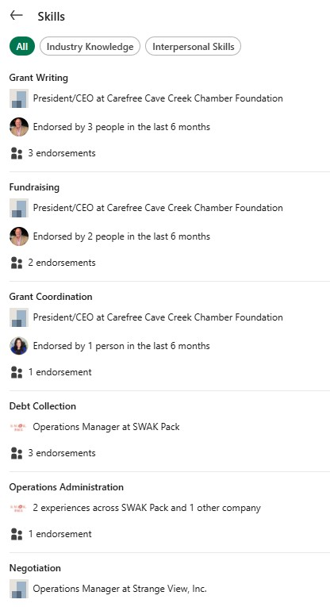
Showcase Your Skills and Endorsements
Notes:
Put skills in every position you have held. Max this out. Put in your skills so people can endorse you.
When you connect with people endorse them for 2-3 skills

Slide 12
Customize Your LinkedIn URL
Notes:
A customized LinkedIn URL enhances your personal brand and makes your profile more shareable. Modify your URL to include your full name or a variation thereof, making it easier for others to find and connect with you.

Slide 13
Expand Your Network
Notes:
Active engagement on LinkedIn increases your visibility. Share industry-relevant articles, comment on posts, and participate in group discussions. Regular interaction not only showcases your expertise but also helps in building a robust professional network.

Slide 14
Invite people you know. Co-workers, colleagues, peers, vendors, customers, friends, etc.
Hi, their first name,
I came across your profile, and it seems we have a few interests and connections in common. I’m expanding my professional network and would love to connect with you, so we can keep in touch.
Looking forward to connecting,
Your name

Slide 15
Connect with influencers in your industry and see what they post, see who engages with their posts, and invite those people to connect.
Hi, their first name,
I liked your comment on X’s post and found it very insightful, and it seems we have a few interests and connections in common. I’m expanding my professional network and would love to connect with you, so we can keep in touch.
Looking forward to connecting,
Your name

Slide 16
Search for your target audience and connect with them
Hi, their first name,
I came across your profile and noticed you like XYZ.
I started doing XYZ 5 years ago.
What got you started in XYZ?
Let’s Connect
Looking forward to connecting,
Your name

Slide 17
Invite your connections to read your content
Hi, first name,
I wrote this article on how to (solve X problem). I would love your feedback on the content. Would you like a link to the article/video?
Please let me know.
Thanks,
Your name

Slide 18
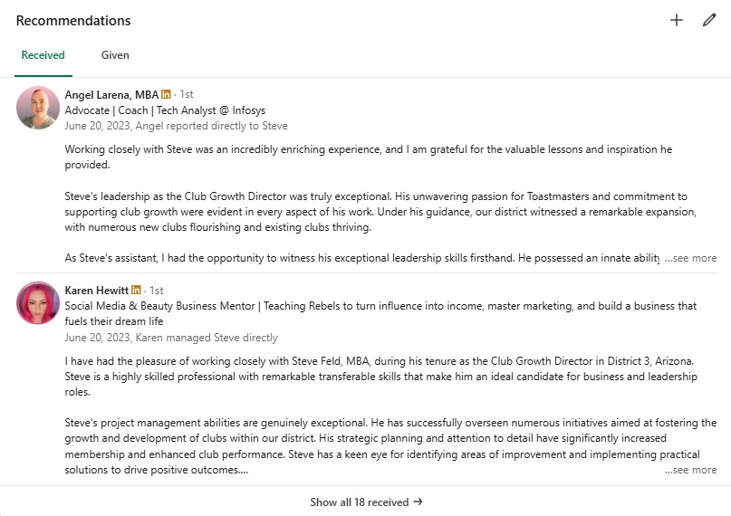
Seek Recommendations
Notes:
Request recommendations from colleagues, supervisors, or clients who can attest to your skills and work ethic. Personal testimonials enhance your credibility and provide social proof of your professional abilities.

Slide 19
Regularly Update Your Profile
Keep your profile current by adding new experiences, certifications, or skills. Regular updates signal to your network that you are active and continually developing professionally.

Slide 20
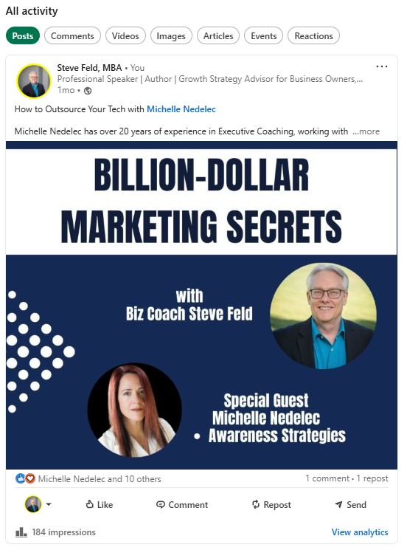
Leverage Multimedia Content
Notes:
Enhance your profile by adding multimedia elements such as videos, presentations, or portfolios. These additions provide a dynamic view of your work and can engage viewers more effectively than text alone.

Slide 21
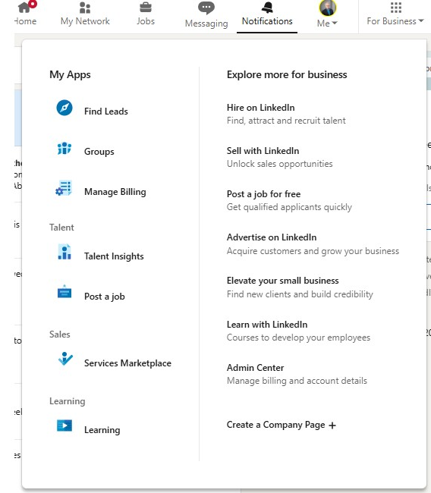
For Business
Notes:
The Dot grid at the upper right of the page opens up so you can manage more of your profile and to find groups and much more

Slide 22
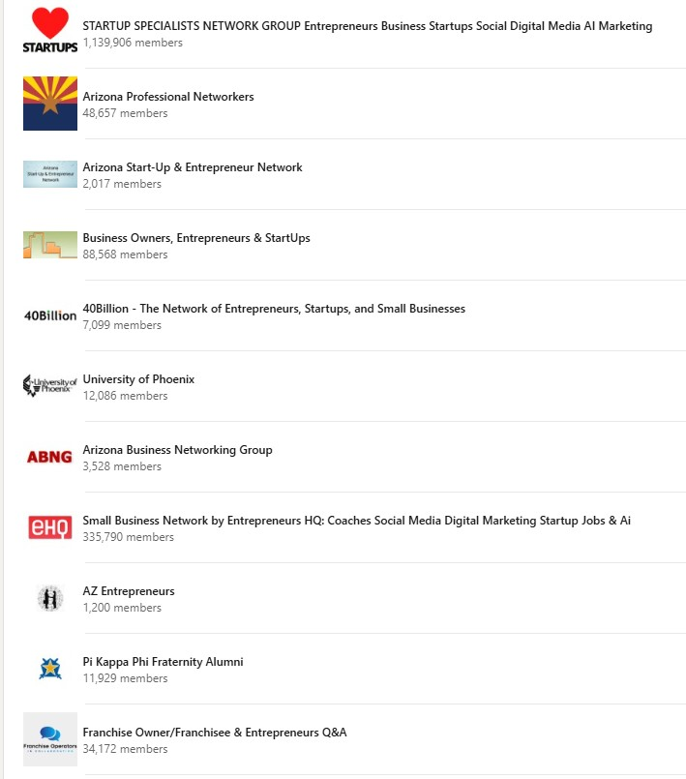
Get into Targeted Groups
Notes:
LinkedIn will use keywords from YOUR profile to suggest some groups for you to join.
Join groups that have your target market in them and/or that are relevant to your business and industry.
Groups you may like could be local.
Pick groups that have many members and high activity
Once you’ve joined the group, engage with posts and add posts of your sown for SEO/Analytics

Slide 23
Connect with your target audience that are in the same groups as you
Hi, their first name,
I noticed we are both in the ABC Group, and it seems we have a few interests and connections in common. I’m expanding my professional network and would love to connect with you, so we can keep in touch.
Looking forward to connecting,
Your name

Slide 24
Search for a company or industry that is your target audience and connect with them.
Hello, their first name,
I see we are in the same industry, and it seems we have a few interests and connections in common. I’m expanding my professional network and would love to connect with you, so we can keep in touch.
Looking forward to connecting,
Your name

Slide 25
Connect with people that comment on your posts and connect with them
Hi, their first name,
Thanks for commenting on my post about ABC.
It seems we have a few interests and connections in common. I’m expanding my professional network and would love to connect with you, so we can keep in touch.
Looking forward to connecting,
Your name

Slide 26
When to Post
For maximizing engagement on LinkedIn, focus on posting during weekdays, particularly Tuesdays, Wednesdays, and Thursdays, between 8 a.m. and 2 p.m., with peak engagement around 11 a.m. to 12 p.m.

Slide 27
Simple tips to be highly successful on LinkedIn
Tell people how you can help them
A picture communicates something relevant to your target market
Current job “title” needs to list your top 3 target market/industry keywords
Website – actual name not “other”
Past jobs – use descriptions that associate with what you do now
Strong summary them what you do and how you can help them
Specialties should be loaded with your top 5 industry keywords matching the current job title
Complete the basic information, focus on education, and work along with your contact information
Likes and showing interest in others will help people associate with you
Have a plan to grow your connections and execute the plan

Slide 28
10 ways to use LinkedIn to promote your business
Create a company profile
Use LinkedIn Polls
Answer a Question
Participate with Groups
Create a Group
Leave a Status Update
Ask for recommendations
Advertise
Post Job Opportunities
Build a company Buzz

Slide 29
5 key items to your profile strategy
A Strong Profile
Building your community
Capturing your audience
Engaging your audience
Streamlining & resources

Slide 30
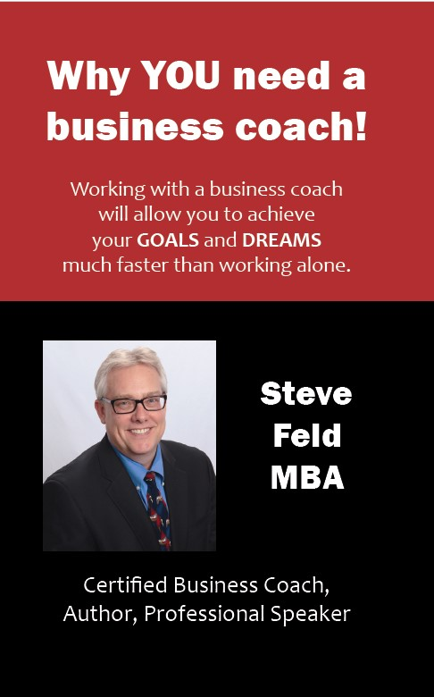
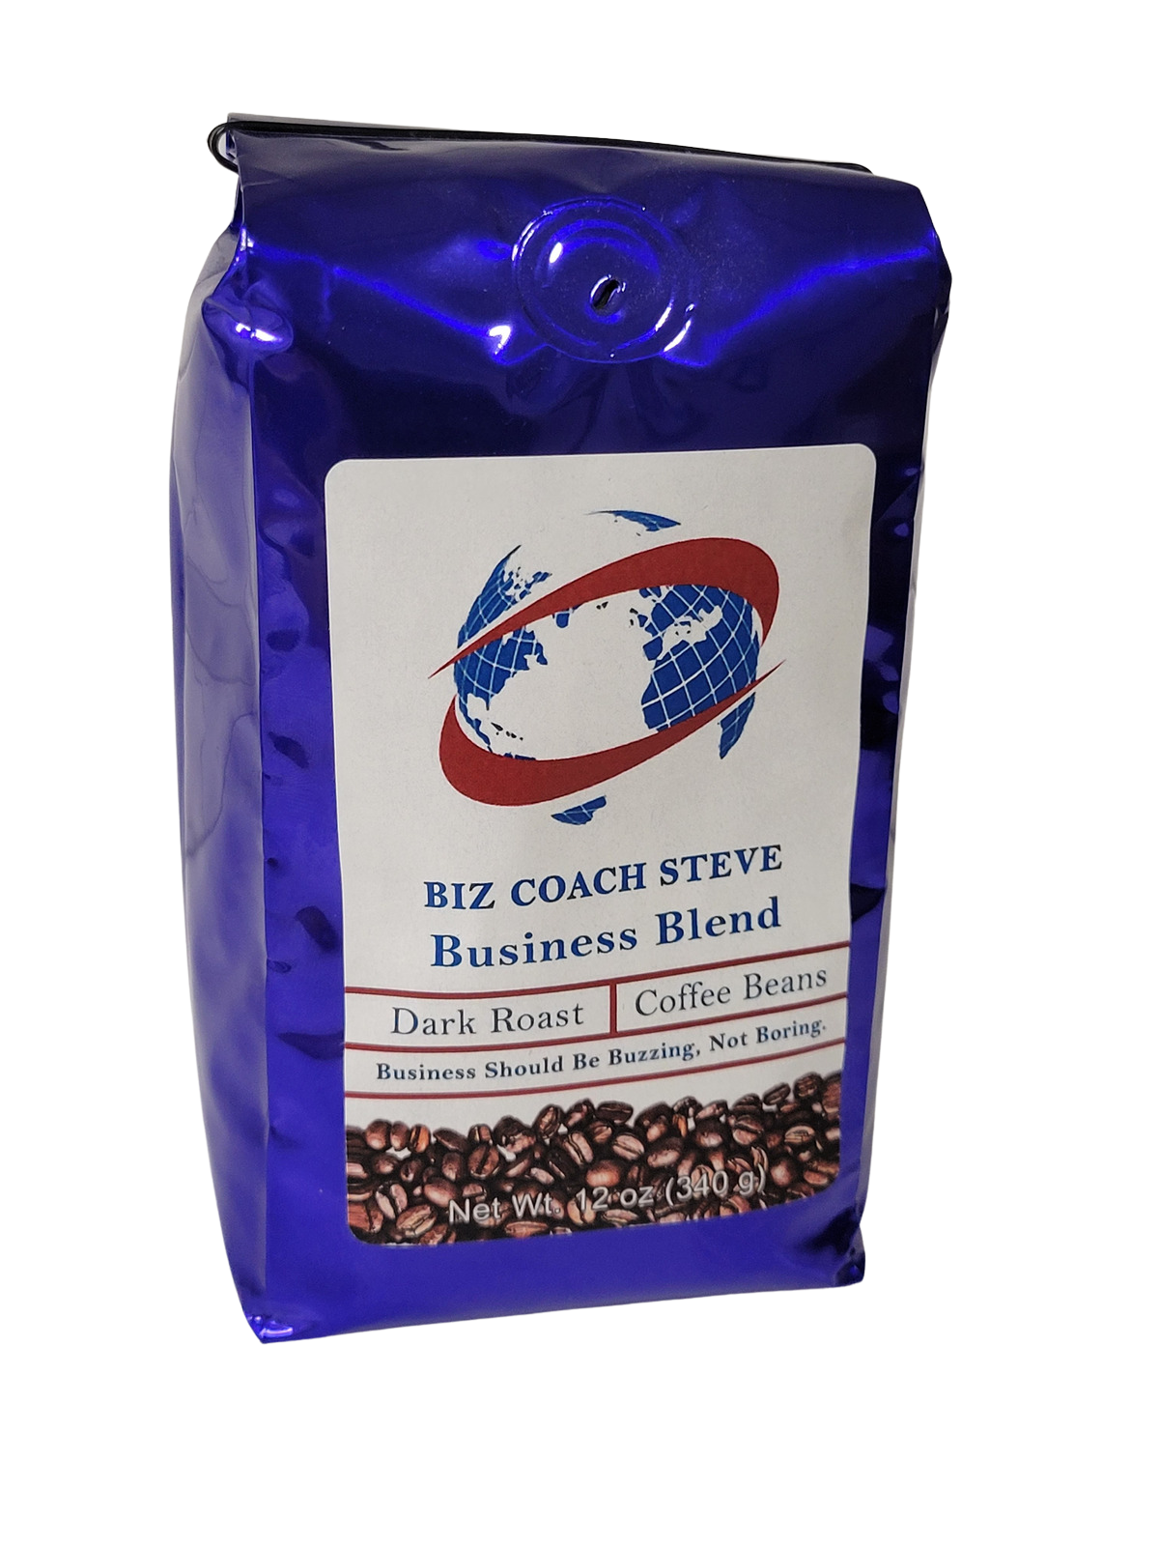
Thank you
Steve Feld
602-750-3017
steve@bizcoachsteve.com
www.bizcoachsteve.com

