Slide 1





Exploring Workforce Trends with the Longitudinal Employer-Household Dynamics Data Tools
October 13, 2022
Presented by: Earlene Dowell
US Census Bureau

Slide 2
Longitudinal Employer-Household Dynamics Program

Slide 3
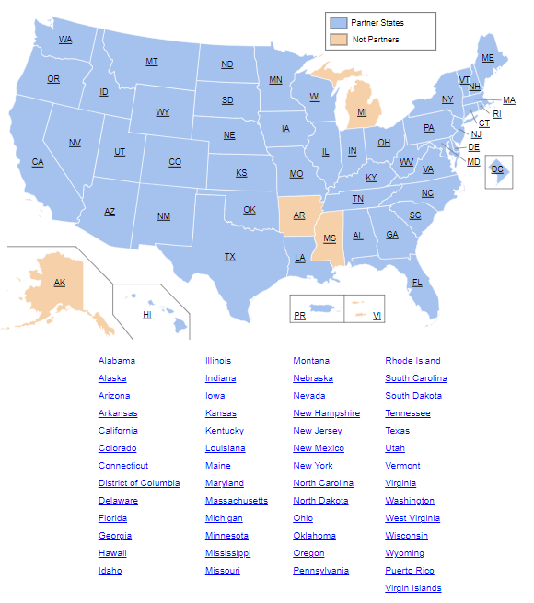
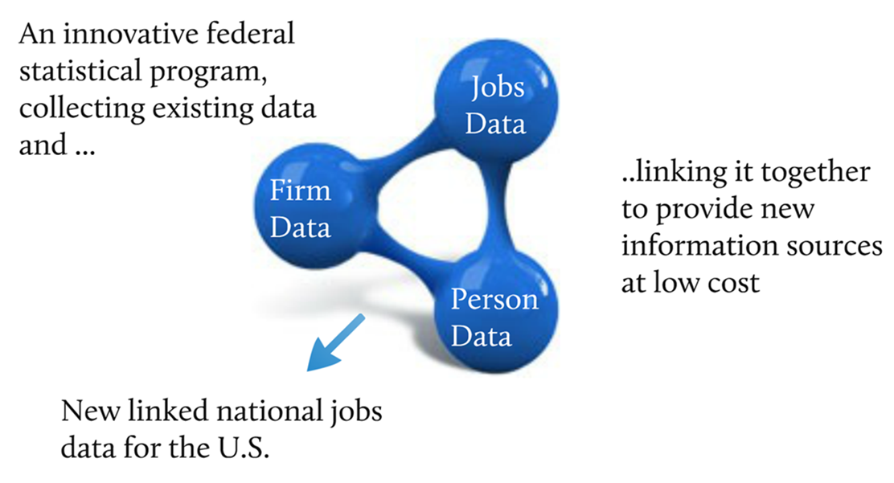
About LEHD
LEHD Program
Notes:
Updates – Mississippi and Michigan talk of reengaging.
2023 LED Partnership Virtual Workshop is in planning stages – possibly March 2023.

Slide 4
LEHD Program
Longitudinal Employer-Household Dynamics (LEHD)
Data Product | Explore the data, answer questions, or get visualizations | Bulk data for use in analysis process/software | Live queries for building web applications
QWI | QWI Explorer | LED Extraction Tool and Raw data download | Census Bureau API
LODES | OnTheMap OnTheMap for Emergency Management | Raw data download LED Extraction Tool – Coming in 2023 | Future development
J2J | J2J Explorer | LED Extraction Tool and Raw data download | Future Development
PSEO | PSEO Explorer | Raw data download | Future Development
VEO | VEO Explorer | Raw data download | Future Development

Slide 5

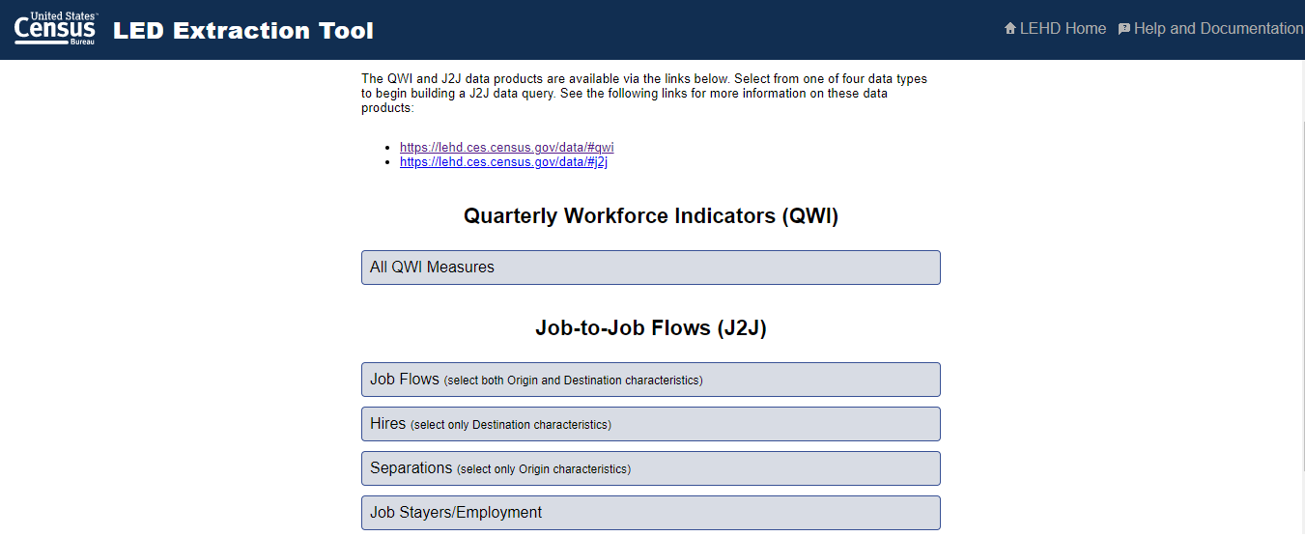
LED Extraction Tool

Slide 6
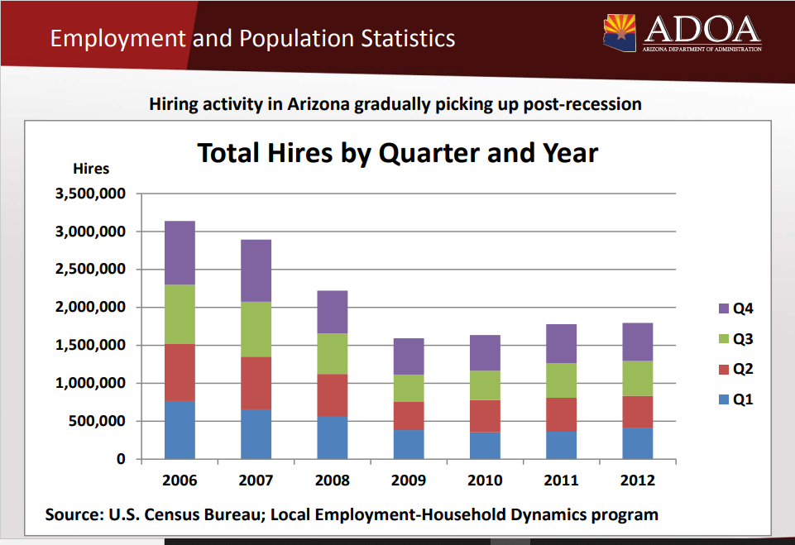
LED in Action

Slide 7
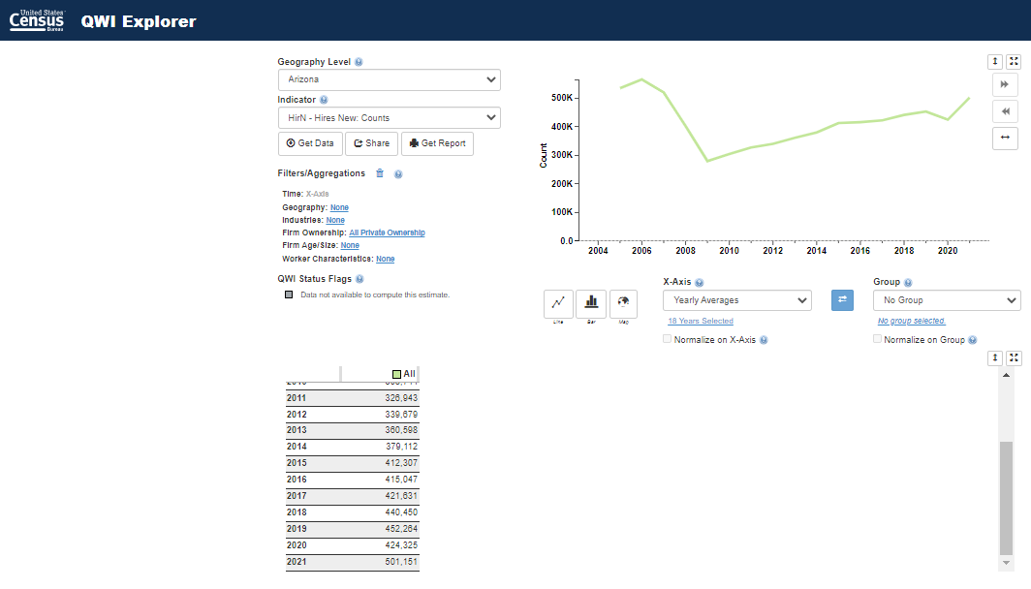
QWI Explorer

Slide 8
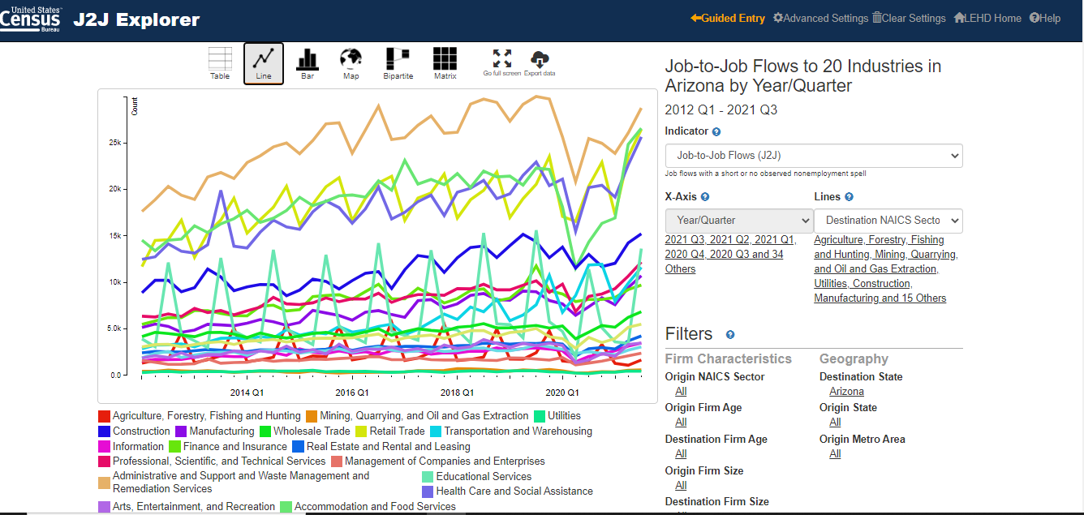
J2J Explorer

Slide 9
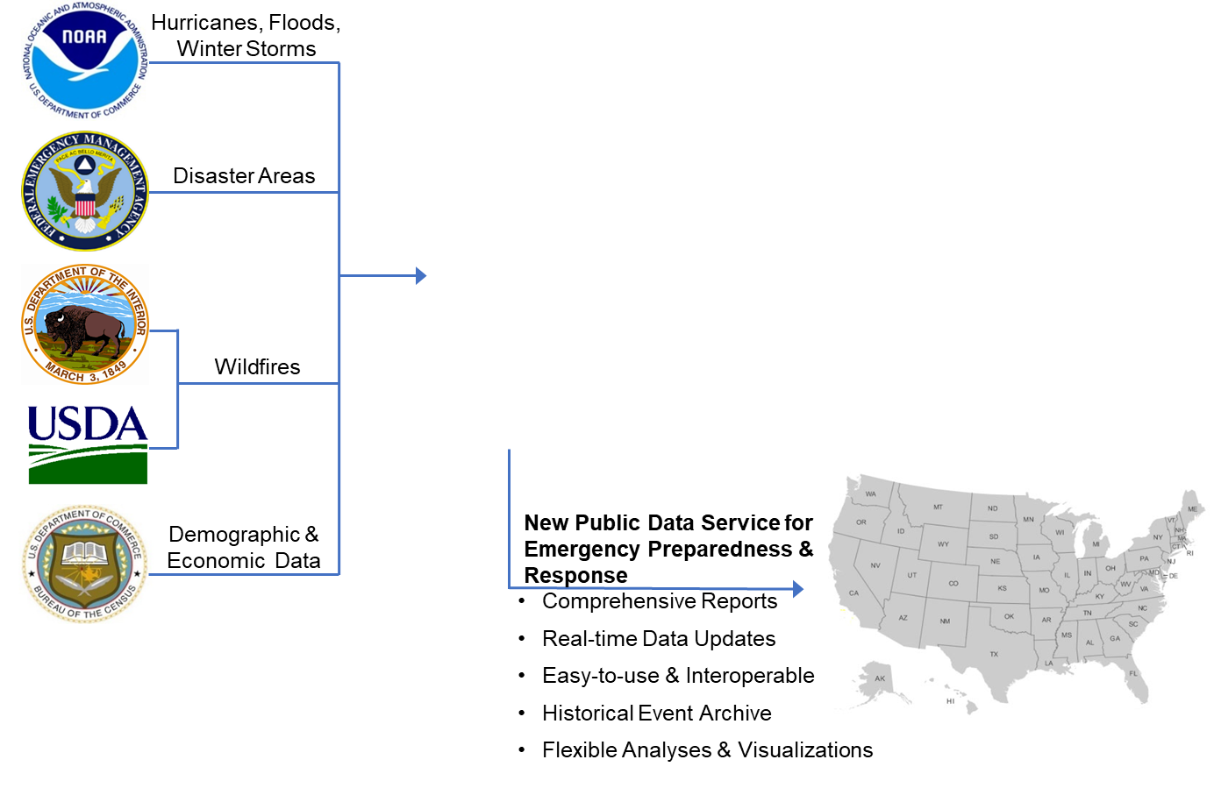
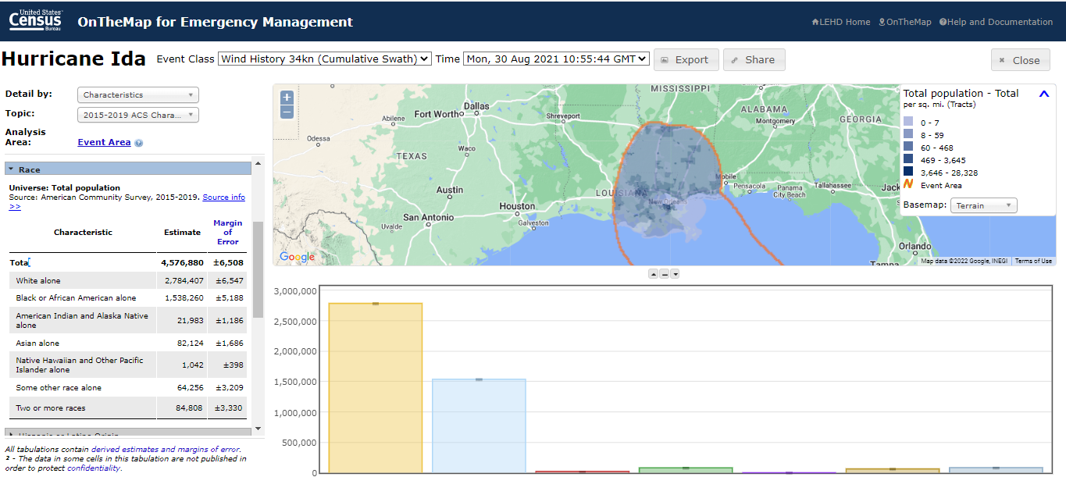
LEHD Program

Slide 10
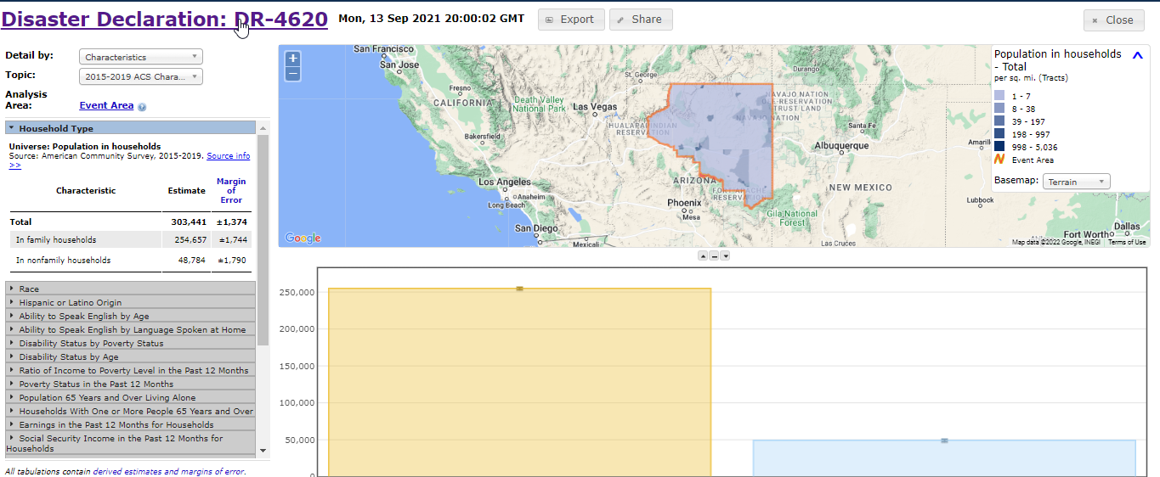
DR-4620

Slide 11
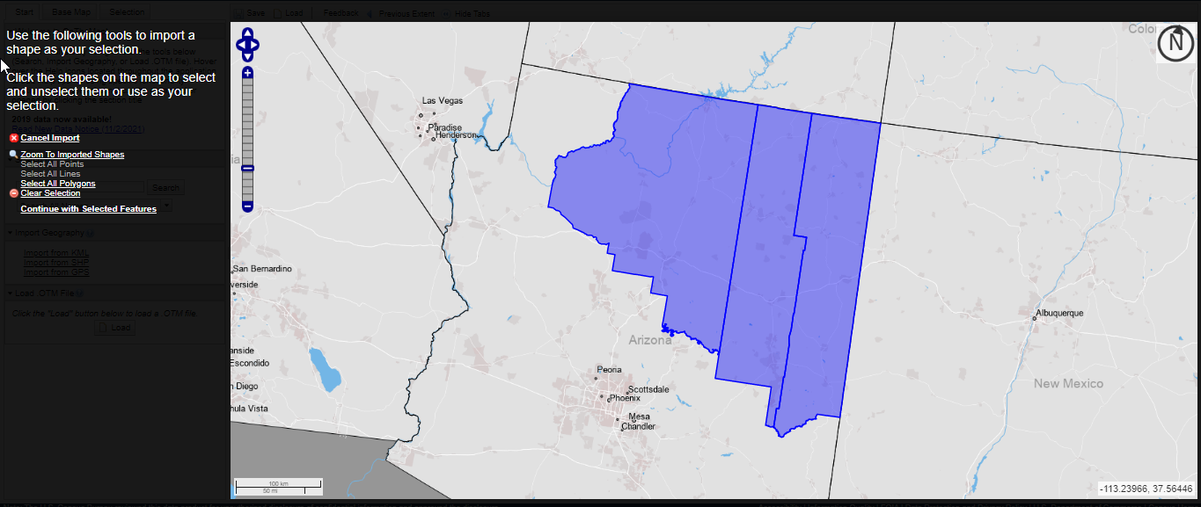
OnTheMap
Notes:
We can use J2J to look at the industries the new hires went into between 2012 – 2021. Look at education

Slide 12

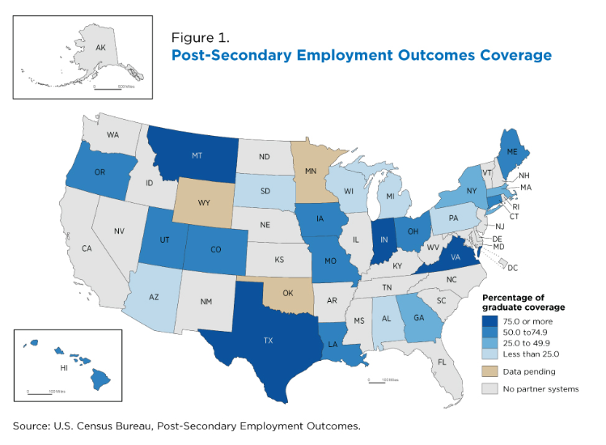

Slide 13
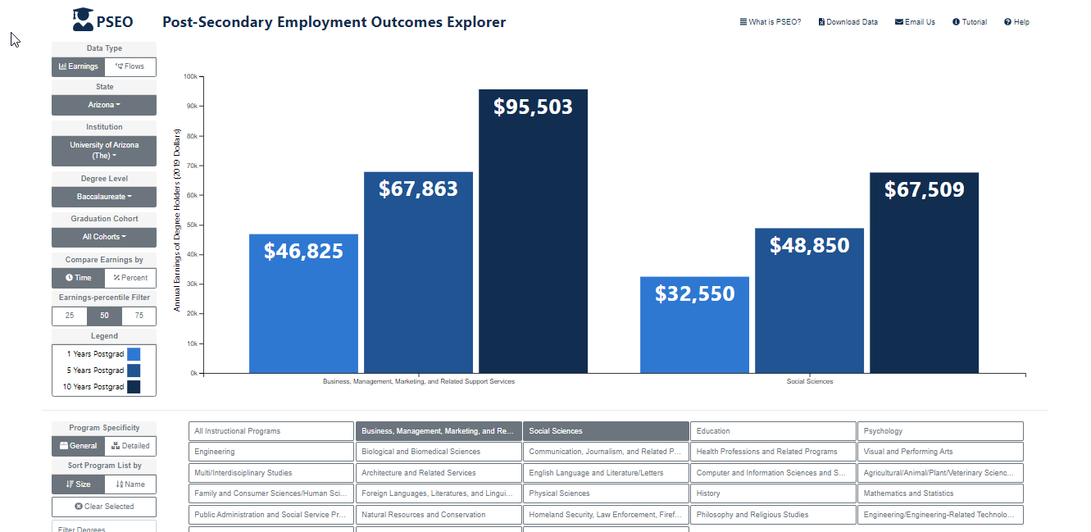
Post-Secondary Employment Outcome Explorer

Slide 14
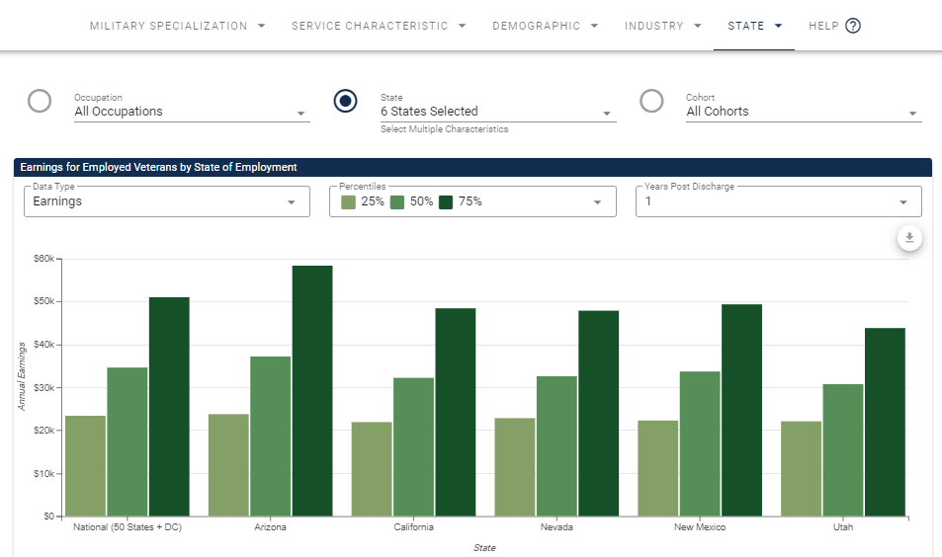
Veteran Employment Outcome Explorer

Slide 15
LEHD Program
Summary and Resources
Help and Documentation
  Quarterly Workforce Indicator
  https://lehd.ces.census.gov/applications/help/qwi_explorer.html#!what_is_qwi_explorer
  Job-to-Job Flows
  https://lehd.ces.census.gov/applications/help/j2j_explorer.html#!what_is_j2j_explorer
  OnTheMap
  https://lehd.ces.census.gov/applications/help/onthemap.html#!getting_started
  OnTheMap for Emergency Management
  https://lehd.ces.census.gov/applications/help/onthemap_em.html#!getting_started
  Post Secondary Employment Outcomes
  https://lehd.ces.census.gov/data/pseo_experimental.html#methodology
  Veteran Employment Outcomes
  https://lehd.ces.census.gov/data/veo_experimental.html

Slide 16



Q & A and Thank You!
Contact Information:
Earlene K.P. Dowell
301-763-9628
earlene.kp.dowell@census.gov
To schedule additional training with a Census Data Dissemination Specialist in your area, please call 844-Ask-Data
Or email us at: census.askdata@census.gov

